Slide 1

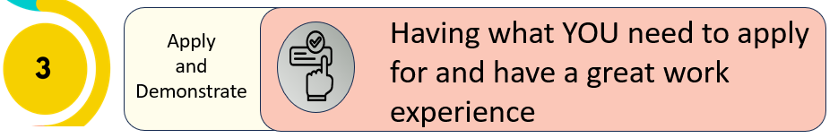


Delivery Notes
Before session 3, ensure the students will be able to download the templates.
All students to have own computer with Internet access.
Deliverer to have whiteboard for presentation.
Timings | Slides | Activity | Notes | Key task
5 mins | 1 - 6 | Refresh and sign in | Workbook
20 mins | 7 - 15 | Composing an email to send to an employer, how to get it to them and following up. |  | Yes
10 mins | 16 | Logistics and scenarios |  | Yes
5 mins | 17 – 19 | Quick intro to CV and where to find the template | Workbook
10 mins | 20 - 21 | Recap and survey | Workbook | Yes
5 mins | 22 - 24 | Wrap up
After session 3, send school summary of what was covered and Digital Postcard for session 3 to send to each students.

Slide 2






Session Three: Welcome back
What do YOU want from life and future work?
Introduce and Inspire
Investigate and Explore
Exploring work experience opportunities and YOUR skills.
Having what YOU need to apply for and have a great work experience
Apply
and Demonstrate

Slide 3
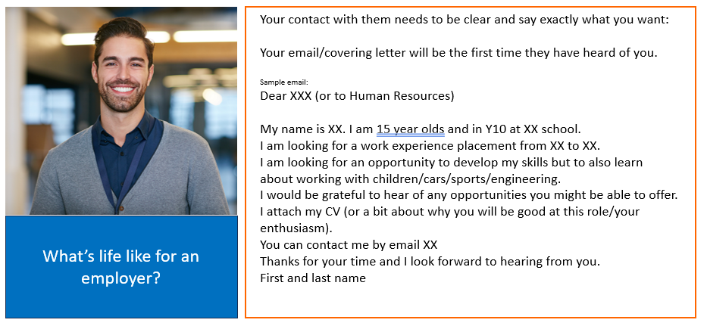
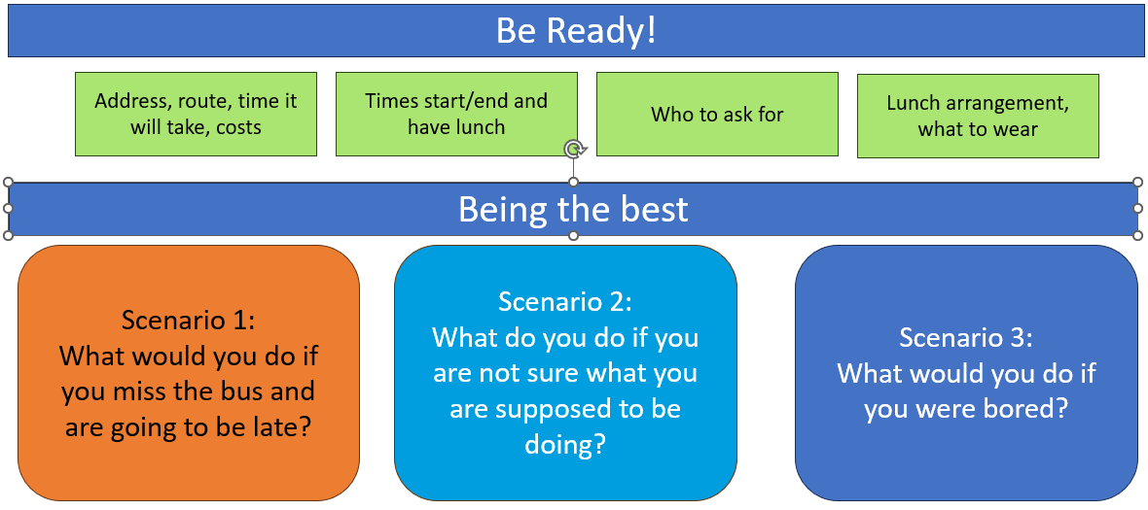
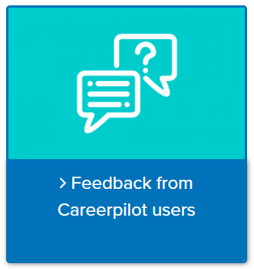
In this session you will:
1
Use a template to write an email to send to an employer or add your skills to a CV
2
Consider how to check organisational arrangements to help you have a successful placement
3
Comment on what you have learnt through a quiz/survey
careerpilot.org.uk

Slide 4
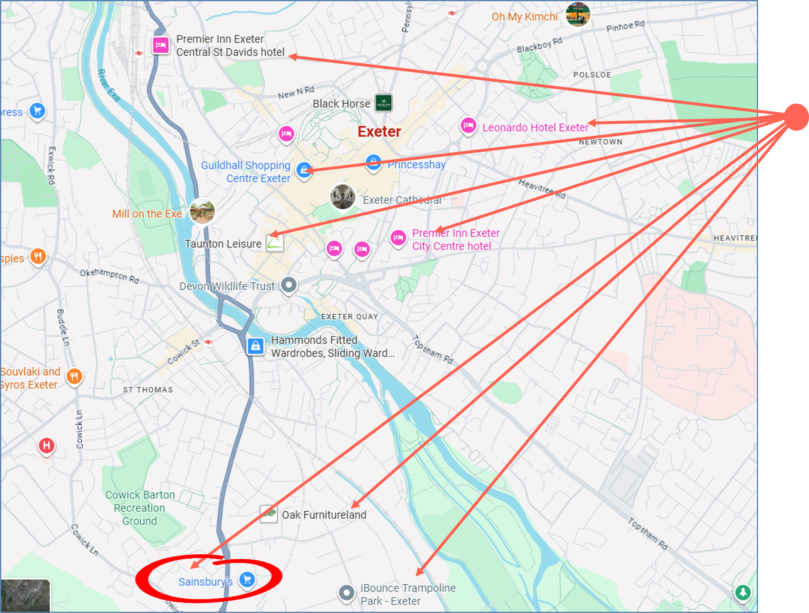
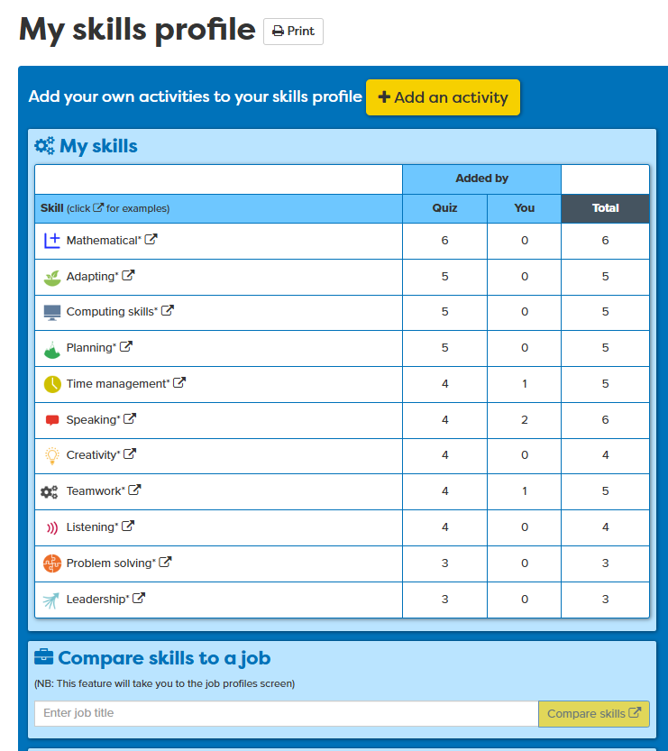

In session 2 you:
You looked at employers near to you
You looked at employers near to you
You identified skills you have already
And matched your skills to a job role

Slide 5

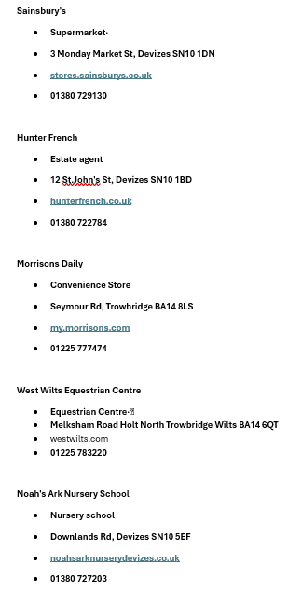
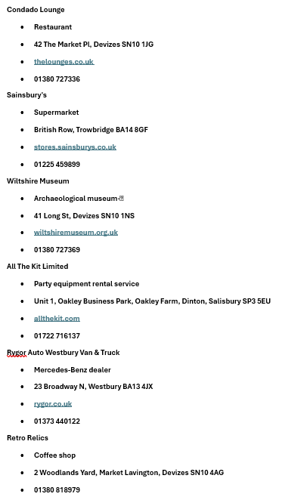
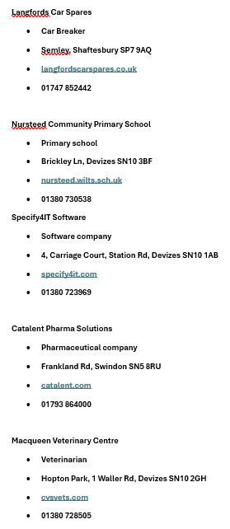
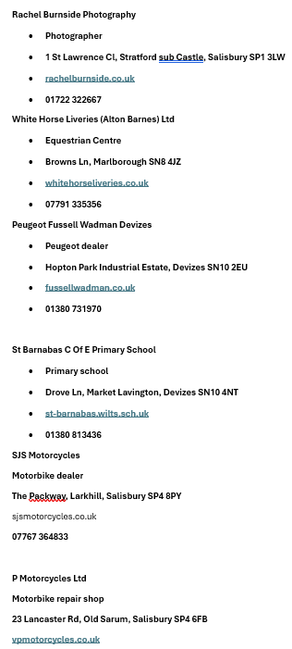
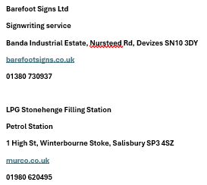
We got a great list of employers you could contact
Notes:
You will need to personalise this for your school.
To be discussed

Slide 6
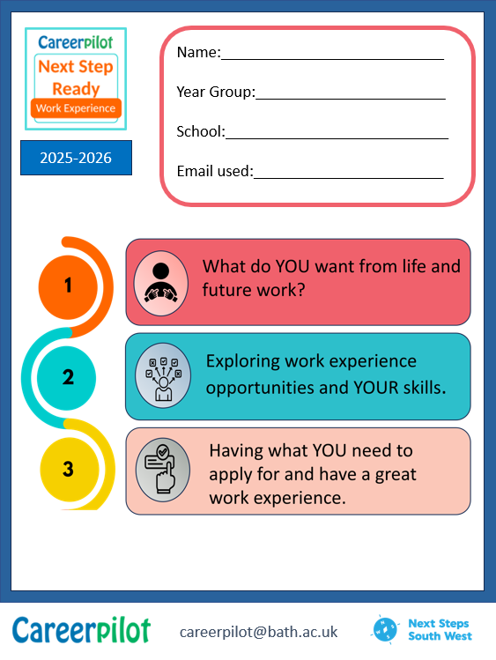

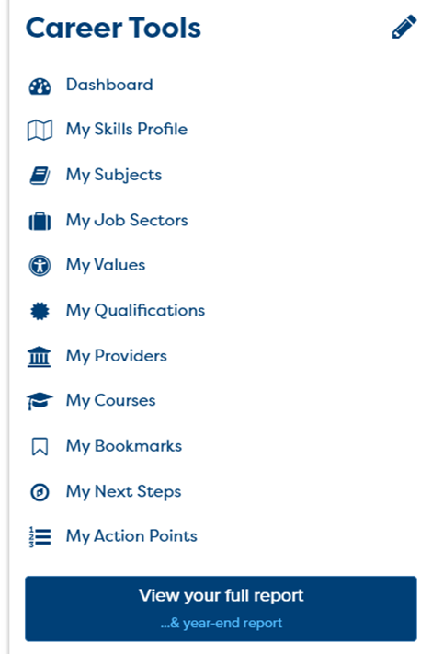
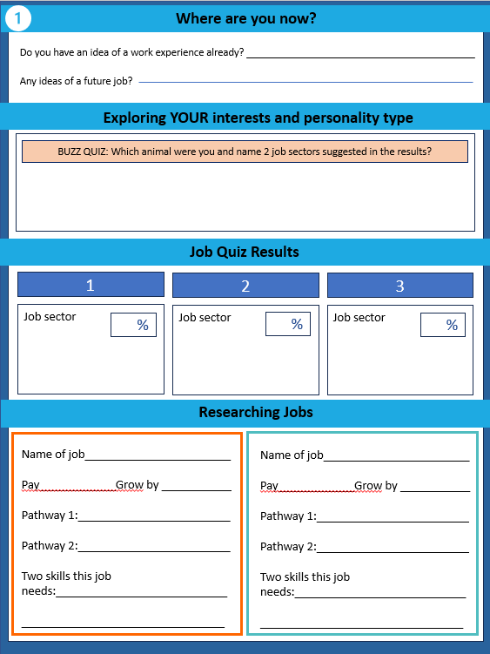
Sign in and review your skills and skills match
5 mins
Notes:
Sign in, review Career Tools, review workbook.

Slide 7

What do you need to get ready for a work experience?
To get a placement
1
Email/covering letter to make contact with employers
2
A CV could be useful, which is a document used when applying for jobs. It allows you to summarise your education, skills and experience
Notes:
Explain will be completing an email to send to an employer – which they can adapt later for a part time job request.
The CV isn’t needed for a Y10 WEX but they can get started now. Not going to do in lesson but will show them where to find an easy template.
Whenever talking to employers good to flag up the skills they have.

Slide 8
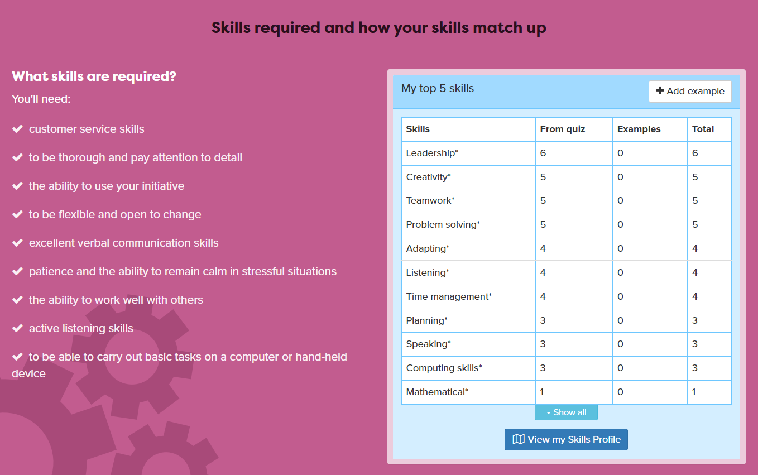
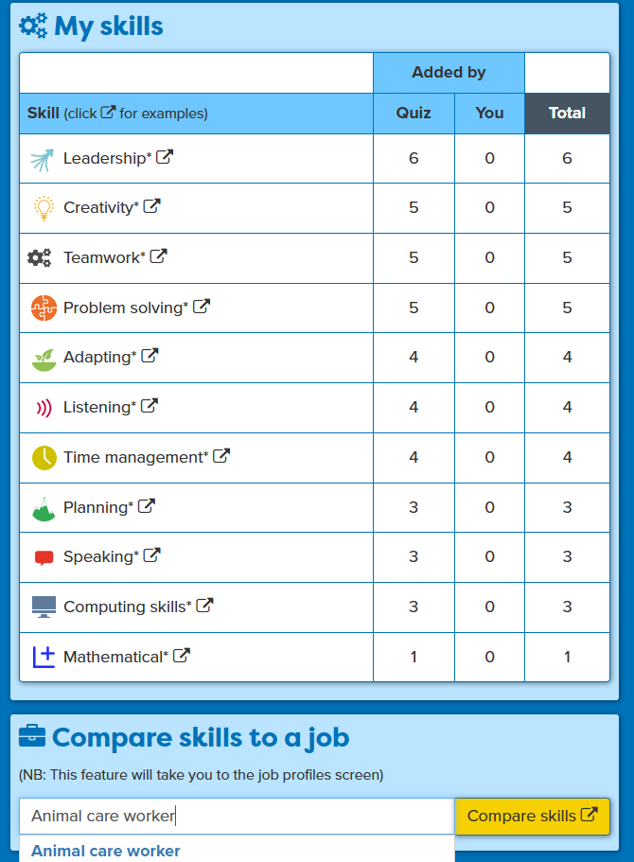
Matching your skills to a job
Notes:
Following session 2 they all have some skills they can mention that match to the sort of job they might do on WEX.
Remind students of this activity from session 2. Ask a few students to say their job role and which 3 or 4 skills they have that the job wants. Get them all to look at this information in their workbooks.

Slide 9
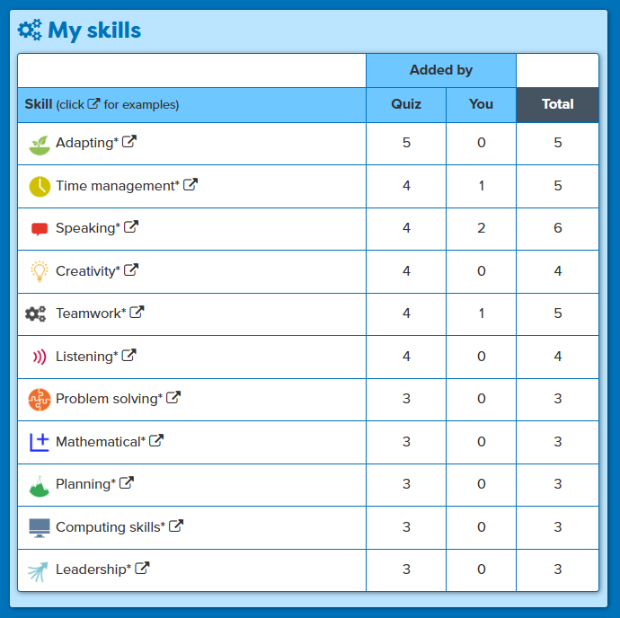
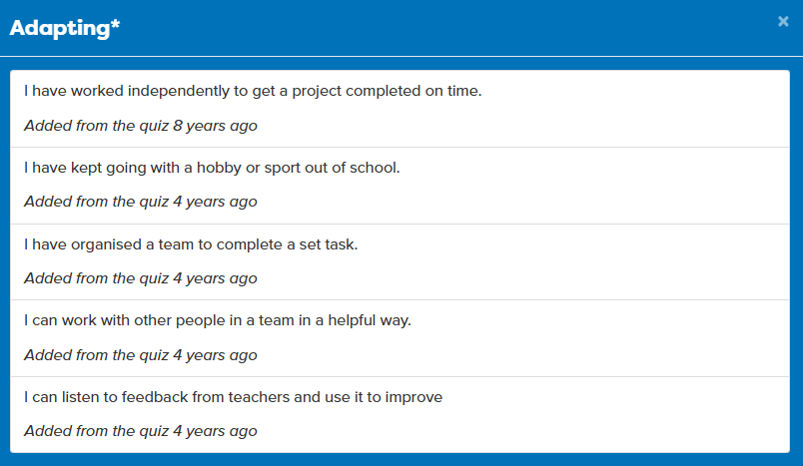
Using your Skills Profile to help you apply for work experience
‘I am good at adapting and being flexible and I have done this in team tasks in school and also when doing my hobbies.’
Notes:
Remind them how they can see the examples they have for each skills, useful when they want to write more about evidencing their skills (although in this session just listing their skills will do).

Slide 10

Contacting Employers
Your contact with them needs to be clear and say exactly what you want and also tells them about YOU:
Your email/covering letter will be the first time they have heard of you.
Sample email:
Dear Sir/Madam (or to Human Resources)
My name is XX. I am 15 year old and in Year 10 at XX school.
I am looking for a work experience placement from XX to XX..
I am interested in a role in sales/sports/animal care because XX.
I have the following skills that would be useful in this role XX.
I would be grateful to hear of any opportunities you might be able to offer
You can contact me by email XX
Thanks for your time and I look forward to hearing from you.
First and last name
What’s life like for an employer?
Notes:
Quick chat about employers – e.g what is you are the manager of the local B&Q/Morrisons, etc, what are you doing day-to-day? Explain the pressures they have, why they might not respond, how you have to engage them clearly, politely, positively and professionally.
Then run through the example intro email/ covering letter

Slide 11
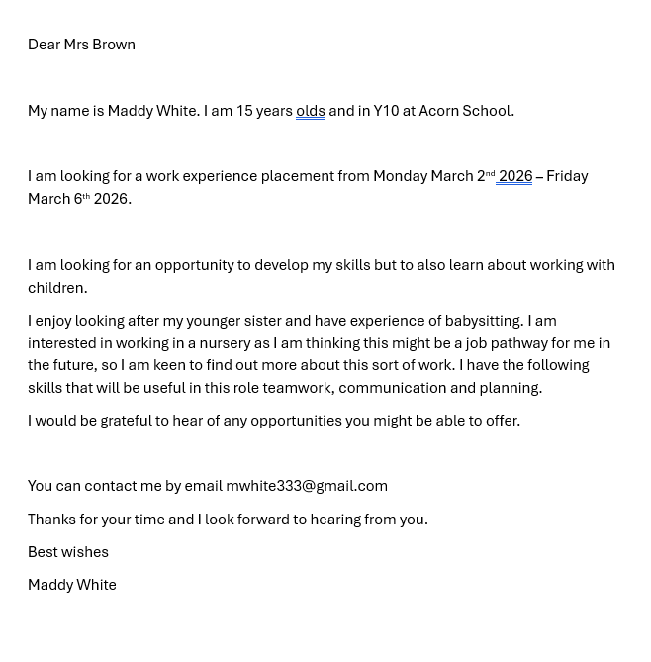
Contacting Employers using an easy template
When giving out any personal information you must be careful so always check with your school or parent/guardian that it is okay
Notes:
Run through this example.
Want the students to have one (or more) sentence about why they want this experience/are suit to it and one sentence about the skills they have to offer.
Reiterate the need for caution when sharing personal information – check with the school about what they advise and do what school says.

Slide 12
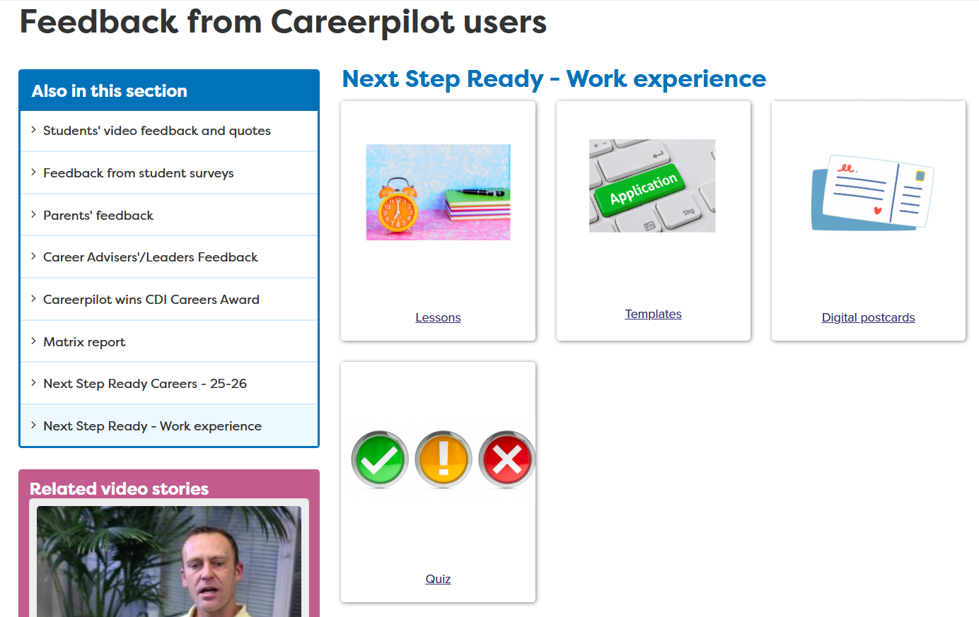
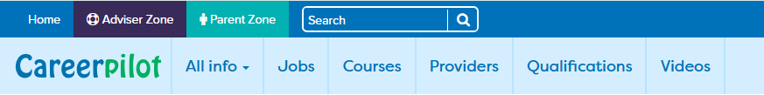
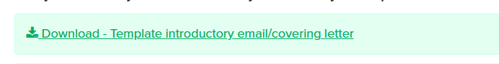
Download Template
Notes:
This is where the template will be on Career pilot, they should download and save to their area of school network. Show them that CV template is also here.

Slide 13
Try it
Open and then save it to your WEX folder
Choose the job you found last time (or a job you know you will be doing for work experience).
Fill in the gaps on the email template or CV
Your work experience dates are Monday July 6th to Friday 10th 2026
15 mins
Notes:
Students should by now have a WEX placement in mind and have contact details, they can use this to create an Intro Email. Change the dates on this slide to reflect the school’s WEX dates.
Suggest students use personal email and send it from home or with the permission of the school, not in the session.

Slide 14
Getting it to an employer
Send it in an email – but make sure your parent/carer or a teacher know you are doing it.
Print it out and take it into the place you are applying to - but make sure your parent/carer or a teacher know you are doing it
Send it in the post – would have to print it out, put it in an envelope with the address and get a stamp.
Notes:
Could ask school where the students could print it out and get an envelope if they need to do the post option.

Slide 15
Follow-Up after sending the email/letter/CV
About a week after sending the email, follow-up.
Just a quick email:
Dear Sir/Madam
Hope you received my email dated XX. Just following up to see if you require additional information about my request for a work experience placement from July 6th to July 10th.
Best wishes
Macie Jones
Send more emails to other companies.

Slide 16
Logistics and support
Be Ready!
Address, route, time it will take, costs
Times start/end and have lunch
Who to ask for
Lunch arrangement, what to wear
Being the best
Scenario 1:
What would you do if you miss the bus and are going to be late?
Scenario 2:
What do you do if you are not sure what you are supposed to be doing?
Scenario 3:
What would you do if you were bored?
Notes:
If time can get them to come up with the things they need to do to be ready, if no time just tell them.
If time, use the scenarios and for a bit of fun get them to say the worse thing a person could do and then the best thing.

Slide 17
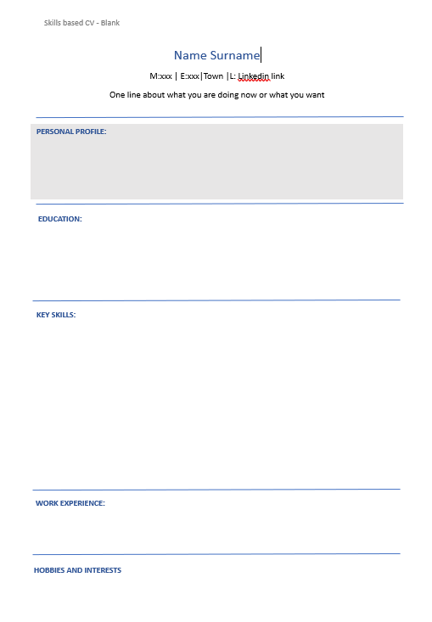
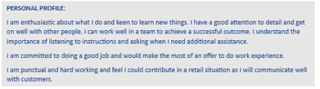

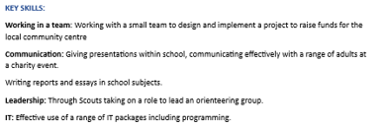


Quick intro to an easy CV
It does not need to be a fancy design, people read from top to bottom
DO NOT add address, town should be enough
Write the ‘personal profile’ at the end.
Put ‘pending’ and the date you will be doing exams.
This is the most important bit – give examples
If you do not have work experience already just take this out
Notes:
ONLY DO THIS IF THERE IS TIME _ ONLY A RUN THROUGH OF HOW IT WORKS NOT DOING IT IN THIS LESSON.
Explain hot tips and simple template

Slide 18
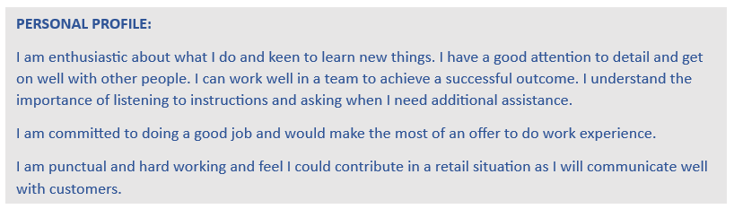
Your ‘personal statement’ is at the top of the CV
Imagine that is the only bit an employer reads.
Use active words e.g enthusiastic, organised, etc.
Think about what the employer wants from someone in this role.
Notes:
Explain personal profile and using active words enthusiastic, committed, organised, etc.

Slide 19
Download Template
Open and then save it to your WEX folder
Notes:
Show them again where they can find Template on CP
Reiterate the need for caution when sharing personal information

Slide 20
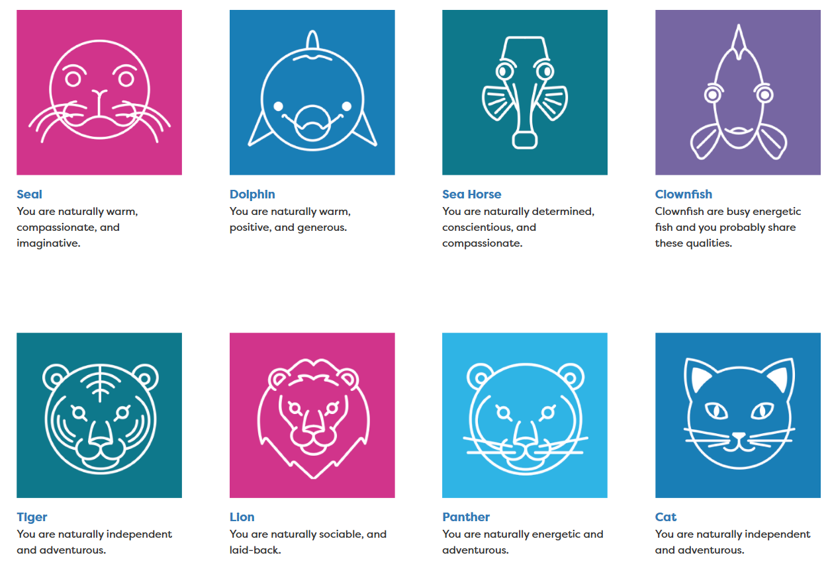
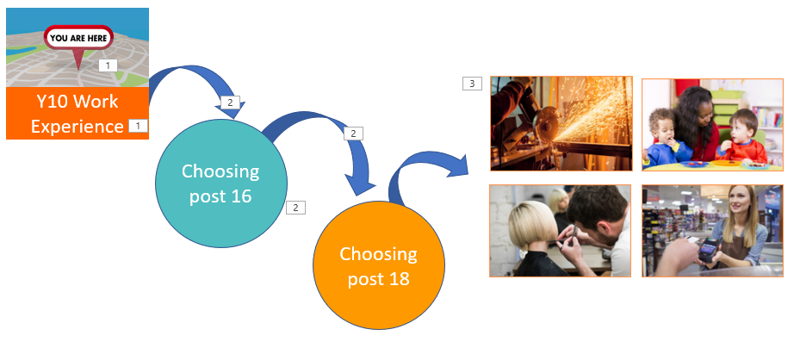

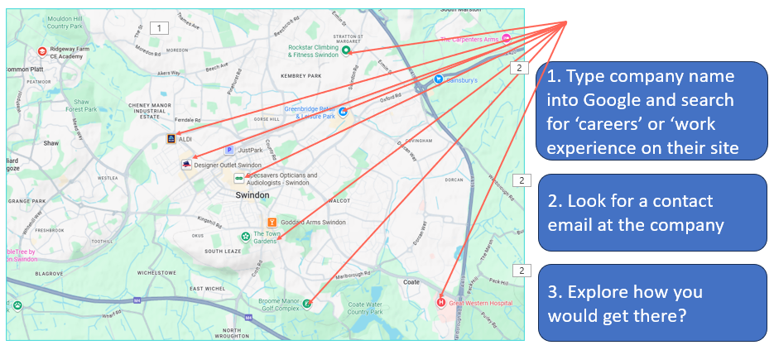
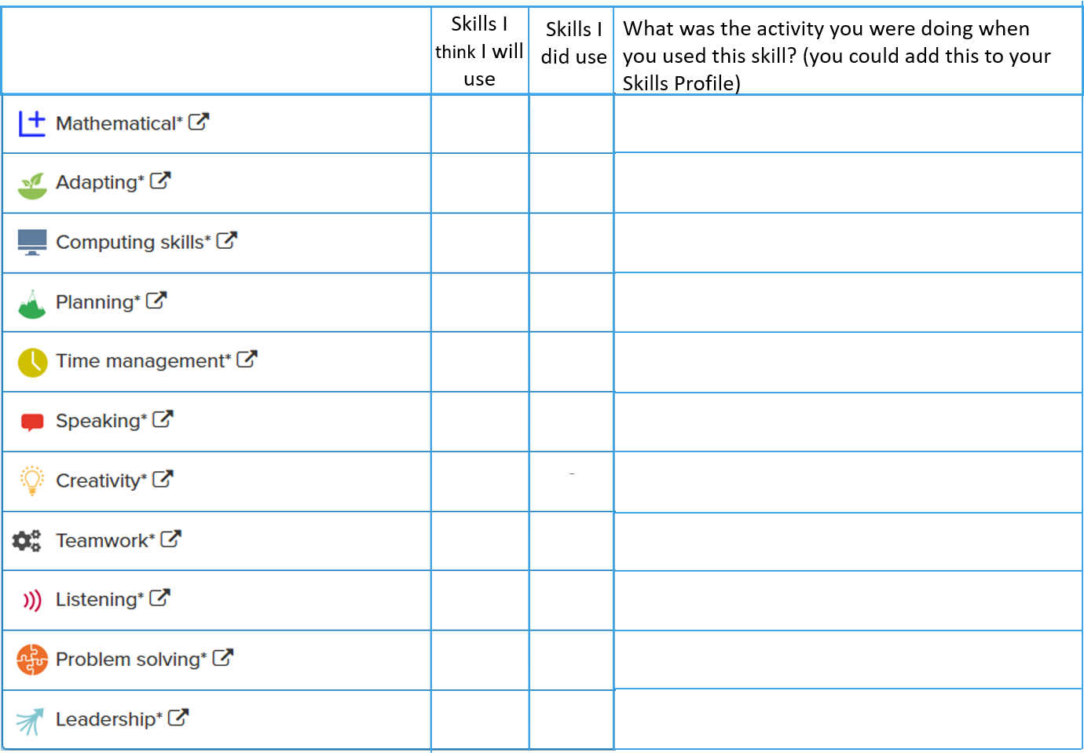
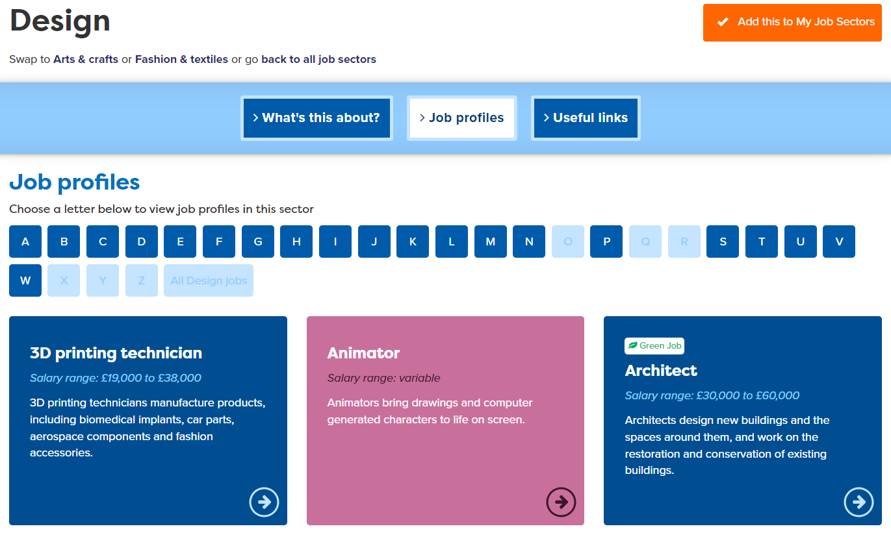
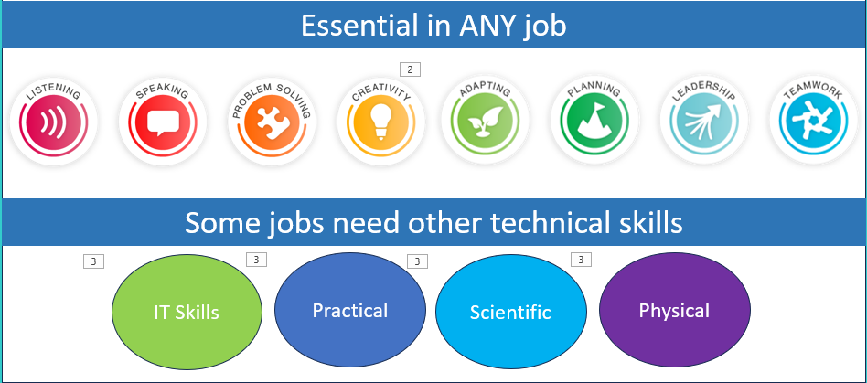
Recap
About you and job ideas
About work experience and skills
Getting Ready for Work experience
Notes:
Reminder of what we have done

Slide 21
Survey
Notes:
Survey to be completed. This is really important so be sure to leave 5 minutes at end to do it.
https://app.onlinesurveys.jisc.ac.uk/s/bathreg/next-step-ready-for-work-experience-student-survey-nssw

Slide 22
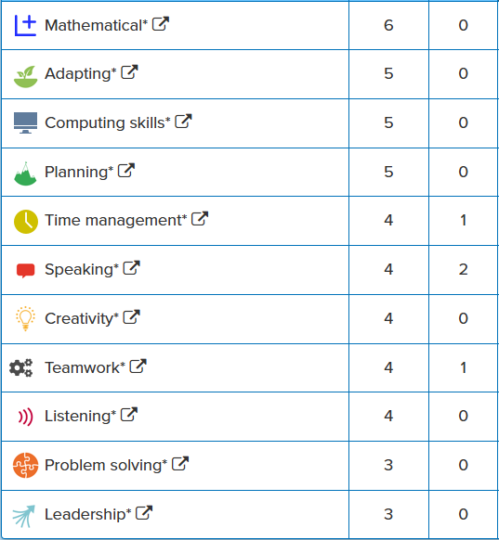

Knowing you are successful
Skills I think I will use
Skills I did use
What was the activity you were doing when you used this skill? (you could add this to your Skills Profile)
Notes:
If time can show this part of workbook.
Explain they can say what skills they think they will use and record what they do use on WEX and then add them to Skills Profile
If time they could tick off which skills they could use on their planned WEX.

Slide 23
In this session you completed:
1
Use a template to write an email to send to an employer or add your skills to a CV
You are a star
well done
and GOOD LUCK!
2
Consider how to check organisational arrangements to help you have a successful placement
3
Comment on what you have learnt through a quiz/survey
careerpilot.org.uk

Slide 24

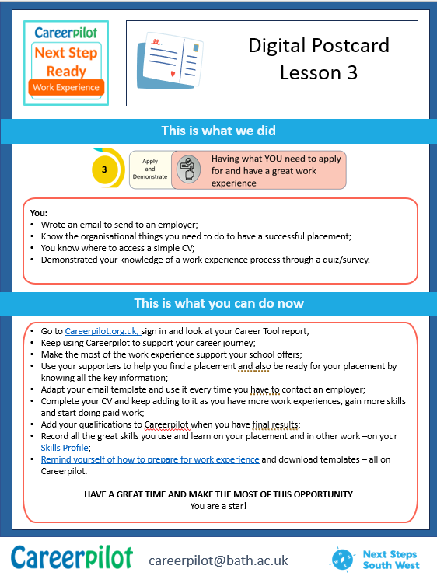
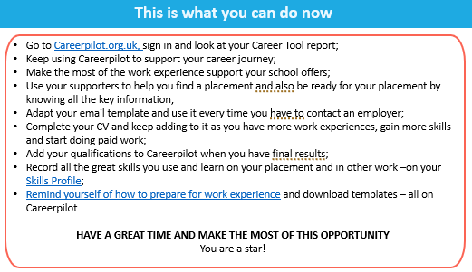
What now – Digital Postcard?
careerpilot.org.uk

