Slide 1

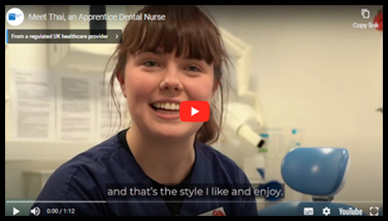


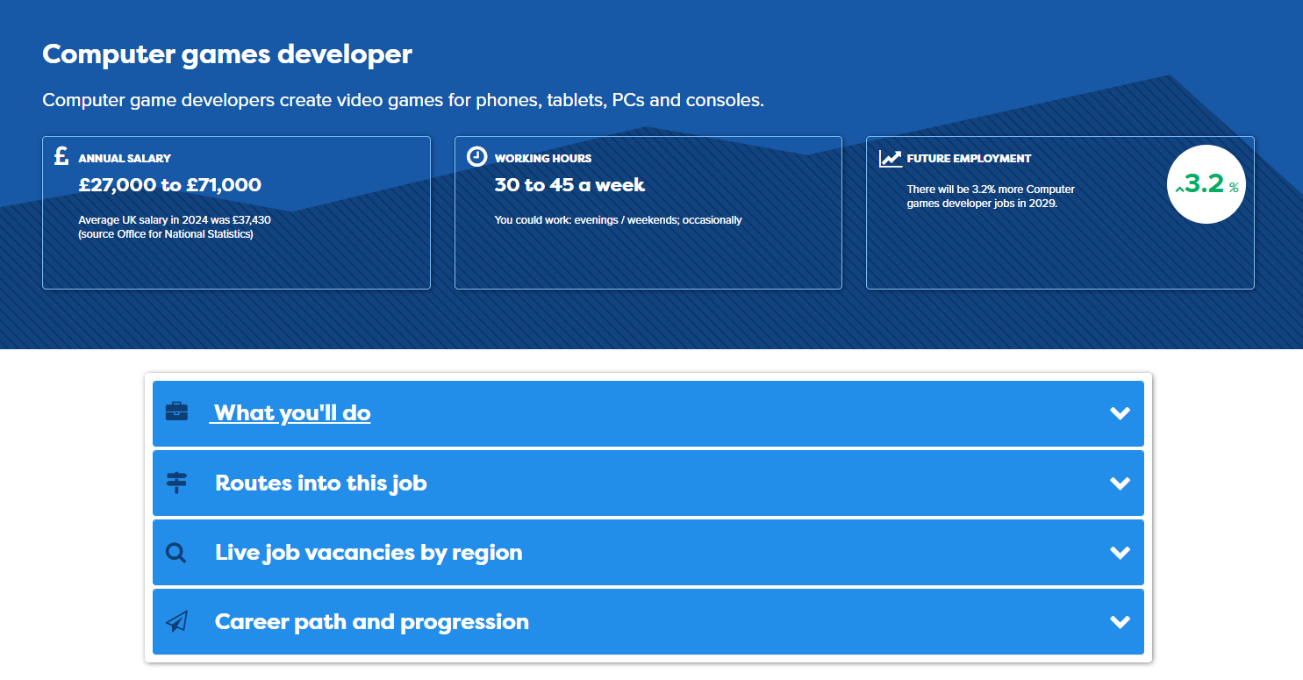




Healthcare Hot Jobs Activities: Teacher Notes
This set of 5 Hot Jobs classroom activities introduces students to a range of different healthcare jobs that are predicted to grow over the coming years with the final session giving time for students to explore other jobs they may be interested in. The activities can be delivered in 15-20 minutes, so could be used in tutor time or as part of a longer lesson.
For each Hot Jobs classroom activity students will:
  Watch a video about the job (3-5 minutes). There is a link to the video from the individual lesson page. Right click on the link and open the video in a new tab to play the video to your class.
  Find out more about the job from the Careerpilot job profile or printed posters (5 minutes). There is a link to the relevant Careerpilot job profile from the individual lesson pages to share from the front (right click to open in separate tab to view). Or students can find the job profile independently using the Job search on Careerpilot (use slide 2 to show how). You can also print out the relevant Hot Job posters which feature a QR code to access the job profile using a phone – see slide 3.
  Students can then work in pairs or as a class to answer questions about the job role using the information from the video and in the job profile (5-10 minutes).
Add a little bit of body text
Add a little bit of body text
Add a littl of body text
These classroom activities support your students to building the following essential skills:
careerpilot.org.uk

Slide 2
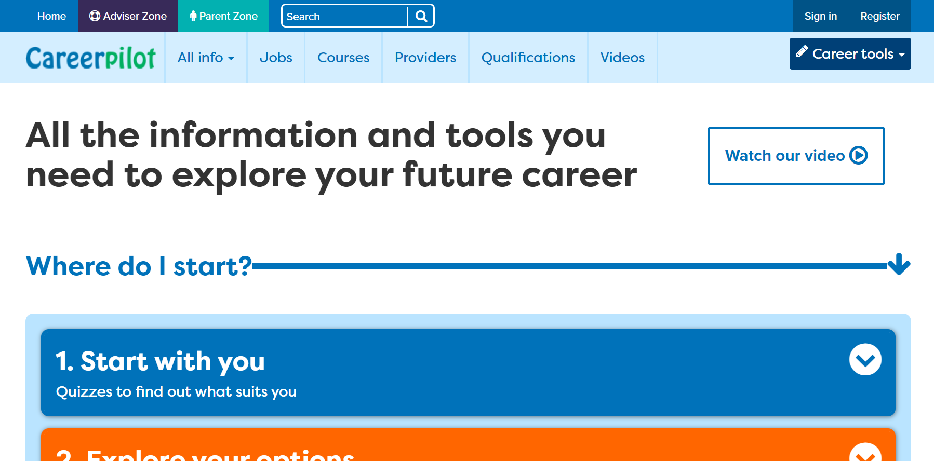
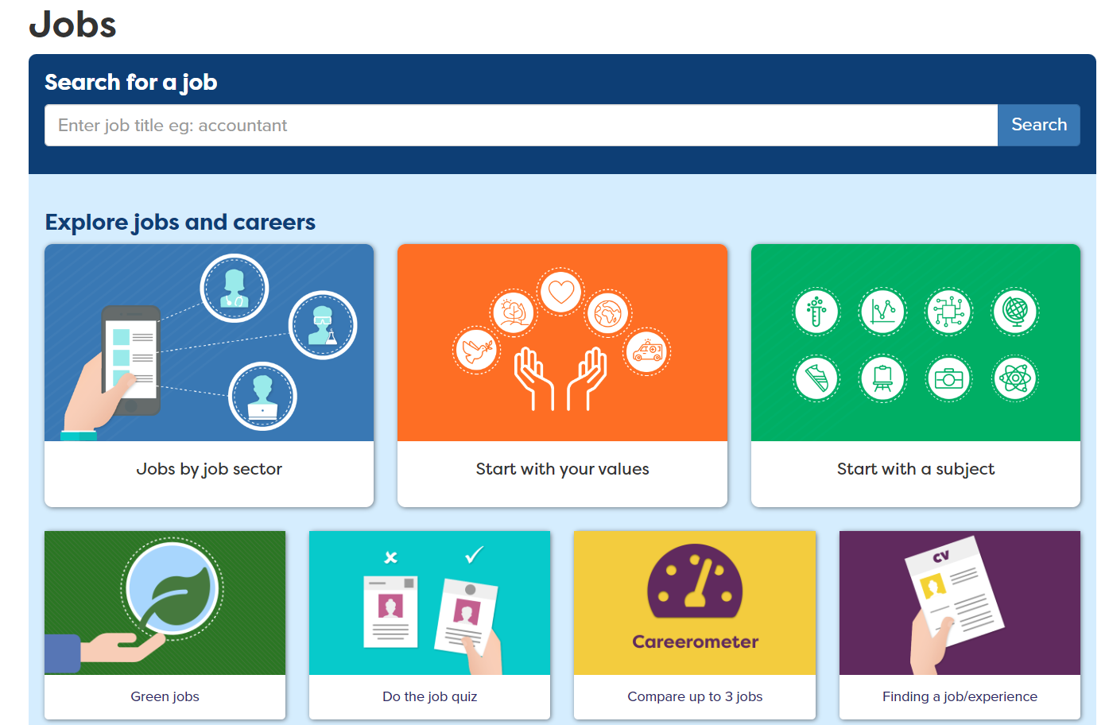
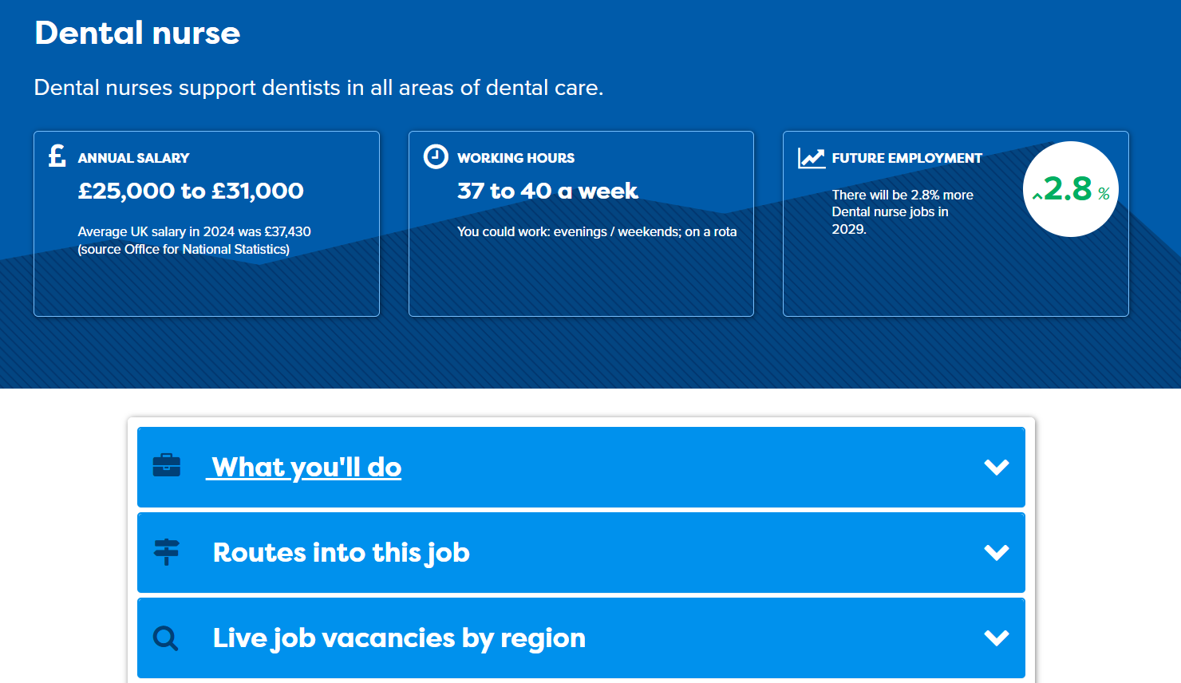
Accessing the Healthcare Hot Jobs Profiles
1. Go to careerpilot.org.uk and click on ‘jobs’
3. Explore job profile to learn more about the role and the routes into it.
2. Search for job role
Add a little bit of body text
Add a little bit of body text
Add a littl of body text
careerpilot.org.uk

Slide 3

Digital Hot Jobs Posters
Posters available to print from Careerpilot Advisor Zone.
Log in to Careerpilot then go to Hot Jobs Resources – Digital and IT Hot Jobs Resources
Add a little bit of body text
Add a little bit of body text
Add a littl of body text
Find pathways in this job and relevant subjects
Find average salary and predicted job growth
careerpilot.org.uk

Slide 4

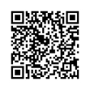


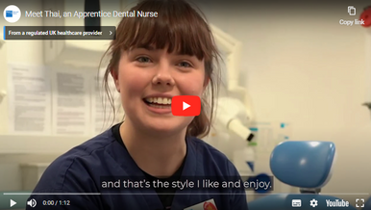

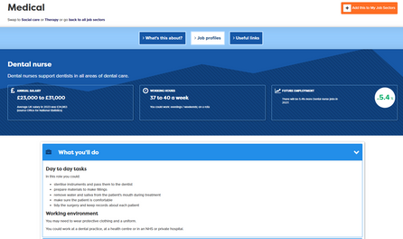


Dental Nurse:
Short Lesson Activity
Dental nurses support dentists in all areas of dental care.
Watch the video: A Dental Nurse Apprentice
Explore the job profile
Lesson Activity - Teacher Notes
This classroom activity will help students explore and understand more about this job role.
  Play the short video from the front (5 mins)
  Students explore key information on the relevant Hot Job poster or job profile on Careerpilot (5 mins)
  Use prompt questions to discuss and feedback in pairs or as a class (5-10 mins)
Add a little bit of body text
Add a little bit of body text
Add a littl of body text
Working in pairs or as a class discuss:
  Make a list of the things a person in this job role will need to do.
  What qualifications do you think you need to do this job role?

Slide 5
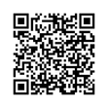

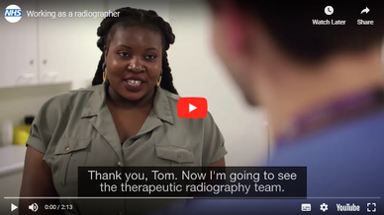
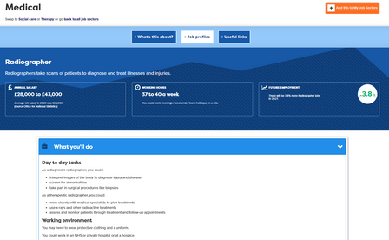

Radiographer:
Short Lesson Activity
Radiographers take scans of patients to diagnose and treat illnesses and injuries.
Watch the video: Working as a Radiographer
Explore the job profile
Lesson Activity - Teacher Notes
This classroom activity will help students explore and understand more about this job role.
  Play the short video from the front (5 mins)
  Students explore key information on the relevant Hot Job poster or job profile on Careerpilot (5 mins)
  Use prompt questions to discuss and feedback in pairs or as a class (5-10 mins)
Add a little bit of body text
Add a little bit of body text
Add a littl of body text
Working in pairs or as a class discuss:
  What qualifications do you think you need to do this job e.g. GCSEs, A levels, Vocational qualifications, apprenticeship, degree?
  Has anybody any experience of having an X Ray? What was it like? Were there safety procedures?
careerpilot.org.uk

Slide 6
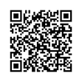

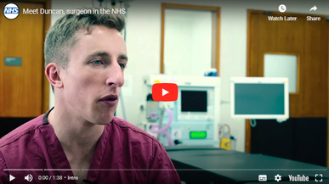
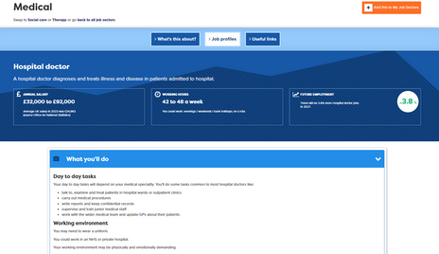
Hospital Doctor:
Short Lesson Activity
A hospital doctor diagnoses and treats illness and disease in patients admitted to hospital.
Watch the video: Working as a Surgeon
Explore the job profile
Lesson Activity - Teacher Notes
This classroom activity will help students explore and understand more about this job role.
  Play the short video from the front (5 mins)
  Students explore key information on the relevant Hot Job poster or job profile on Careerpilot (5 mins)
  Use prompt questions to discuss and feedback in pairs or as a class (5-10 mins)
Add a little bit of body text
Add a little bit of body text
Add a littl of body text
Working in pairs or as a class discuss:
  In pairs, make a list of all the things you think a hospital doctor may do in their job.
  Put a 1,2,3 to show which things on your list you think they will do most of the time.
careerpilot.org.uk

Slide 7
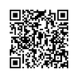

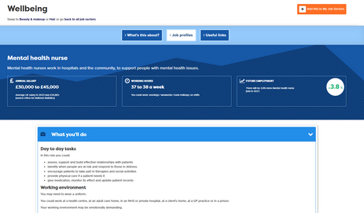

Mental Health Nurse:
Short Lesson Activity
Mental health nurses work in hospitals and the community, to support people with mental health issues.
Watch the video: Working as a Mental Health Nurse
Explore the job profile
Lesson Activity - Teacher Notes
This classroom activity will help students explore and understand more about this job role.
  Play the short video from the front (5 mins)
  Students explore key information on the relevant Hot Job poster or job profile on Careerpilot (5 mins)
  Use prompt questions to discuss and feedback in pairs or as a class (5-10 mins)
Add a little bit of body text
Add a little bit of body text
Add a littl of body text
Working in pairs or as a class discuss:
  List at least 5 skills you need to be an effective nurse.
  What different routes can you take to become a mental health nurse?
careerpilot.org.uk

Slide 8
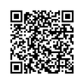

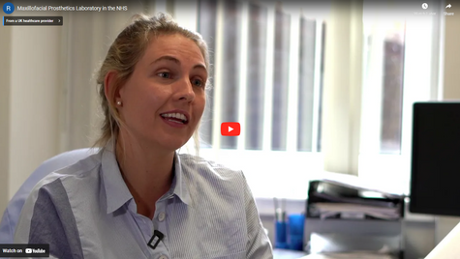
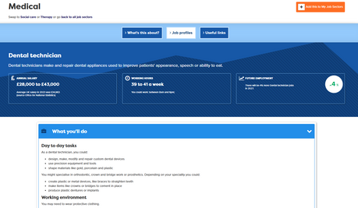
Dental Technician:
Short Lesson Activity
Dental technicians make and repair dental appliances used to improve patients' appearance, speech or ability to eat.
Watch the video: Working as a Dental Technician
Explore the job profile
Lesson Activity - Teacher Notes
This classroom activity will help students explore and understand more about this job role.
  Play the short video from the front (5 mins)
  Students explore key information on the relevant Hot Job poster or job profile on Careerpilot (5 mins)
  Use prompt questions to discuss and feedback in pairs or as a class (5-10 mins)
Add a little bit of body text
Add a little bit of body text
Add a littl of body text
Working in pairs or as a class discuss:
  List three tasks that a Dental Technician may be involved with as part of their role.
  What subjects would be useful for being a Dental Technician?
careerpilot.org.uk

Slide 9

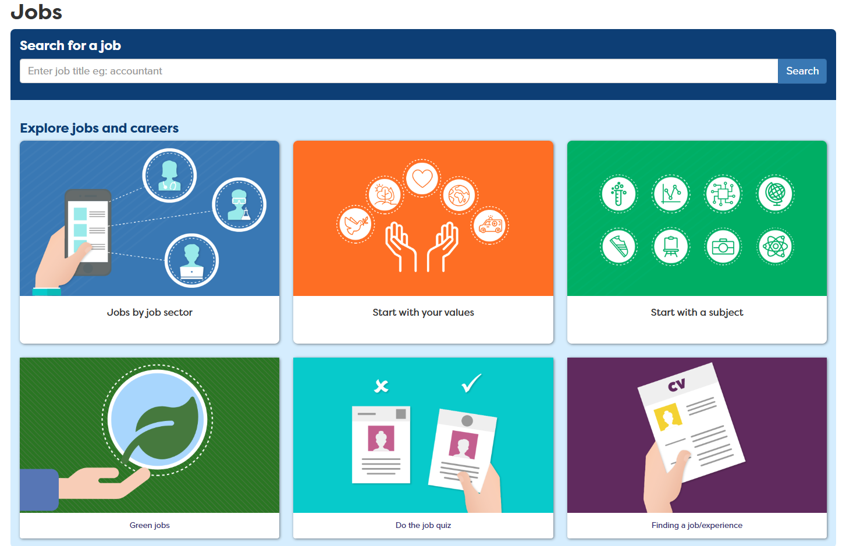

Explore more healthcare jobs on Careerpilot
Find other jobs on Careerpilot and explore the pathways into them.
Go to the Careerpilot Jobs Search and click on Jobs by Jobs Sector
Choose 2 job profiles from the health & social care sector to explore further
Teacher notes - What’s in the Job?
This classroom activity will help students explore and understand about more other job roles and the pathways into them.
  Visit the Careerpilot job search page
  Choose 2 job profiles to explore in more detail, including job growth, salary and the pathways into them
  Discuss the job roles in pairs or as a class using prompt questions
Add a little bit of body text
Add a little bit of body text
Add a littl of body text
Working in pairs or as a class discuss:
  What 2 jobs did you choose to explore?
  What different pathways can take to get into each of the jobs?

