Slide 1

Introduction to Careerpilot for Parents and Carers
careerpilot.org.uk
Notes:
Introductions of attendees – webinar protocol – cameras on to say hi, then ok to turn mic and cameras off for the session if preferred. Use chat for any questions throughout – we will check questions to answer at the end of presentation.

Slide 2
Agenda
The changing careers landscape
Careerpilot – a one-stop-shop careers website with information and tools to support students to explore their future career
Careerpilot Parent Zone - information to help parents and carers support young people in making the right decision about study and work
Notes:
Before looking at Careerpilot its worth looking at the bigger picture, in terms of the careers landscape.
There has been a move away from the idea of a ‘job for life’ to a more varied and squiggly career path. Important for young people to keep up with what is happening and how things are changing, equipping them with the skills they need to be proactive, to adapt and build resilience for the future.
Research shows young people born in 2002, are likely to live to 100 and have 17 different jobs!

Slide 3


What does the future look like for our young people?
Careers in the past
Careers in the future?
Notes:
Before looking at Careerpilot its worth looking at the bigger picture, in terms of the careers landscape.
There has been a move away from the idea of a ‘job for life’ to a more varied and squiggly career path. Important for young people to keep up with what is happening and how things are changing, equipping them with the skills they need to be proactive, to adapt and build resilience for the future.
Research shows young people born in 2002, are likely to live to 100 and have 17 different jobs!

Slide 4


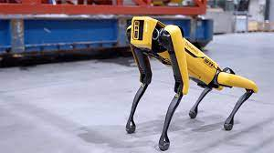

The growth in automation is impacting on some jobs
Notes:
The employment landscape is constantly evolving. Lots of jobs are changing or disappearing, because of automation. .for example the new Amazon Go store has no tills and few staff…. an example is libraries, which has changed a lot over the last 10 years or postal services where most people send messages now rather than letters.

Slide 5




Which employment sectors are predicted to grow?
Medical, Health Science and Care
Digital and IT
Engineering and Construction
Environmental/Green Jobs
Notes:
Important for young people to keep up with what is happening and how things are changing. The big sectors for growth in jobs are medical and health, IT and tech, engineering and construction and environment or green jobs. There are many routes in to these sectors, including academic, vocational and apprenticeships that students need to be aware of.

Slide 6

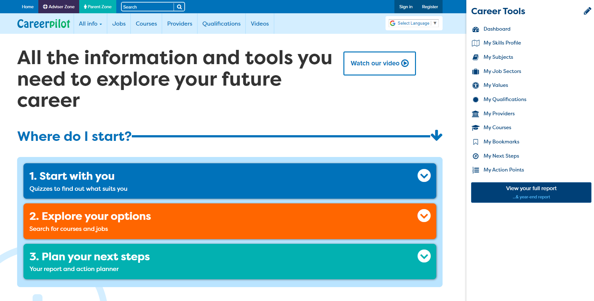

The Student Zone
v
Notes:
Students can register straight onto the site, when they use the career Tools this creates data in the Reporting Zone

Slide 7
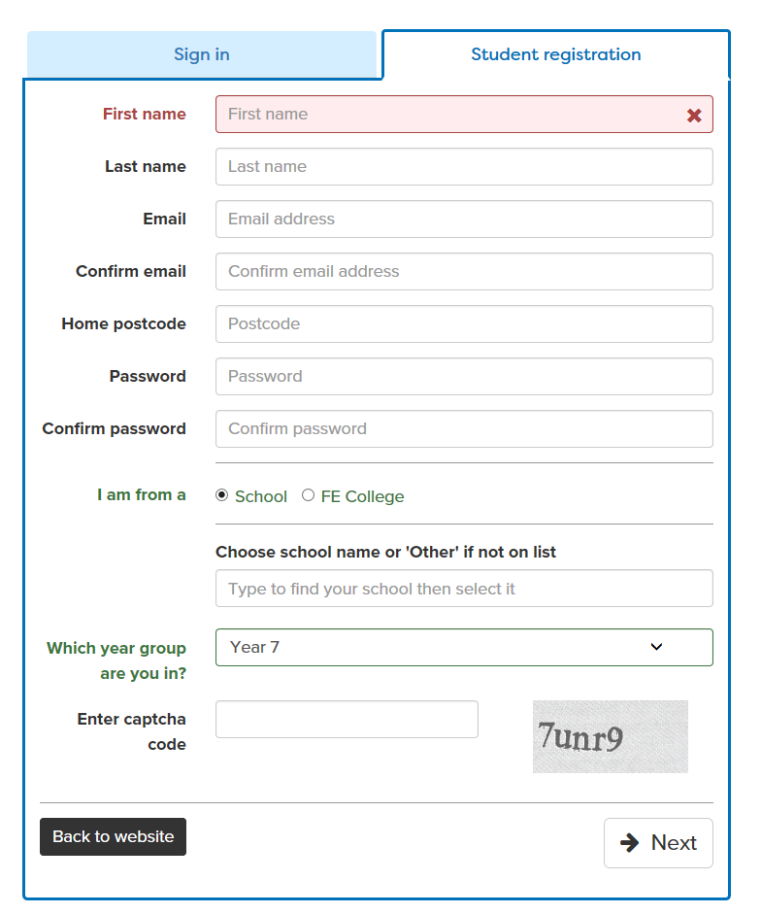
Student registration
Students can set up a FREE account on Careerpilot
Notes:
Registration is easy and self explanatory. They can use personal or school email address. The most critical thing is that they attach themselves to your school or college so that if you would like to access their progress, you can do this via your school.

Slide 8
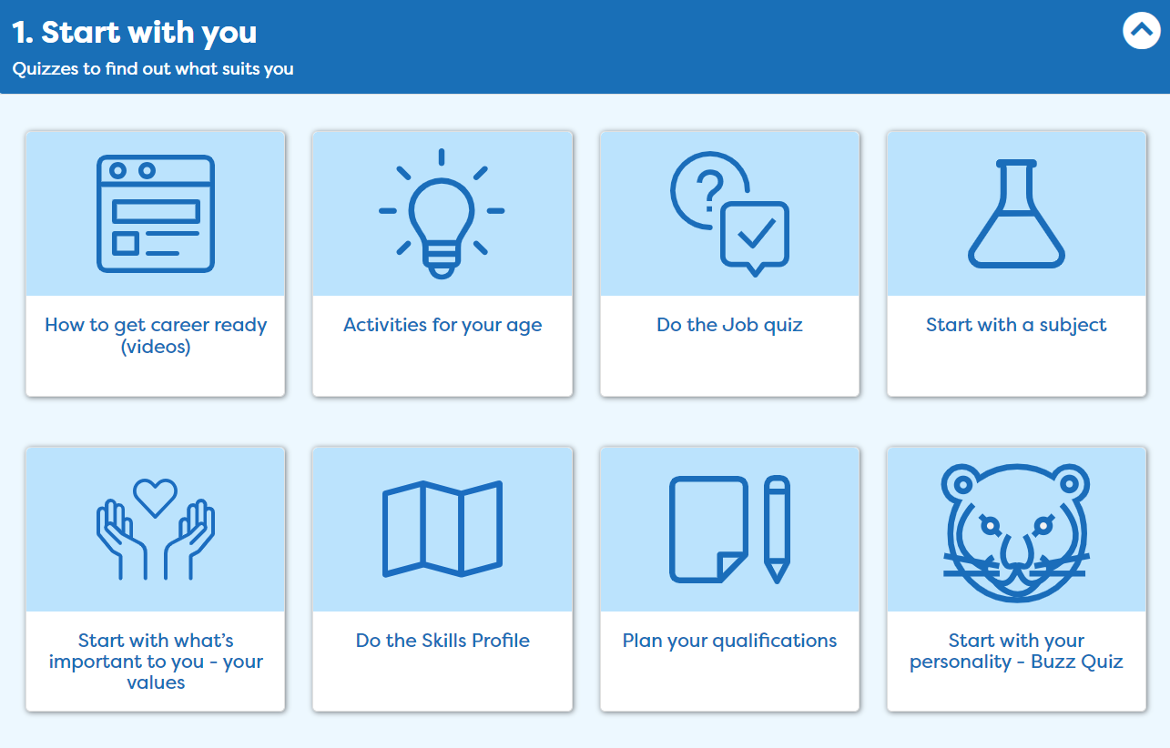
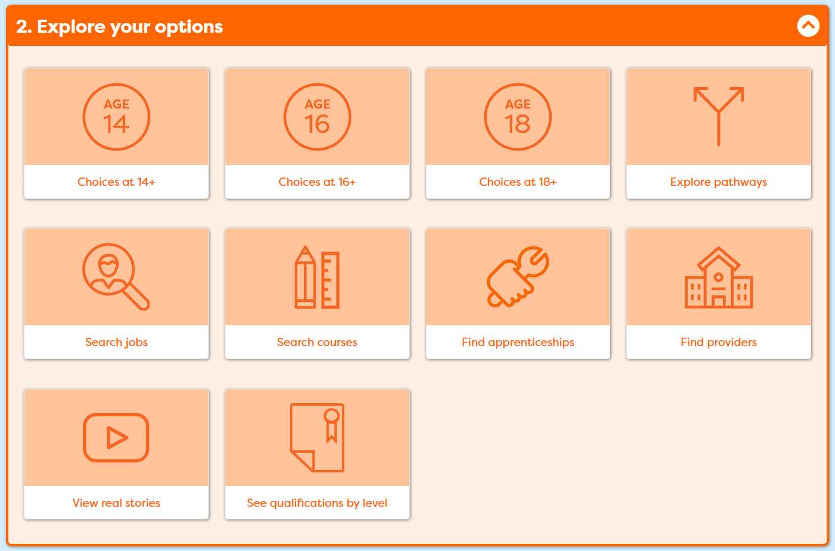
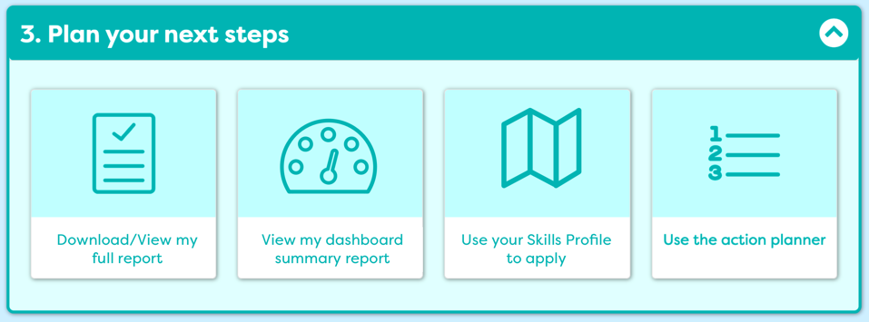
Three Stages of Career Decision-making
Notes:
Ok so how does Careerpilot work - This is the Careerpilot homepage. You will see three sections – Start with you, Explore your options and Plan your next steps. The website is built on theoretical knowledge of decision making and ran by Level 6 Careers Advisers .

Slide 9
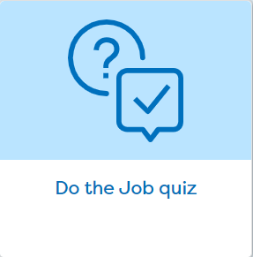
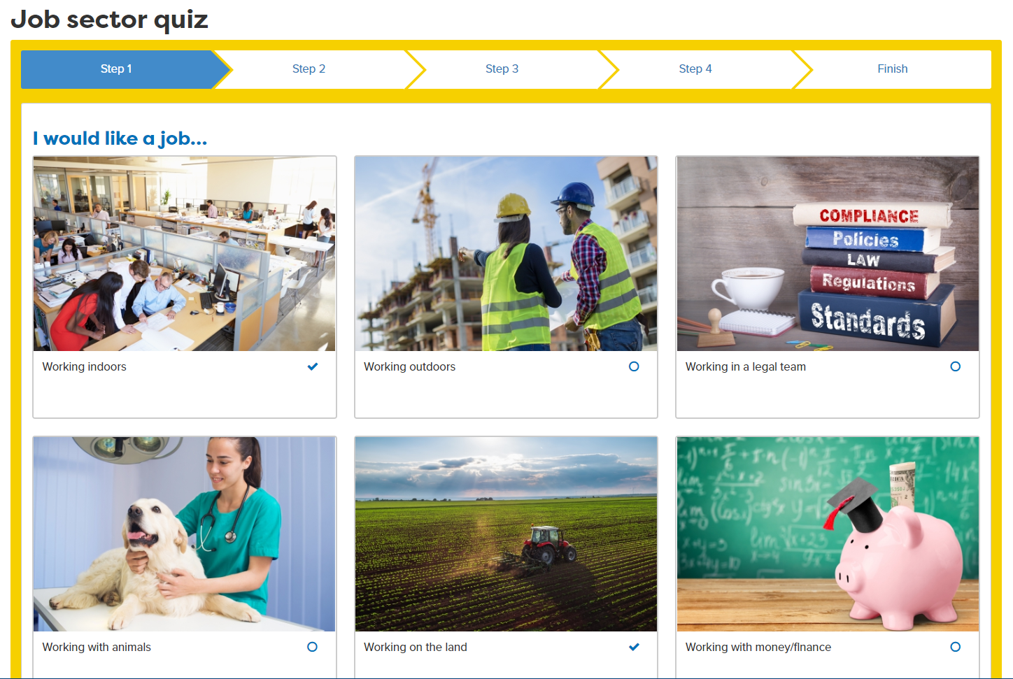
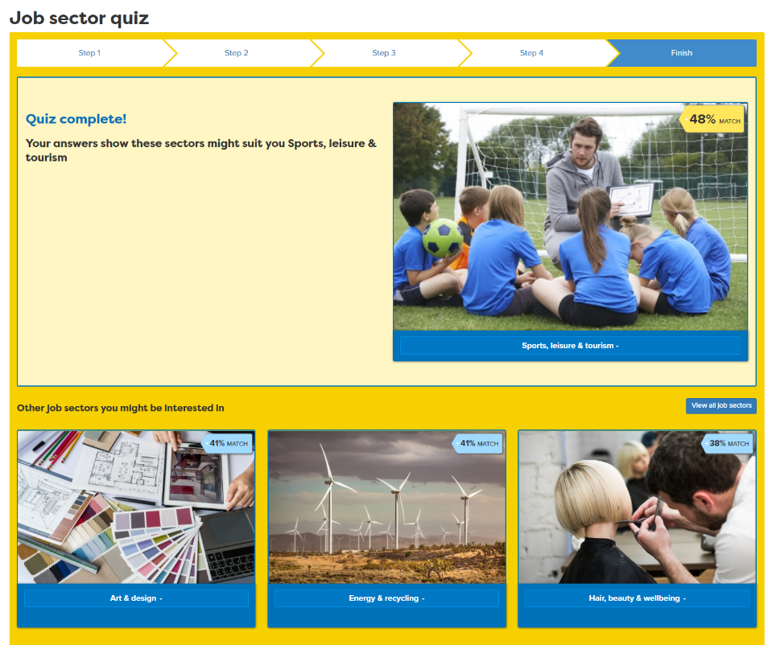

Notes:
There are a range of starting points in addition to the activities for age groups. Job sector quiz, pre and post 16 skills map. The Skills Map ask students what they have done already.

Slide 10
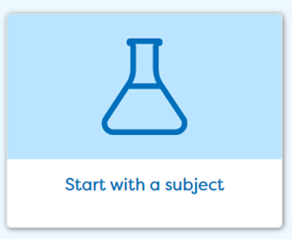
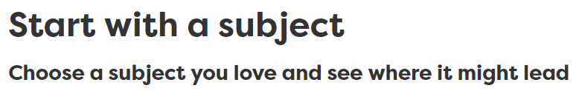
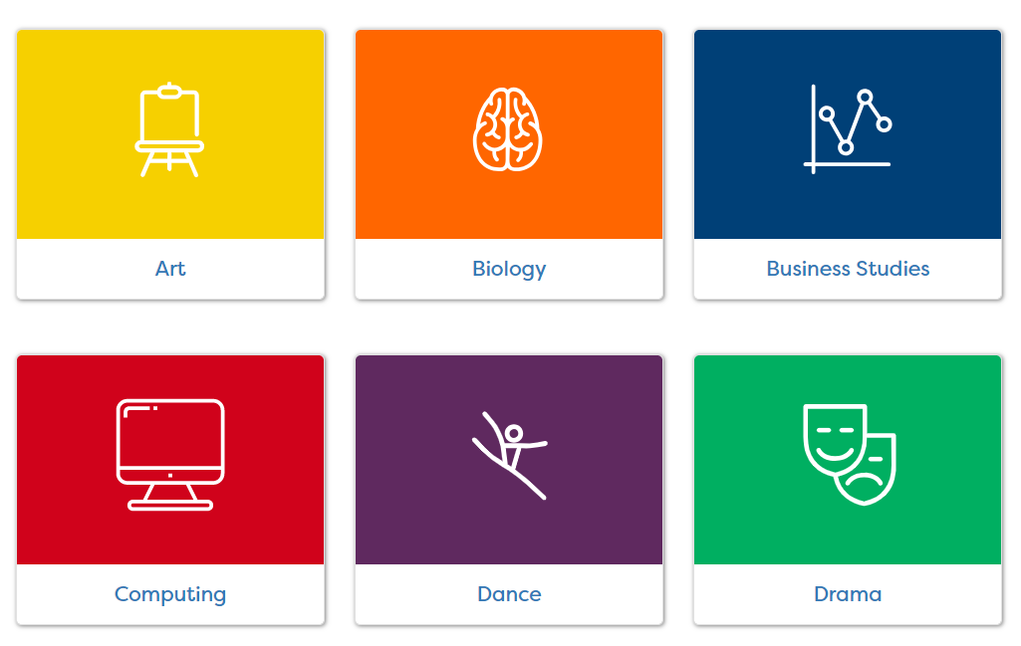
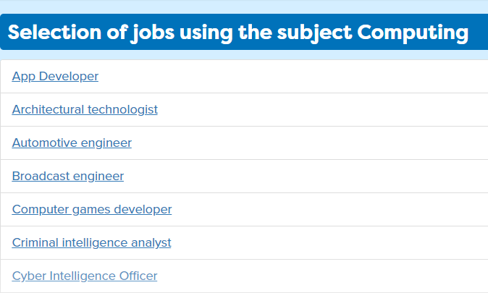
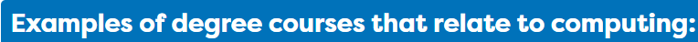




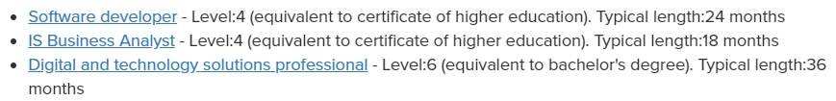
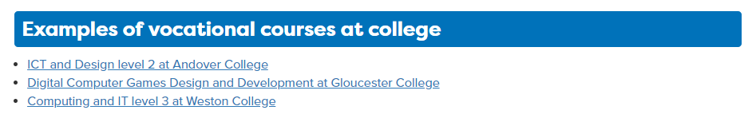
Notes:
Aside from the skills profile, Careerpilot also links to the curriculum and links courses and jobs through ‘Start with a subject’ . In this section students can pick subjects they are interested in and read more about jobs, courses and online activities they can take part in which are related to the subject. A direct way of Achieving Gatsby Benchmark 4

Slide 11

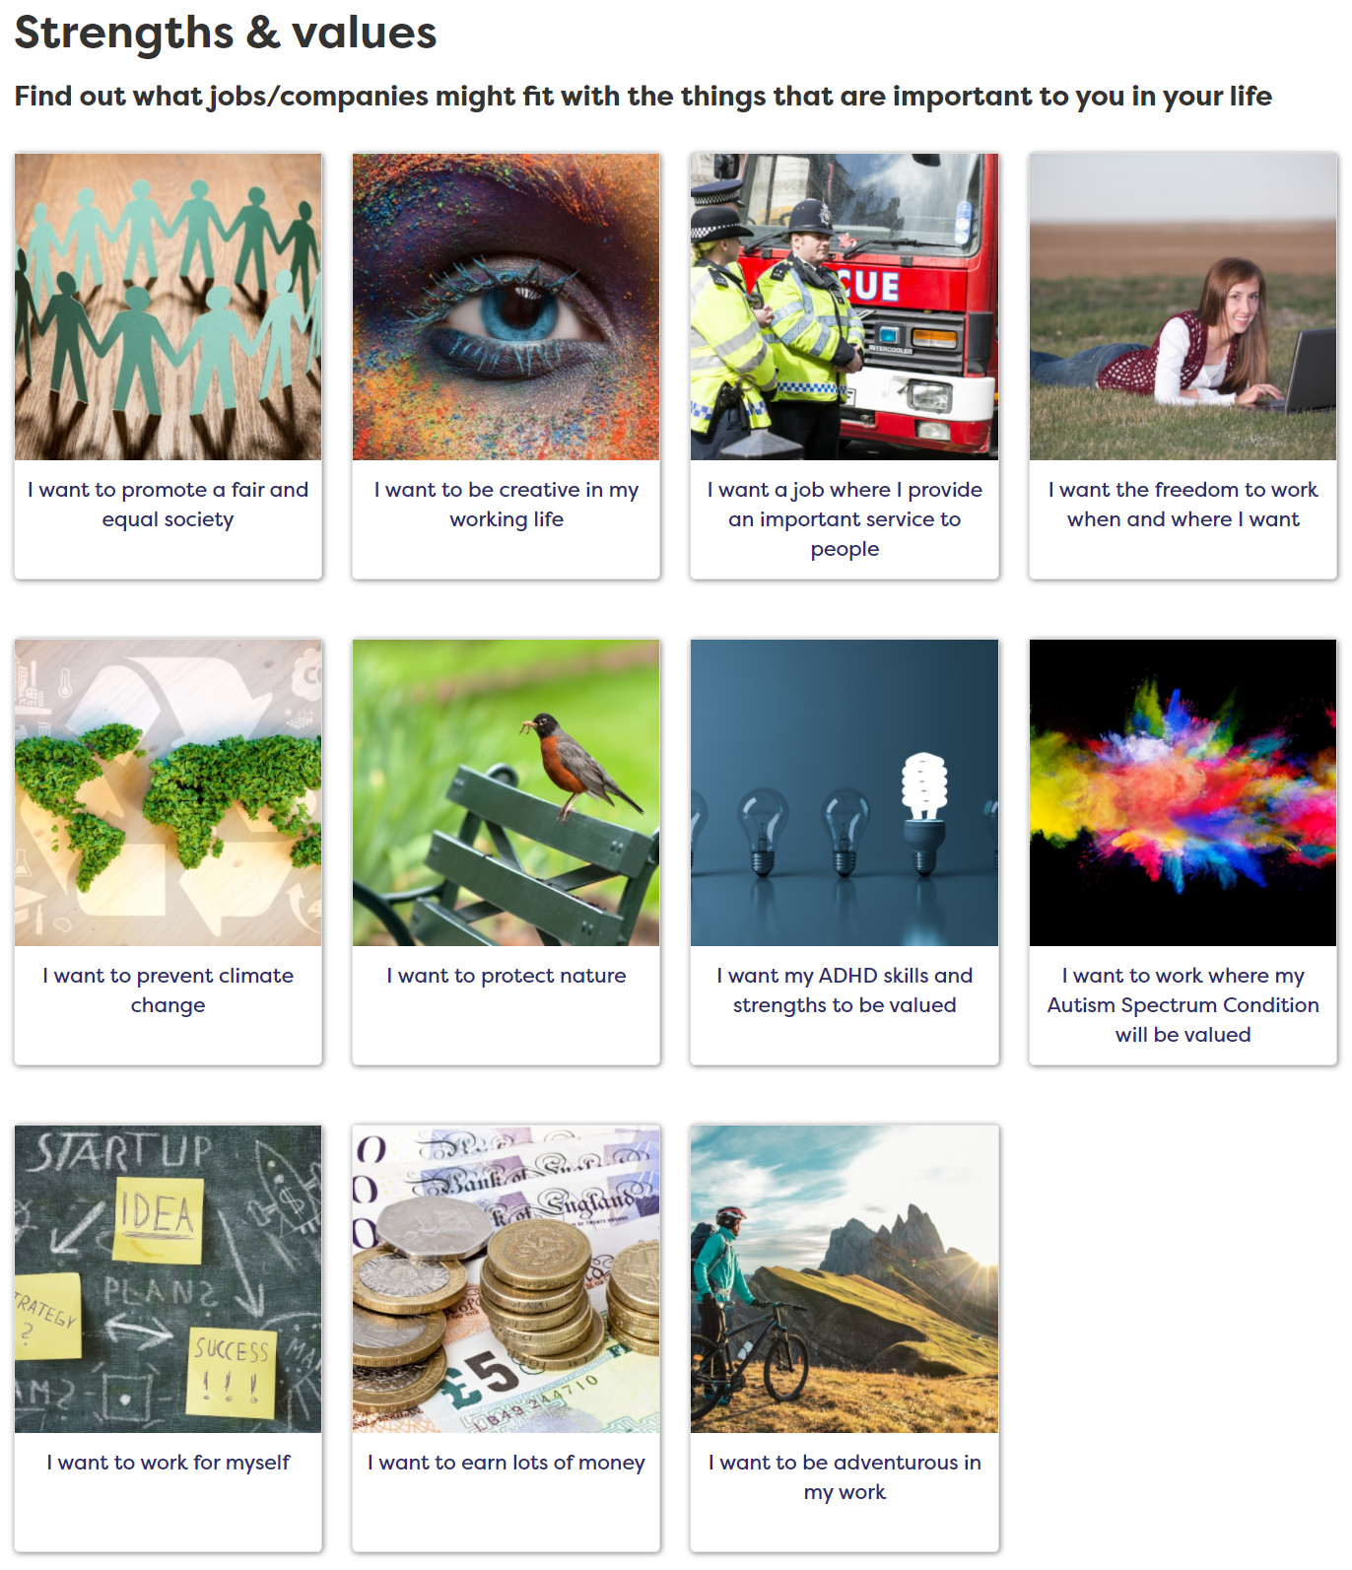
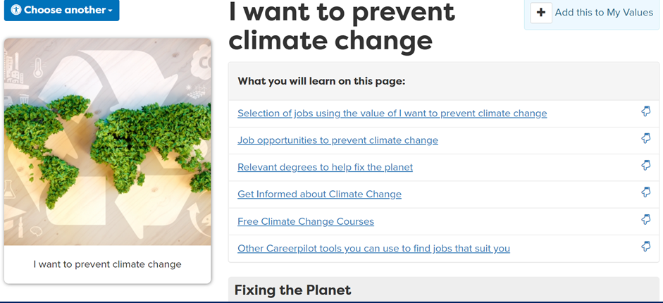
Notes:
They can look at ‘Start with what’s important to you’ and see what jobs fit with their values and get ideas of how to make the most of this value.

Slide 12
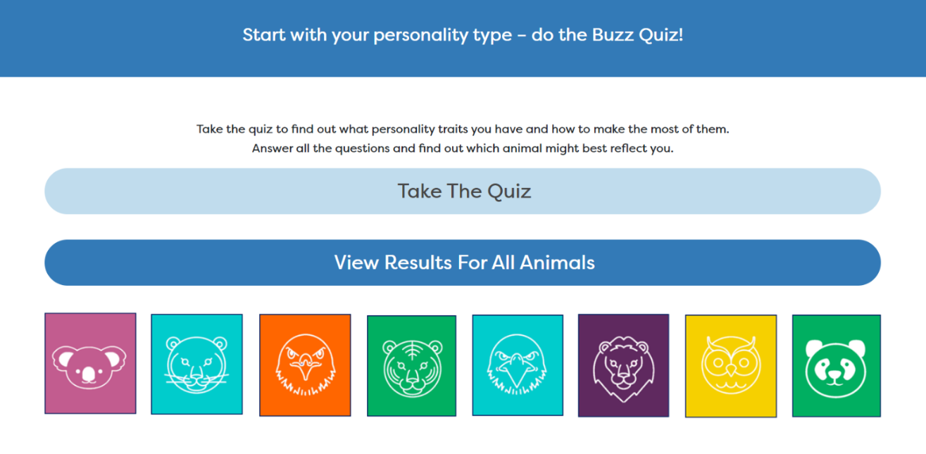
Notes:
They can look at ‘Start with what’s important to you’ and see what jobs fit with their values and get ideas of how to make the most of this value.

Slide 13
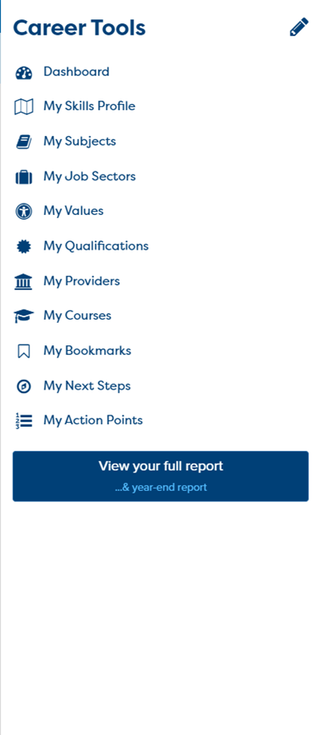
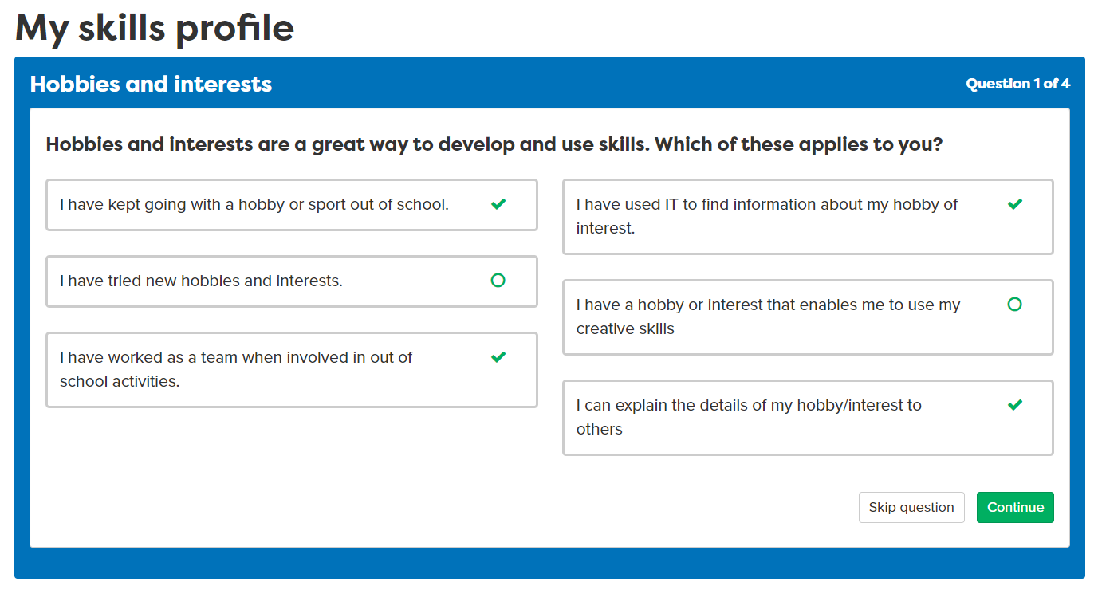
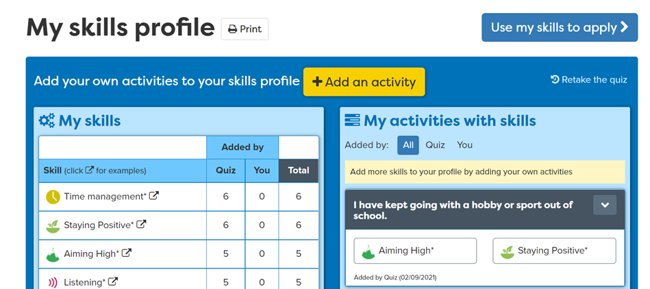
Notes:
What is the skills profile? It is questionnaire which helps a student understand the skills they have developed/or are yet to develop, based on easy to answer questions. Eg ‘I have kept going with a hobby or sport out of school’. Working with Skillsbuilder, this maps activities to particular skills that can be transferrable into a career.

Slide 14
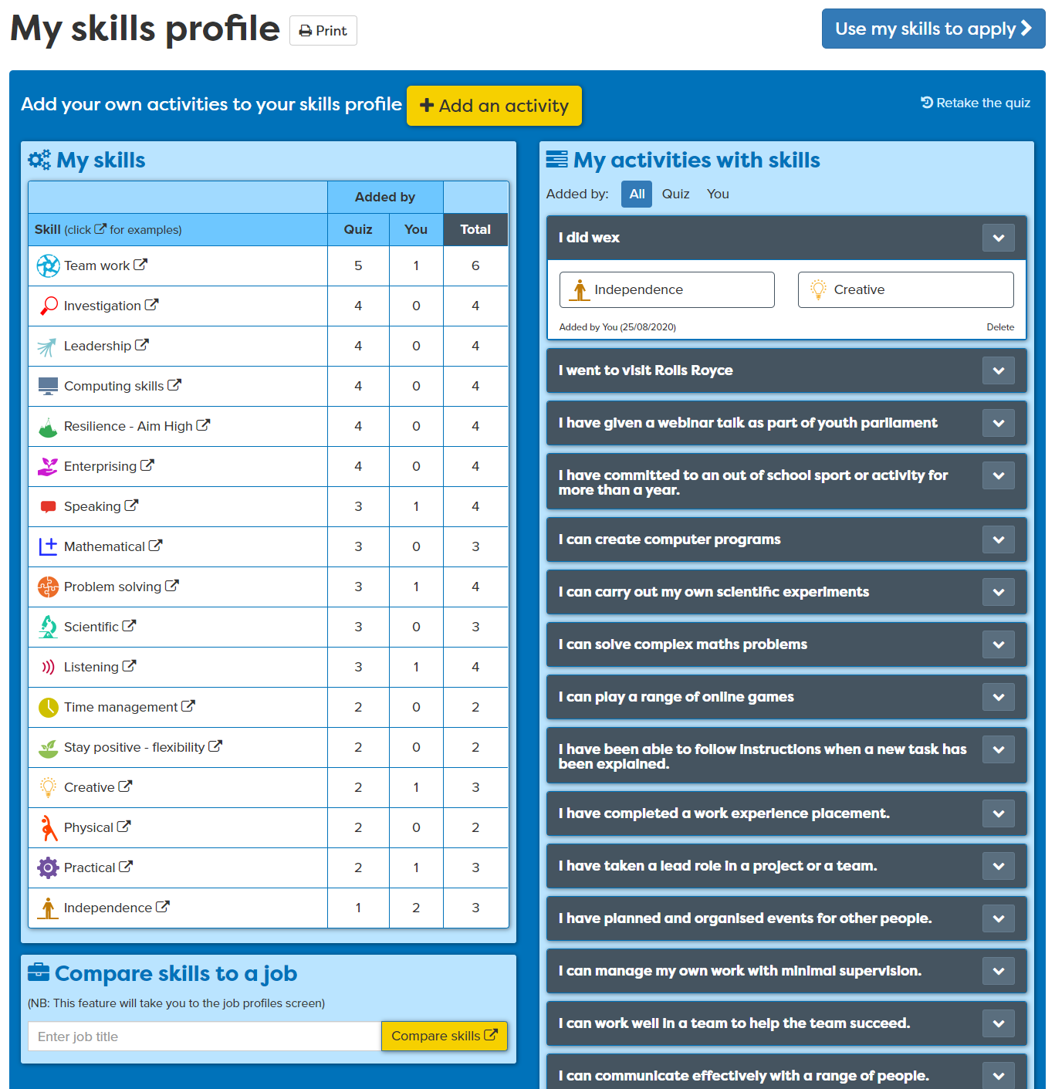
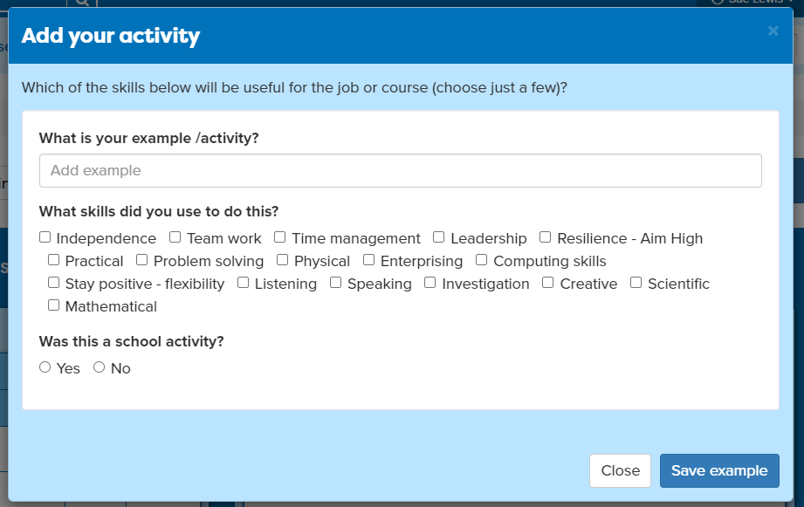
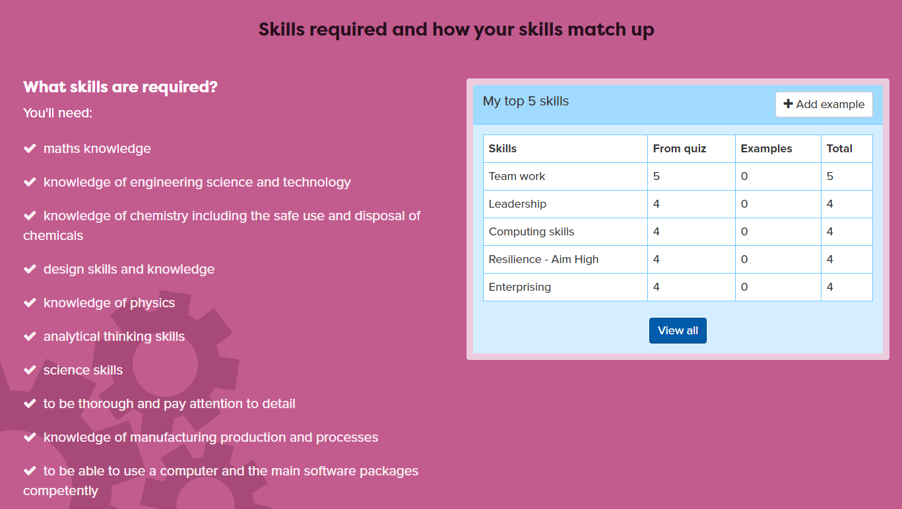
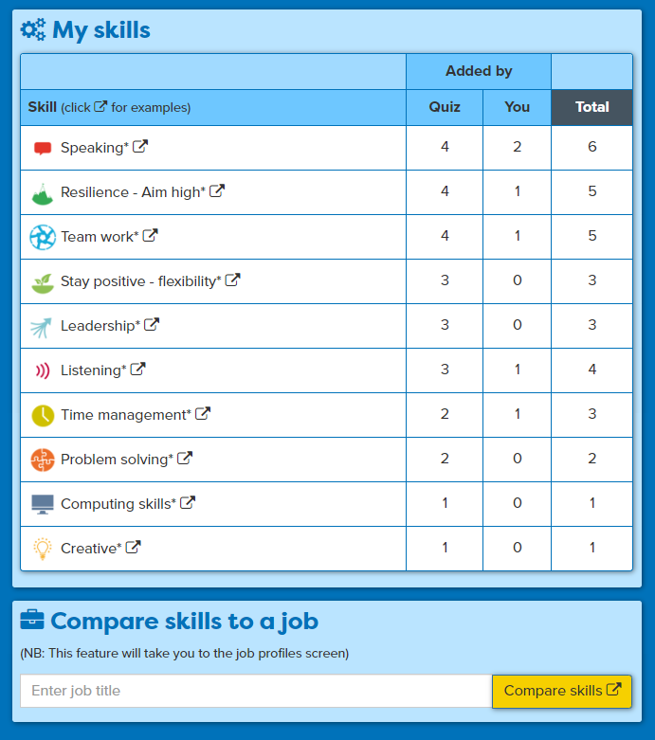
Add your own examples
All skills are ‘banked’ for later when they want to apply
See how skills compare to a job
Notes:
All their skills will be put in the Skills Bank, they should add at least one example of their own in the lesson but keep going back to add things over time. The Skills Bank can then be used when they come to apply.

Slide 15
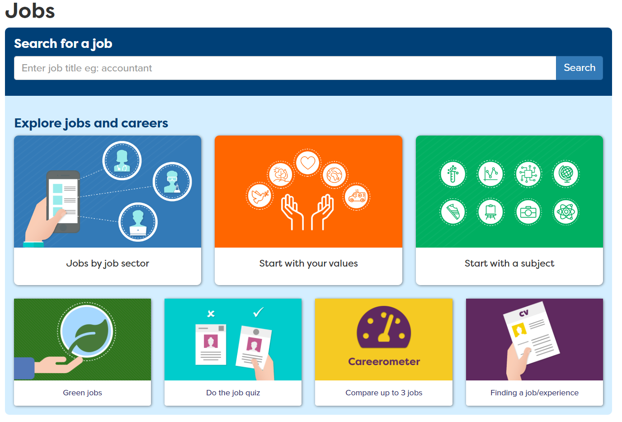
Notes:
Students can also explore job by sector, find out about jobs that are likely to grow and compare up to 3 jobs and how their skills match up.
This is good to help you achieve Gatsby Benchmark 2.

Slide 16
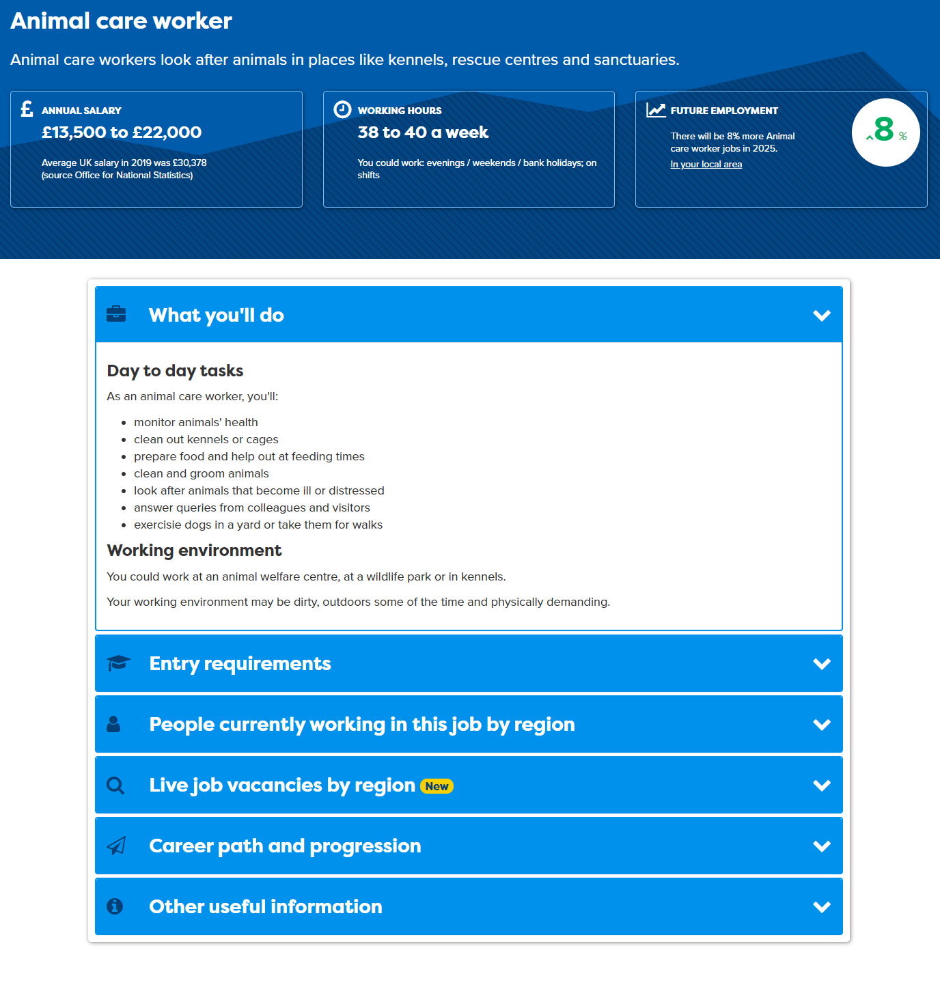
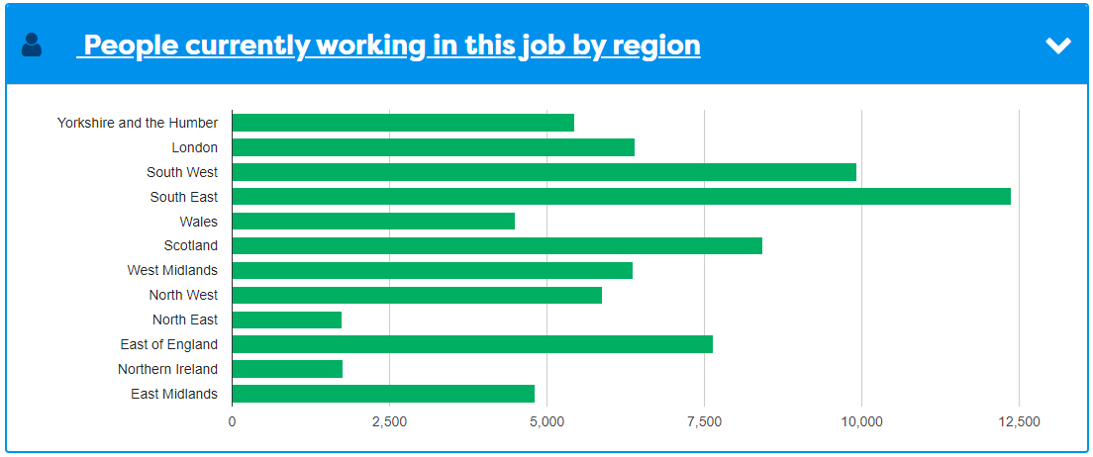
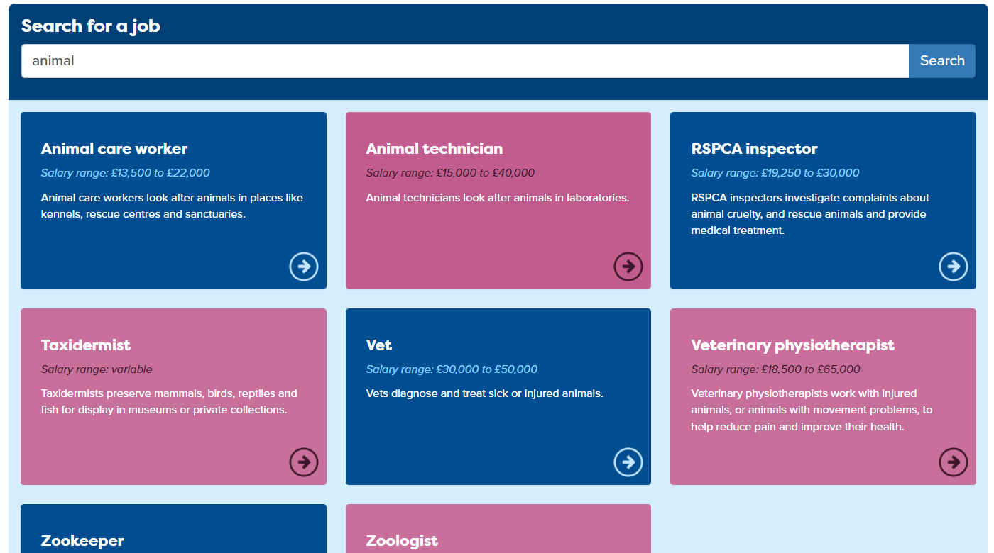
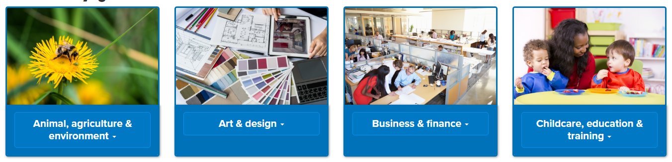
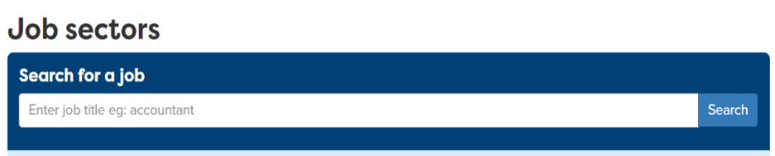
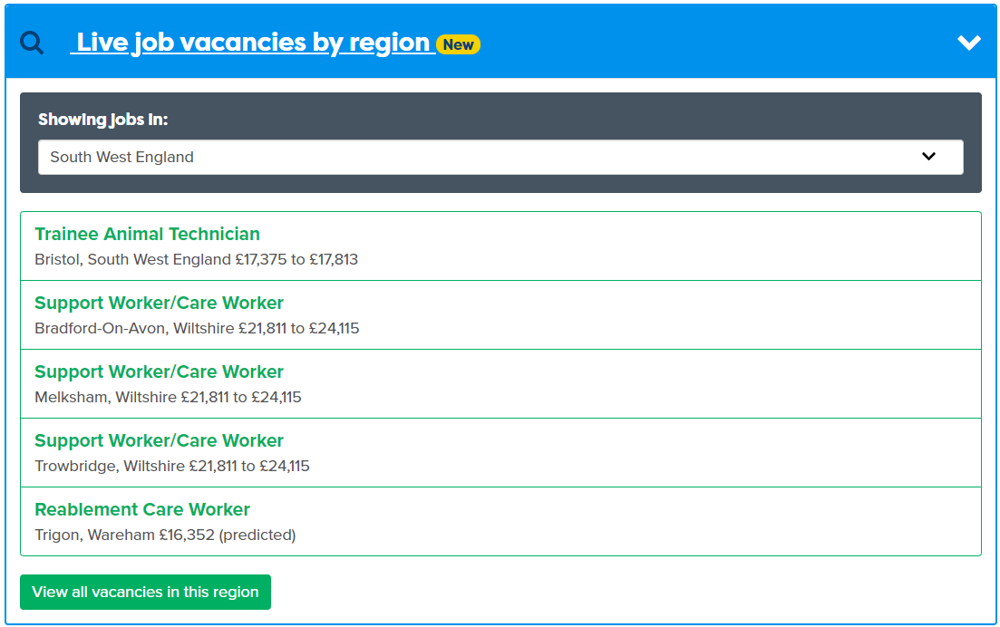

Slide 17

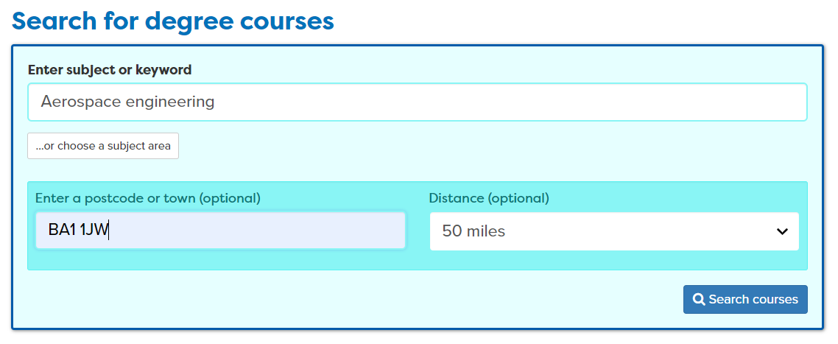
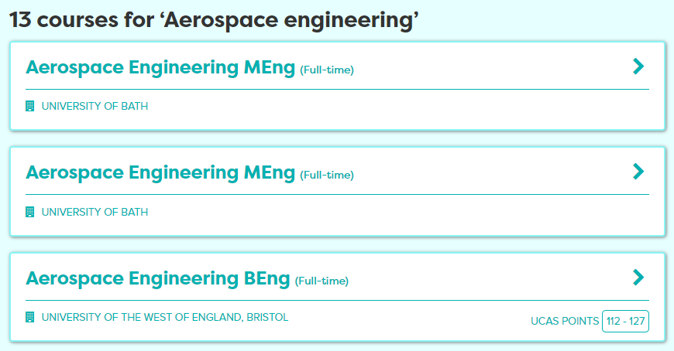
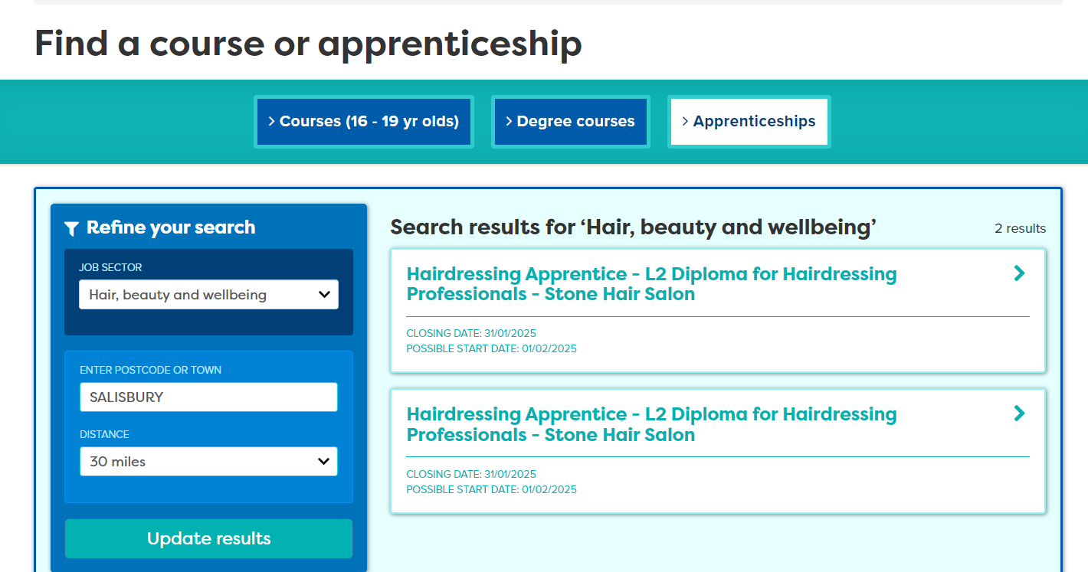
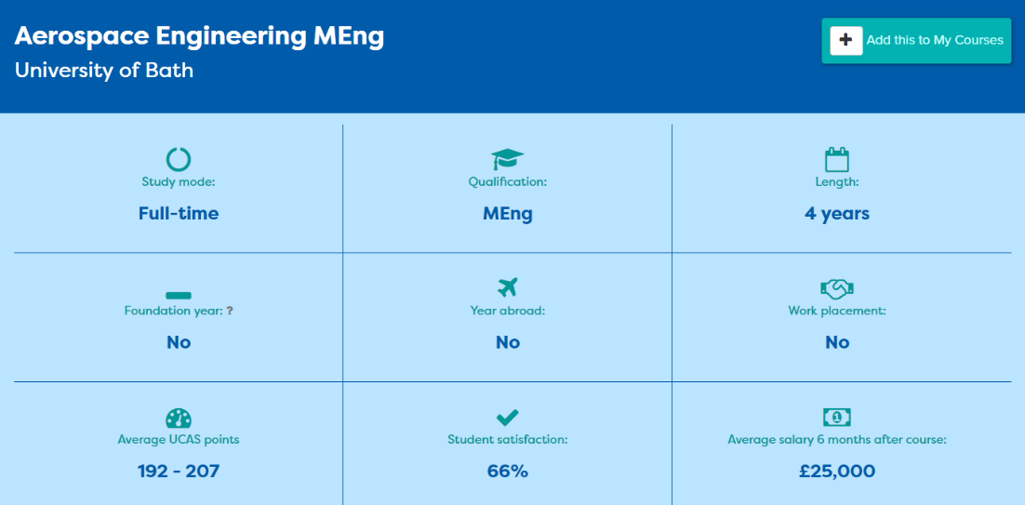

Slide 18
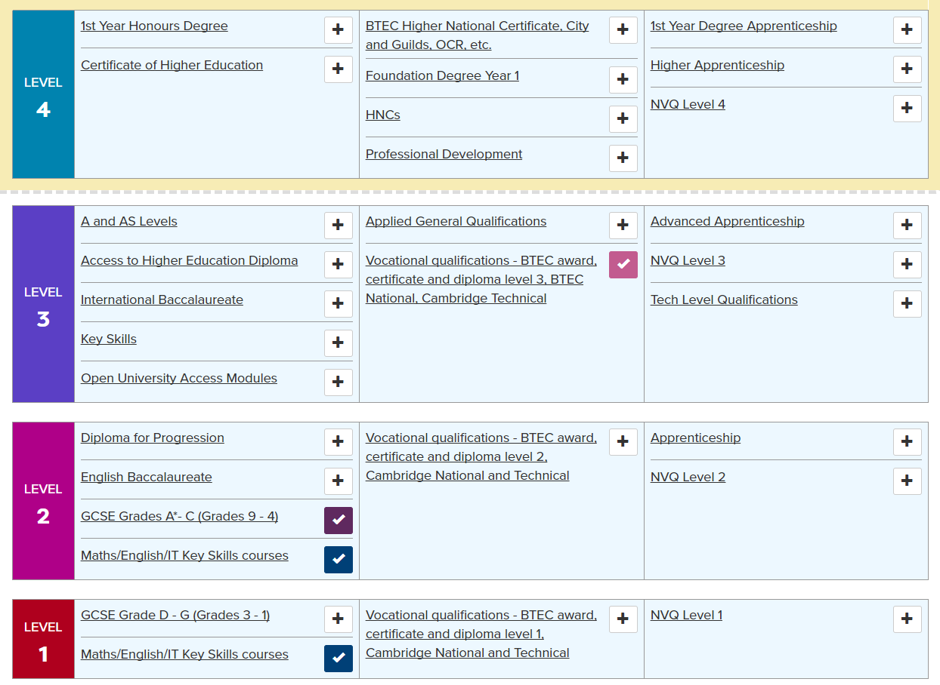

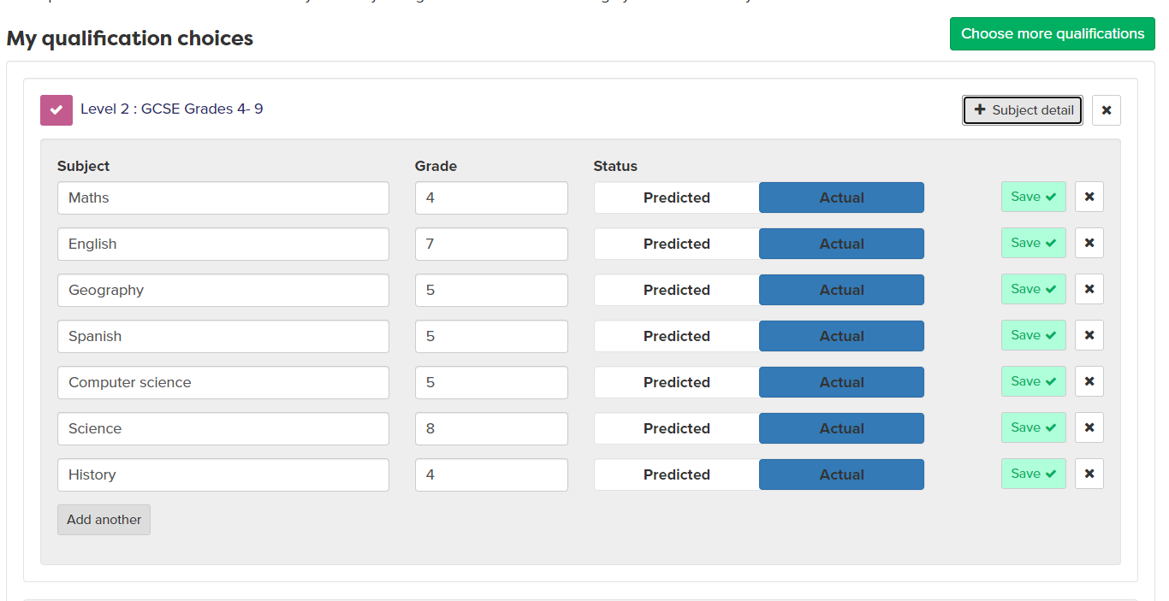
Notes:
Users can chose quals through the levels and indicate done, doing and considering.
When they have chosen they can then add their predicted or actual grades.
They can search for providers near to where they live

Slide 19
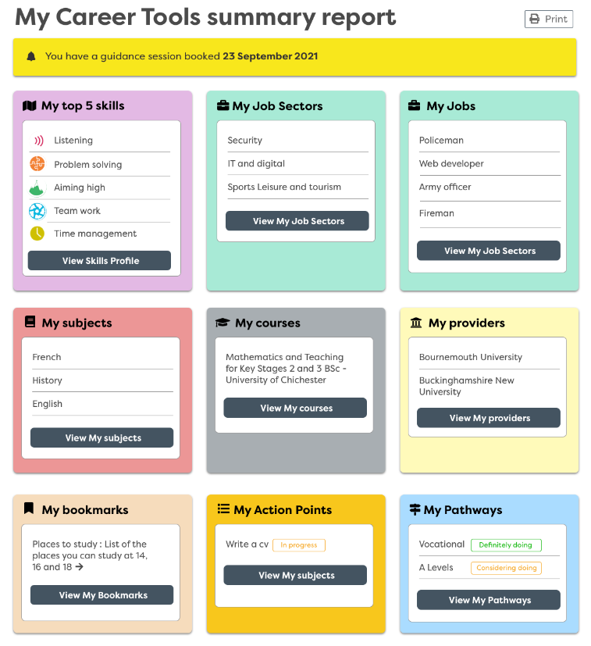
Notes:
This is a summary of the students Careerpilot journey – highlighting the importance of tagging and using it as often as possible.

Slide 20
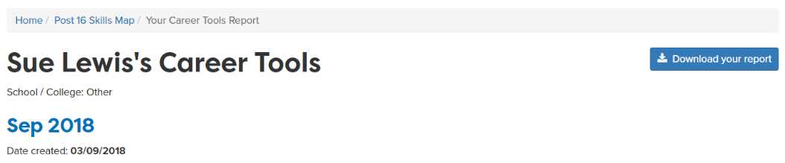

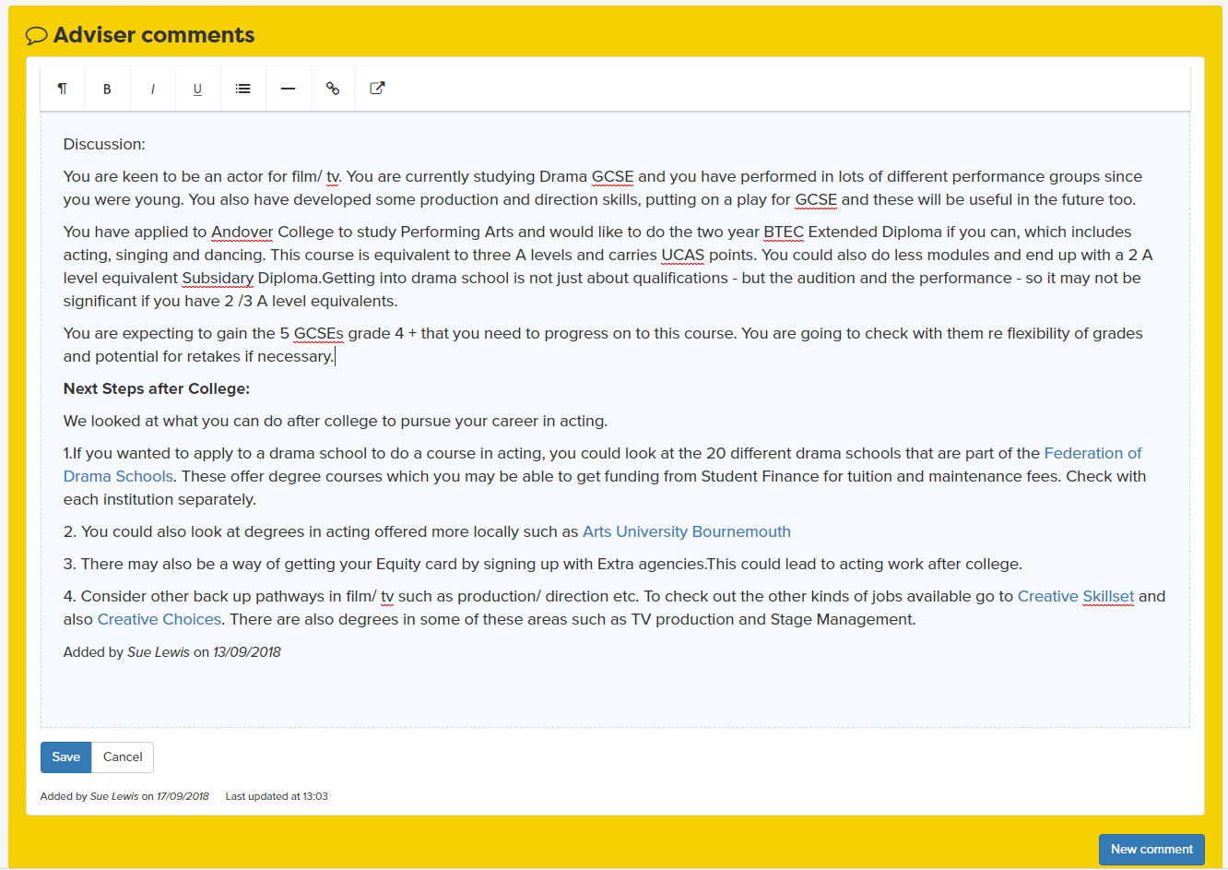



Report moves up each year
Notes:
This is a summary of the students Careerpilot journey – highlighting the importance of tagging and using it as often as possible. You can also find a more in depth report here which they are able to click on and look into further. It automatically moves up with them in September every year. PAUSE.

Slide 21
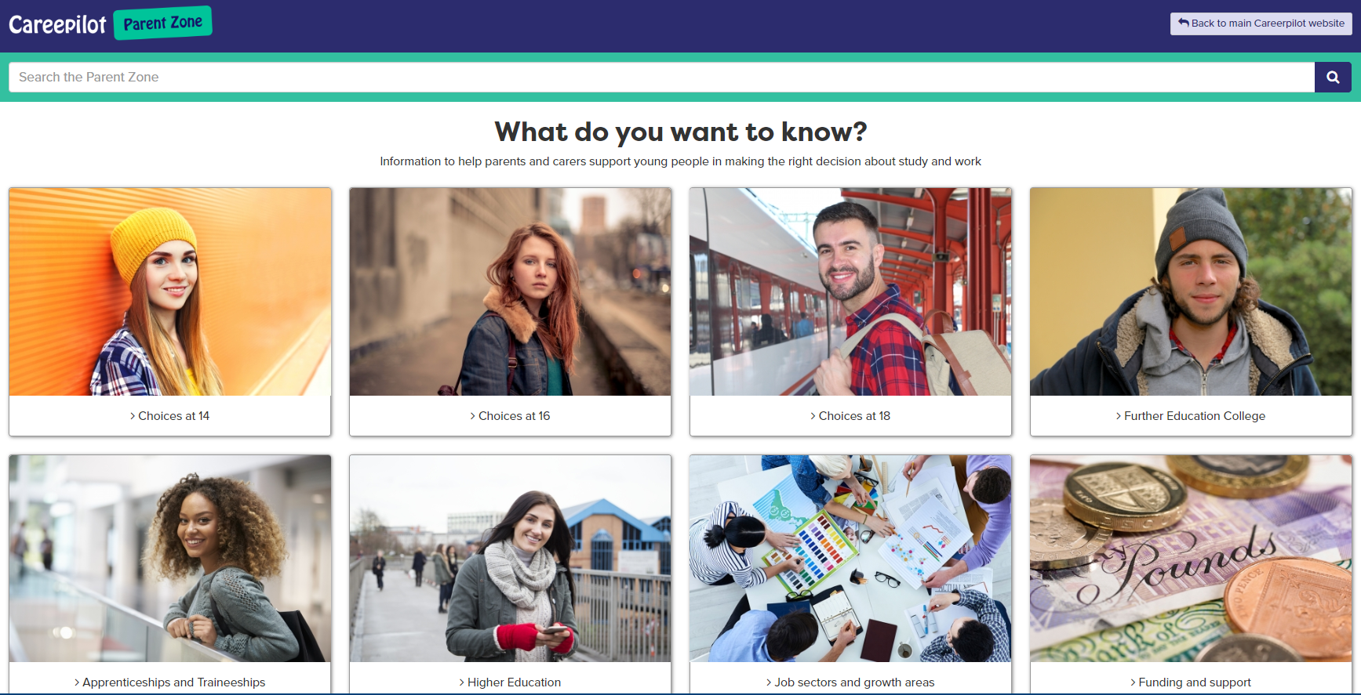
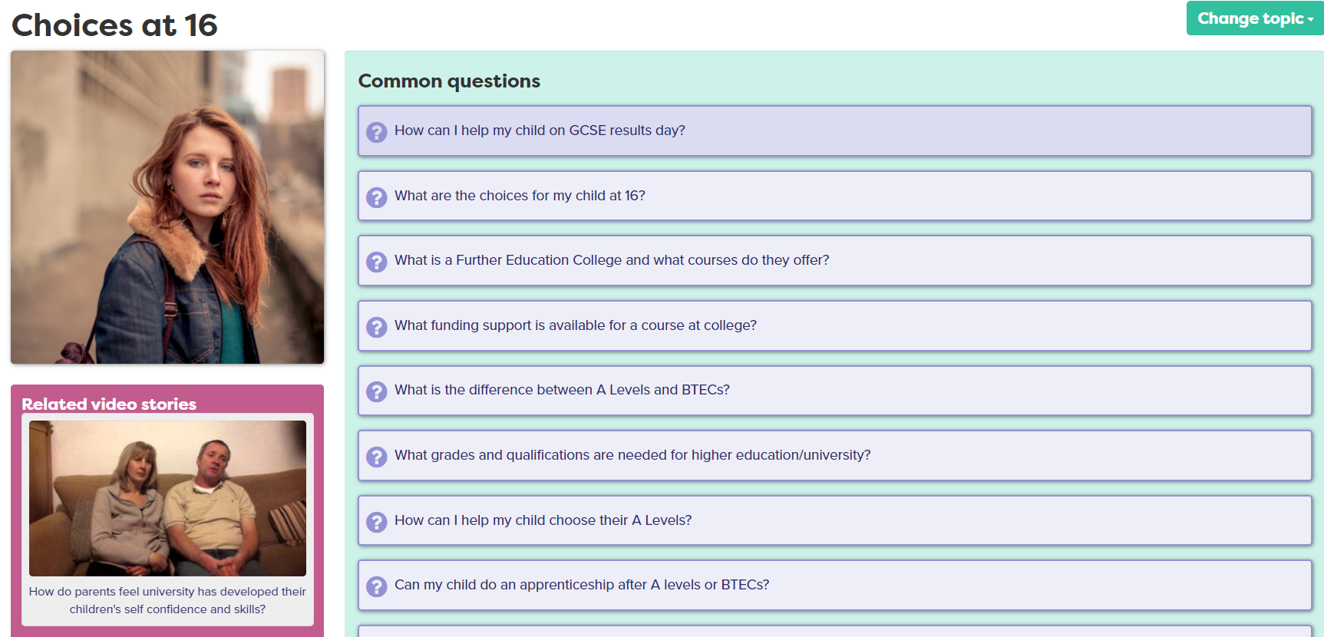
Parents and Carers
www.careerpilot.org.uk/parent-zone
Notes:
If you would like to tell your parents/carers about Careerpilot we have a free, no need to sign up Parent Zone for them to find out lots of information about their son or daughters career journey.

