Slide 1

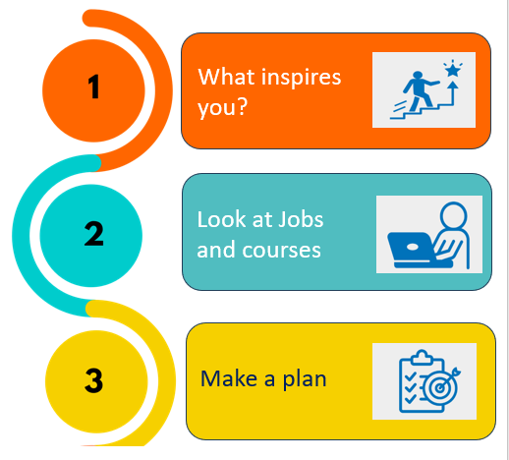

Name:___________________________
Year Group:_______________________
School:___________________________
Email used:_______________________
25-26
careerpilot.org.uk

Slide 2
About your GCSE subjects
Which GCSE subjects are you most looking forward to (Y9) or are most enjoying (Y10)?
Which do you think you will do best in?
Do you think you will get a grade 4 or above for: Maths?
English?
Yes
No
Not sure
About your ideas for your future: Date ______________
After Y11
Jobs
Your personal interests and skills
BUZZ QUIZ: Which animal were you and say 2 job sectors it suggested?
3 subjects you love
Your top three skills on the Skills Profile

Slide 3
Job Quiz Results
1
2
3
Job sector
Job sector
Job sector
%
%
%
Researching Jobs
Name of job_______________________
Pay______________________________
Grow by _________________________
Pathway 1:________________________
Pathway 2:________________________
Other information:_________________
_________________________________
Name of job_______________________
Pay______________________________
Grow by _________________________
Pathway 1:________________________
Pathway 2:________________________
Other information:_________________
_________________________________
Pathways at 16 – which are you thinking of doing?
Academic
Vocational/Technical
Apprenticeship

Slide 4
Where could you study?
Name of organisation:________________________________________________________________
What courses or training do they offer?
__________________________________________________________________________________
__________________________________________________________________________________
Give each a rating - out of 5 how interesting is this route to you (1 least, 5 most)
Name of organisation:________________________________________________________________
What courses or training do they offer?
__________________________________________________________________________________
__________________________________________________________________________________
What ideas do you have? Date ________________
After Y11
After Y13
Job ideas
Put them in order of your preference – add 1, 2 3.
6th Form
College
Apprenticeship
Click on any you are already thinking of:
University
College
Apprenticeship
Work
-----------------------
-----------------------
-----------------------
-----------------------
Agreed actions
Action: By when:
Action: By when:
Your full report will be in your Career Tools – careerpilot.org.uk

