Slide 1









Careerpilot Reporting Zone
Manage students
How to move accounts out of your school
How to set up sub-groups

Slide 2
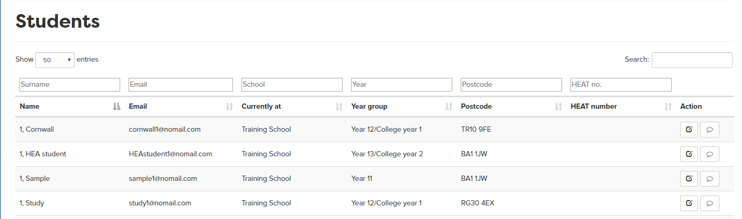

Find the student you want to look at or manage
Search for the student
frankfurter@nomail.com
Click edit to view record

Slide 3
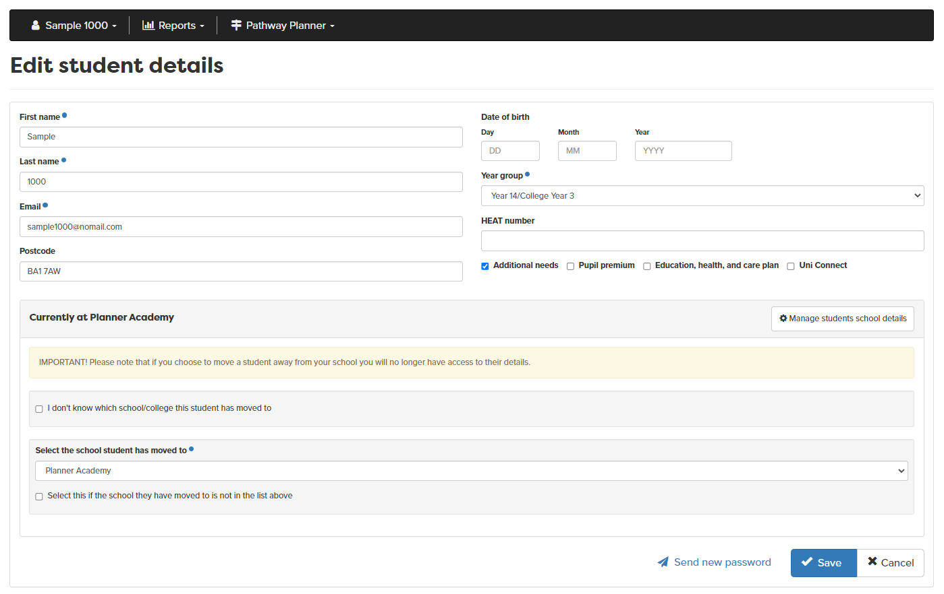
The Student Record – how to move them out of your school
If you want to move the student, click here
Save
Click here

