Slide 1

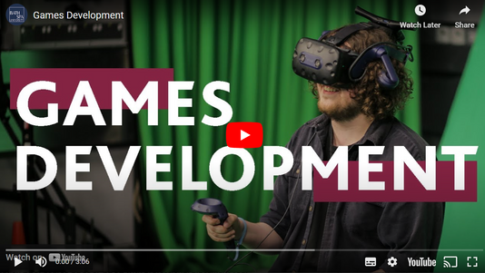


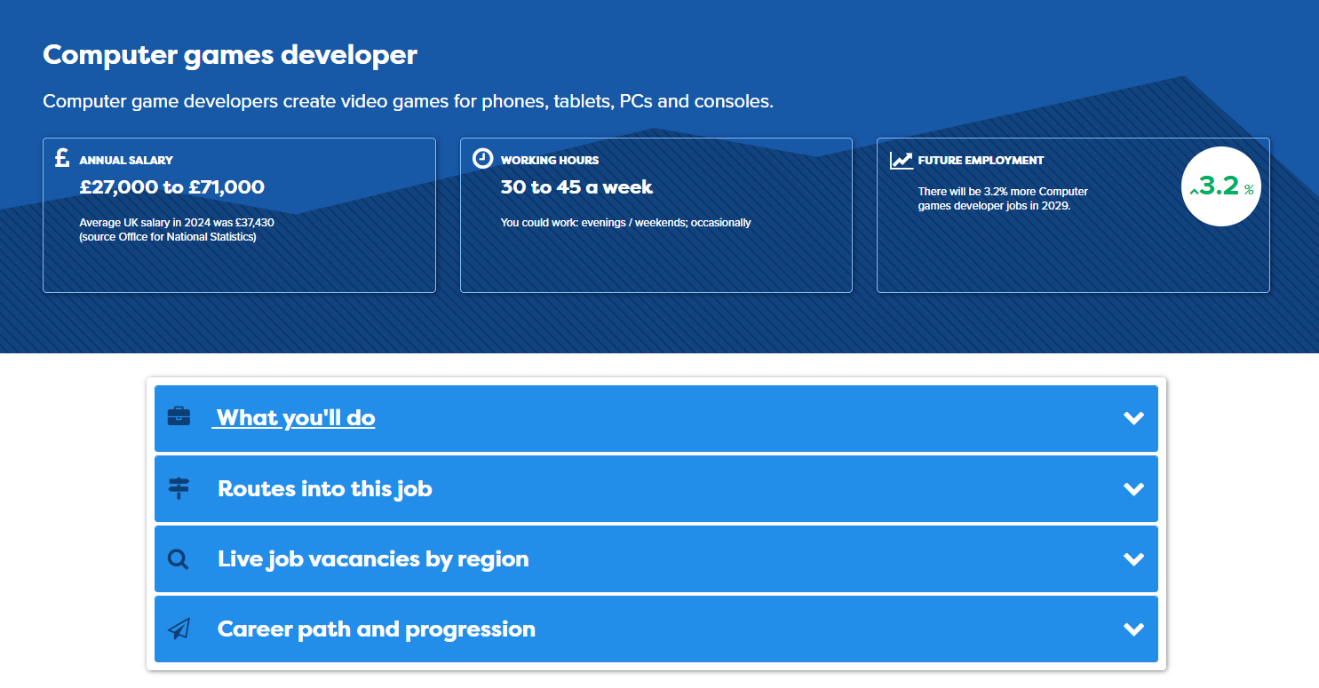




Digital Hot Jobs Activities: Teacher Notes
This set of 5 Hot Jobs classroom activities introduces students to a range of different digital jobs that are predicted to grow over the coming years with the final session giving time for students to explore other jobs they may be interested in. The activities can be delivered in 15-20 minutes, so could be used in tutor time or as part of a longer lesson.
For each Hot Jobs classroom activity students will:
  Watch a video about the job (3-5 minutes). There is a link to the video from the individual lesson page. Right click on the link and open the video in a new tab to play the video to your class.
  Find out more about the job from the Careerpilot job profile or printed posters (5 minutes). There is a link to the relevant Careerpilot job profile from the individual lesson pages to share from the front (right click to open in separate tab to view). Or students can find the job profile independently using the Job search on Careerpilot (use slide 2 to show how). You can also print out the relevant Hot Job posters which feature a QR code to access the job profile using a phone – see slide 3.
  Students can then work in pairs or as a class to answer questions about the job role using the information from the video and in the job profile (5-10 minutes).
Add a little bit of body text
Add a little bit of body text
Add a littl of body text
These classroom activities support your students to building the following essential skills:
careerpilot.org.uk

Slide 2
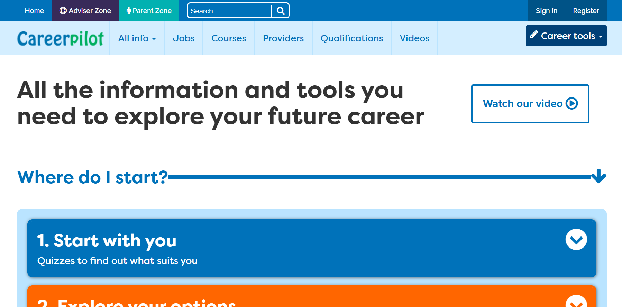
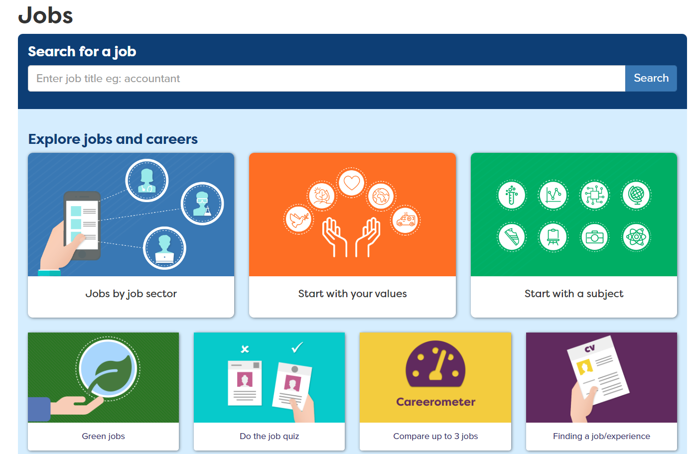
Accessing the Digital Hot Jobs Profiles
1. Go to careerpilot.org.uk and click on ‘jobs’
3. Explore job profile to learn more about the role and the routes into it.
2. Search for job role
Add a little bit of body text
Add a little bit of body text
Add a littl of body text
careerpilot.org.uk

Slide 3

Digital Hot Jobs Posters
Posters available to print from Careerpilot Advisor Zone.
Log in to Careerpilot then go to Hot Jobs Resources – Digital and IT Hot Jobs Resources
Add a little bit of body text
Add a little bit of body text
Add a littl of body text
Find pathways in this job and relevant subjects
Find average salary and predicted job growth
careerpilot.org.uk

Slide 4
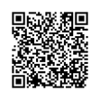



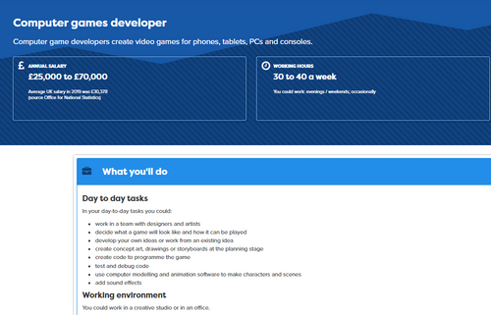


Computer Games Developer:
Short Lesson Activity
Computer game developers create video games for phones, tablets, PCs and consoles.
Watch the video: Games Development
Explore the job profile
Lesson Activity - Teacher Notes
This classroom activity will help students explore and understand more about this digital & IT job role.
  Play the short video from the front (5 mins)
  Students explore key information on the relevant Hot Job poster or job profile on Careerpilot (5 mins)
  Use prompt questions to discuss and feedback in pairs or as a class (5-10 mins)
Add a little bit of body text
Add a little bit of body text
Add a littl of body text
Working in pairs or as a class discuss:
  Name three skills you might learn on a Games Development course?
  What other industries might make good use of game development skills?

Slide 5
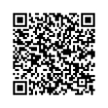

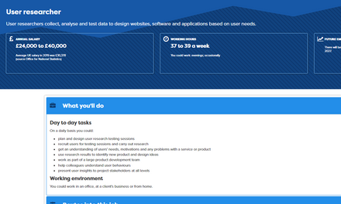
User Researcher:
Short Lesson Activity
User researchers collect, analyse and test data to design websites, software and applications based on user needs.
Watch the video: Becoming a User Researcher
Explore the job profile
Lesson Activity - Teacher Notes
This classroom activity will help students explore and understand more about this digital & IT job role.
  Play the short video from the front (5 mins)
  Students explore key information on the relevant Hot Job poster or job profile on Careerpilot (5 mins)
  Use prompt questions to discuss and feedback in pairs or as a class (5-10 mins)
Add a little bit of body text
Add a little bit of body text
Add a littl of body text
Working in pairs or as a class discuss:
  Which skills would be useful for this job?
  What are the different routes you could take to get into this type of job?

Slide 6
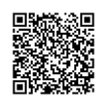

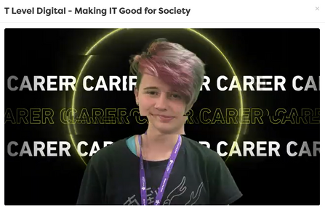
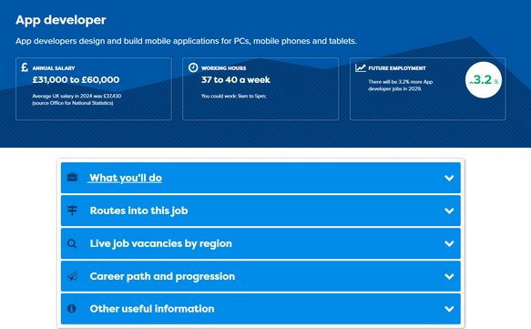
App Developer:
Short Lesson Activity
App developers design and build mobile applications for PCs, mobile phones and tablets.
Watch the video: Making IT Good for Society
Explore the job profile
Lesson Activity - Teacher Notes
This classroom activity will help students explore and understand more about this digital & IT job role.
  Play the short video from the front (5 mins)
  Students explore key information on the relevant Hot Job poster or job profile on Careerpilot (5 mins)
  Use prompt questions to discuss and feedback in pairs or as a class (5-10 mins)
Add a little bit of body text
Add a little bit of body text
Add a littl of body text
Working in pairs or as a class discuss:
  What other apps can you think of that are good for society?
  What subjects would be helpful to study if you want to work in this job role?

Slide 7
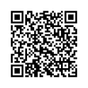

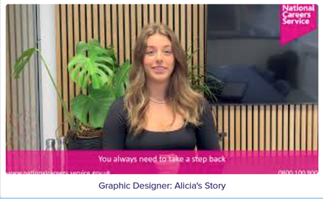
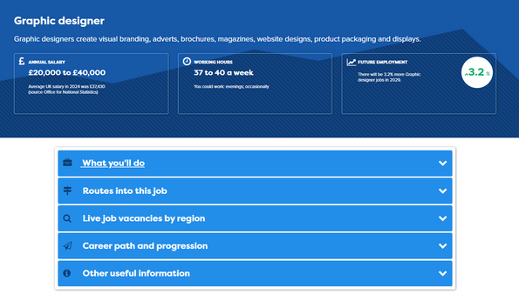
Graphic Designer:
Short Lesson Activity
Graphic designers create visual branding, adverts, brochures, magazines, website designs, product packaging and displays.
Watch the video: Graphic Designer - Alicia’s Story
Explore the job profile
Add a little bit of body text
Add a little bit of body text
Add a littl of body text
Lesson Activity - Teacher Notes
This classroom activity will help students explore and understand more about this digital & IT job role.
  Play the short video from the front (5 mins)
  Students explore key information on the relevant Hot Job poster or job profile on Careerpilot (5 mins)
  Use prompt questions to discuss and feedback in pairs or as a class (5-10 mins)
Working in pairs or as a class discuss:
  What sort of projects might you work on as a graphic designer?
  What skills do you think would be helpful for this role?

Slide 8

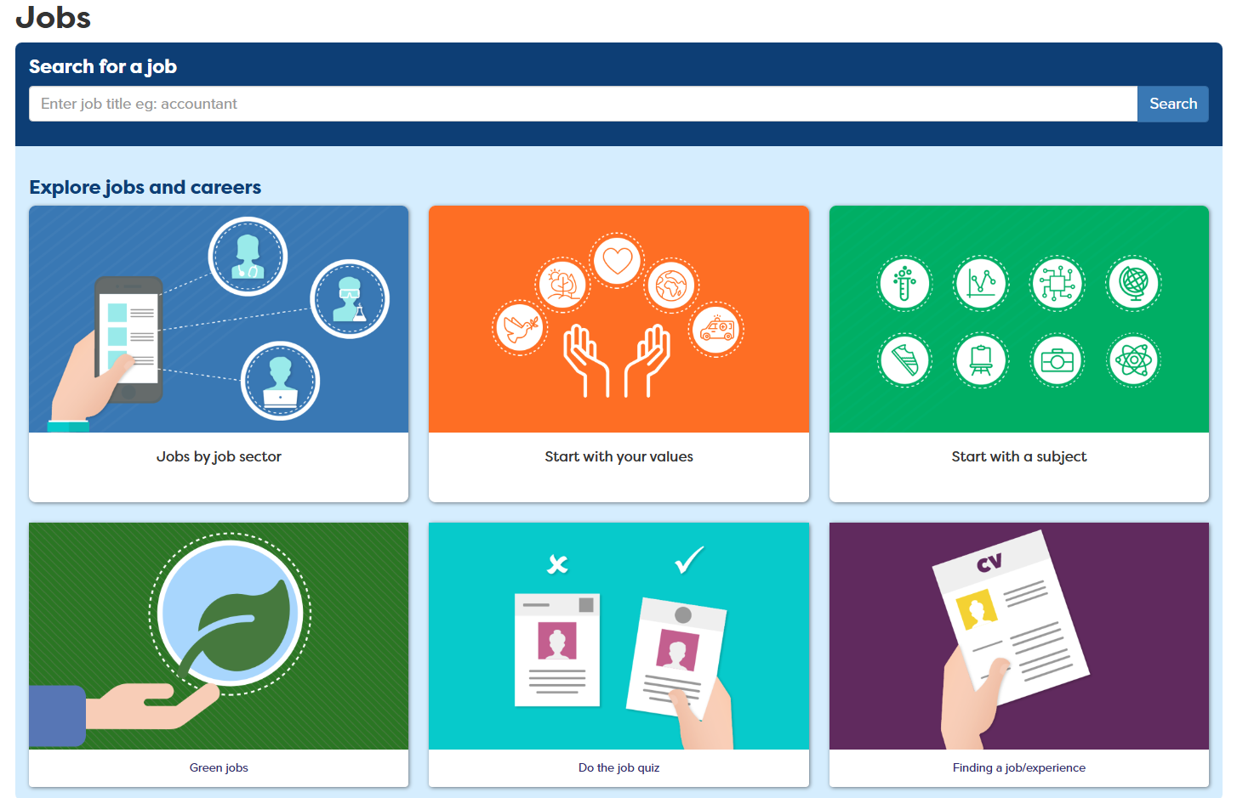

Explore more digital jobs on Careerpilot
Find other jobs on Careerpilot and explore the pathways into them.
Go to the Careerpilot Jobs Search and click on Jobs by Jobs Sector
Choose 2 job profiles from the IT and Digital sector to explore further
Teacher notes - What’s in the Job?
This classroom activity will help students explore and understand about more other job roles and the pathways into them.
  Visit the Careerpilot job search page
  2. Choose 2 job profiles to explore in more detail, including job growth, salary and the pathways into them
  Discuss the job roles in pairs or as a class using prompt questions
Add a little bit of body text
Add a little bit of body text
Add a littl of body text
Working in pairs or as a class discuss:
  What 2 digital jobs did you choose to explore?
  What different pathways can take to get into each of the jobs?

