Slide 1




Delivery Notes
Before session 1, ask school to ‘whitelist’ careerpilot.org.uk
All students to have own computer with Internet access.
Deliverer to have whiteboard for presentation.
Timings | Slides | Activity | Notes | Key tasks
15 mins | 1 - 8 | Setting the scene |  | Yes
20 mins | 9 - 16 | Thinking about you - quizzes | Workbook | Yes
20 mins | 17 - 21 | Exploring jobs | Workbook | Yes
5 mins | 22 - 24 | Wrap-up
After session 1, send school summary of what covered and Digital Postcard for session 1 to send to each students. Remind the school of what you need for session 2 – each students to be able to access Google Maps and Google searches.

Slide 2
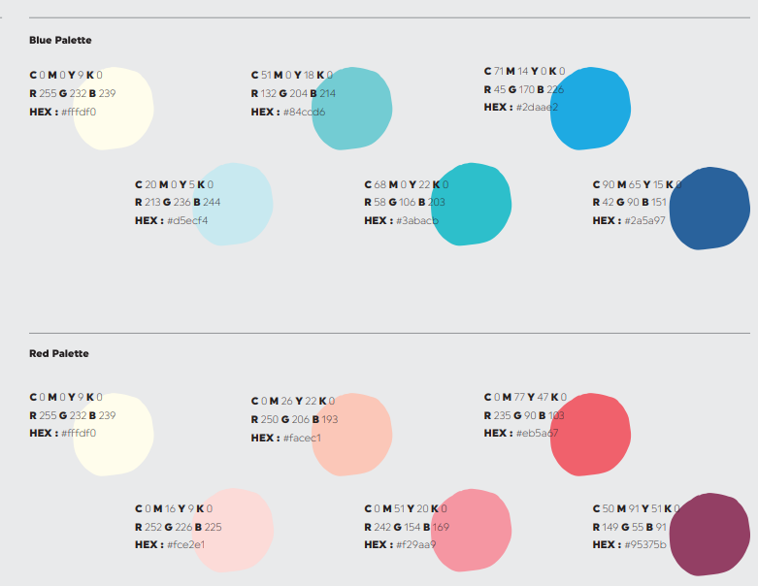




Specially designed to help you develop your skills and explore and plan your future work experience placement
What do YOU want from life and future work?
Introduce and Inspire
Investigate and Explore
Exploring work experience opportunities and YOUR skills.
Having what YOU need to apply for and have a great work experience
Apply
and Demonstrate

Slide 3


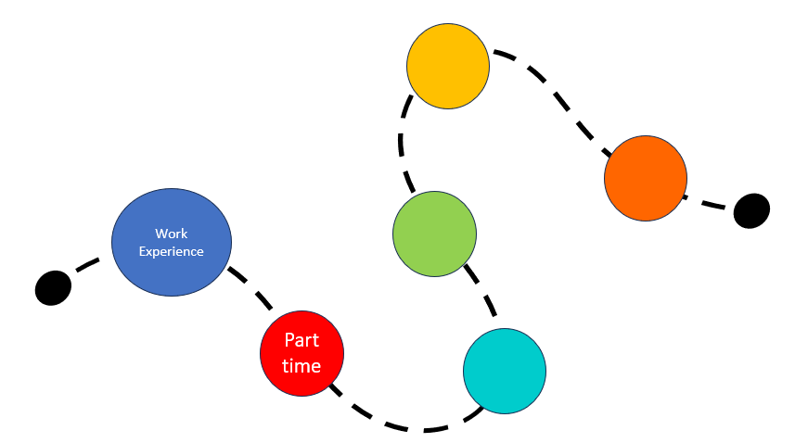
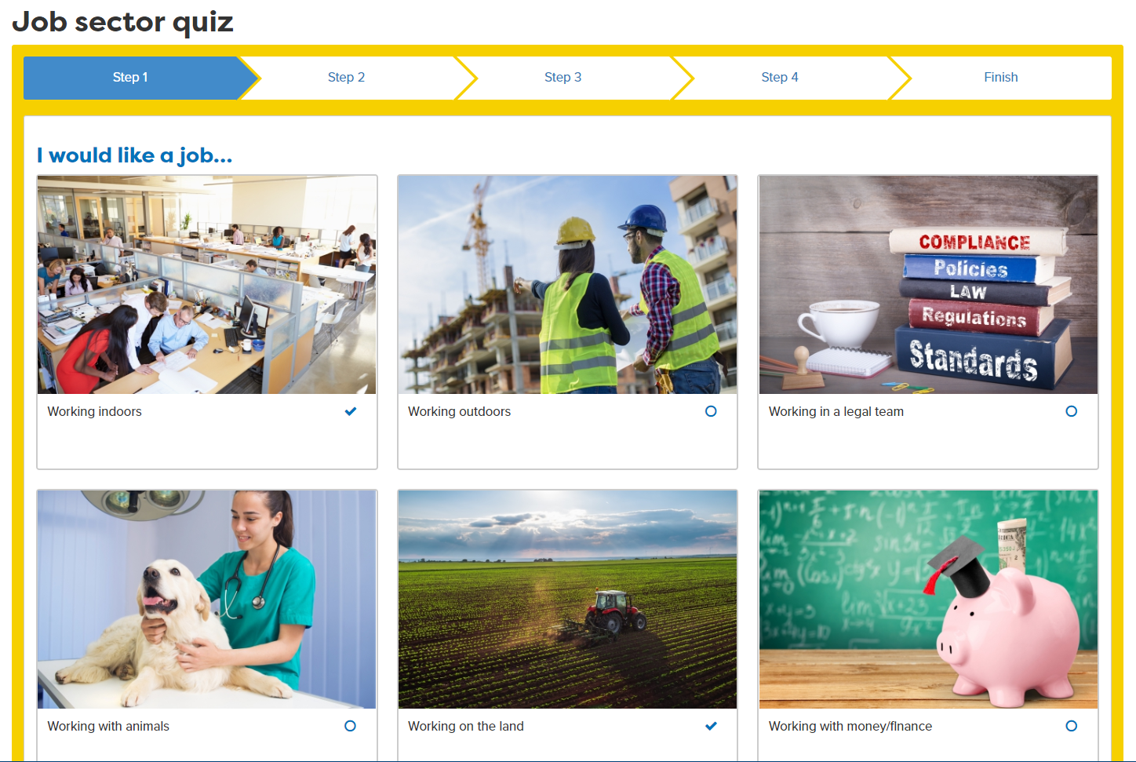
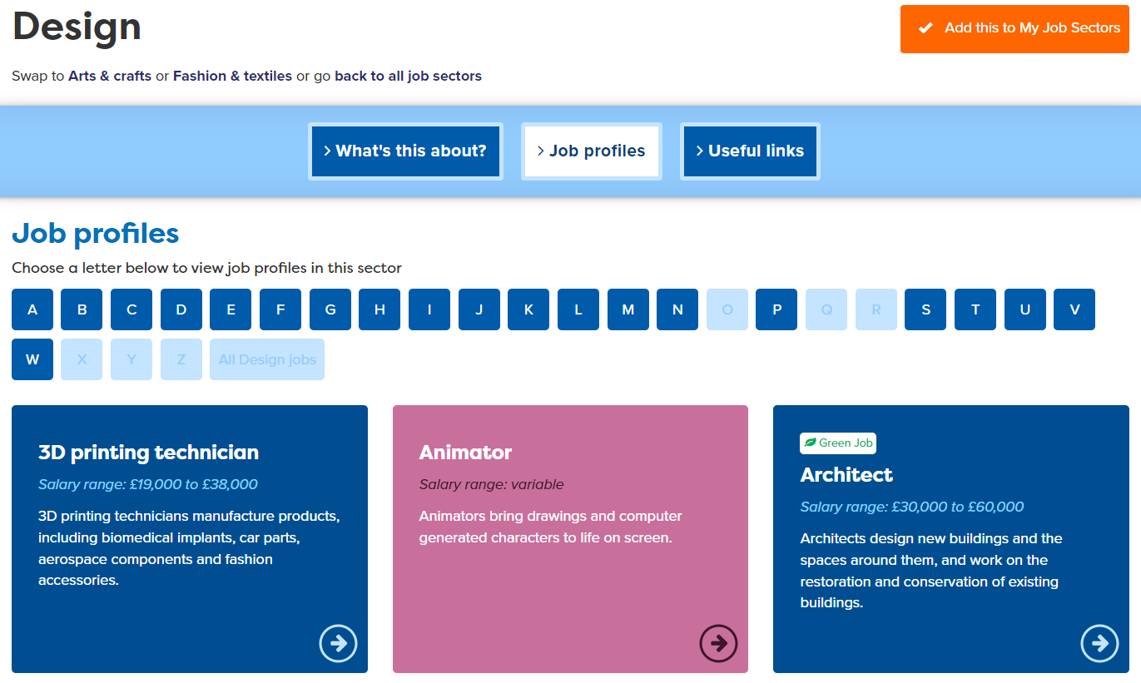
In this session you will:
1
  Understand the benefits of work experience and how it fits with your career journey
2
  Identify your interests and explore how these can inform future careers.
3
  Look at a few jobs to see how you might get into them.
careerpilot.org.uk
Notes:
Three key things to be covered in this session

Slide 4






What do you want in your future life?
?
What do we all need to get the things we want from life?
Notes:
Just say ‘Have you thought about what you want to get from future life?’ they don’t have to say but just making point that we all have ambitions.

Slide 5



It is not just about the money.
What other things do people get from a job?
5 mins
Notes:
The quote is a bit tongue in cheek as guess very unusual we love our jobs that much – so intended to be a bit of a joke – also attributed to Churchill but on Internet sometimes attributed to Ghandi, etc. Does make the point though that having a job we like is better than not!
Explain that what we all need to be able to do the things we want is usually funds, and we get them from having a job. Loads of different types of jobs. But that is not the only thing we get from working. See if they can come up with some ideas like:
Job satisfaction
Meet new people
Learn new things
Gives us purpose
Enjoy leisure time more as have contrast.

Slide 6
What different places can people work?
Office
Home
Workshop
In a hospital
Digital nomad
Outdoors
Notes:
Ask students to come up with differentworking contexts, maybe from the people they know, parents, etc.
Office
Home
Workshop
Outdoors
Shop
Digital nomad – working in a digital job in different locations
Hospital
Make point about – full-time, part-time, shifts, etc.

Slide 7

What is a career?
A career is an individual's journey through life, learning and work.
It is all about YOU!
Work Experience
Part time
Throughout your career you may have many jobs.
Notes:
WEX first stage on career journey

Slide 8






Work experience can help with your career choices
Y10 Work Experience
Choosing post 16
Choosing post 18
Notes:
Will be diving into more detail about WEX in session 2 but in summary WEX can help you with future choices about qualifications as well as jobs.

Slide 9

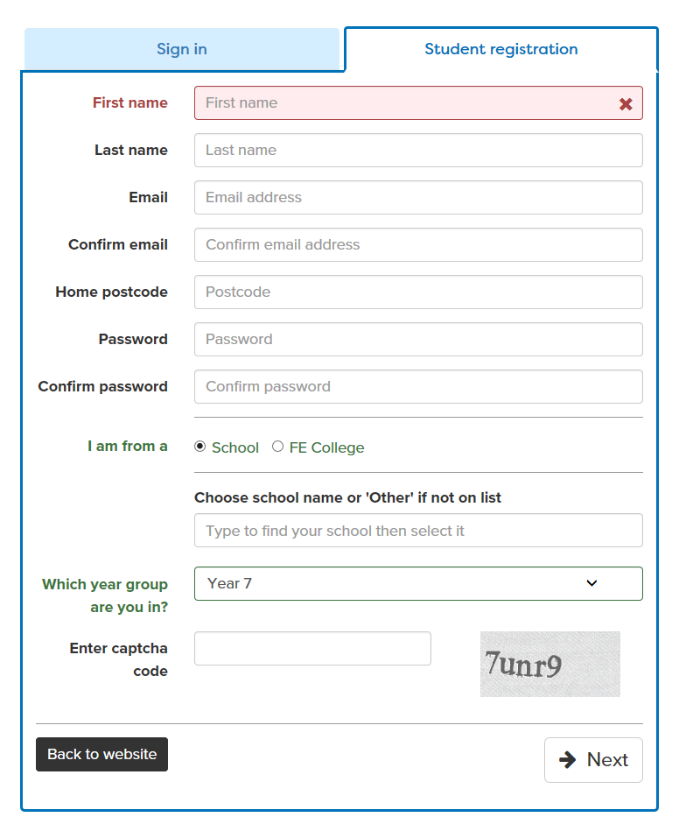
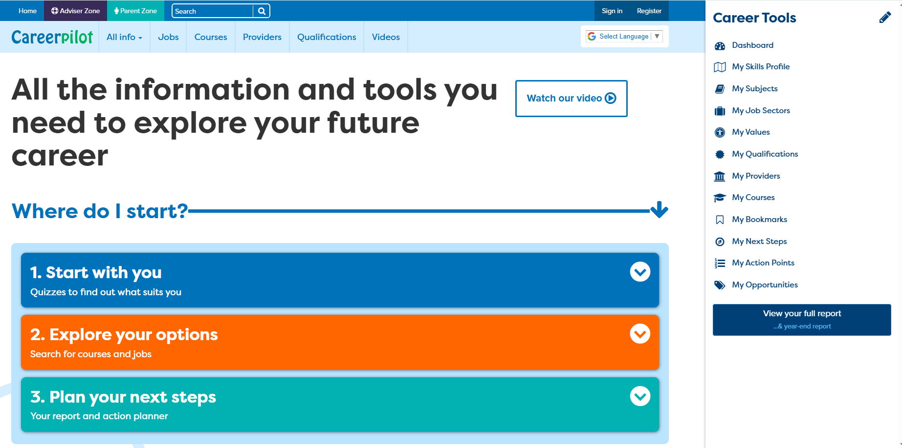
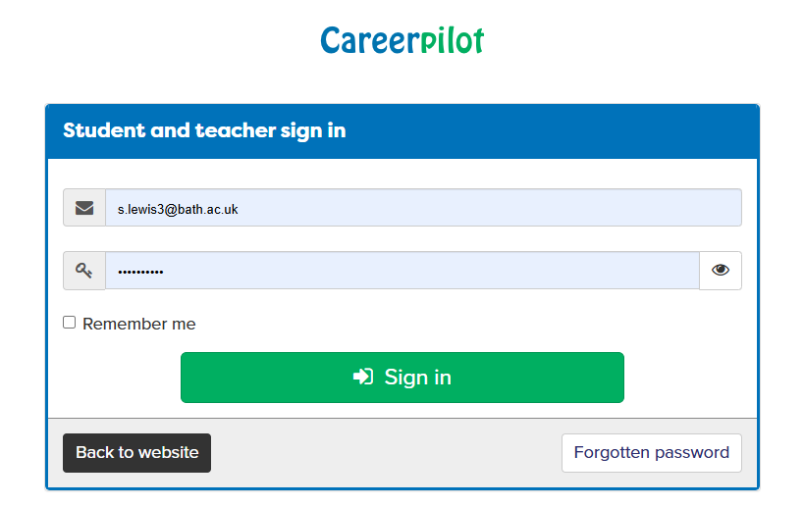
A website to help with your career
careerpilot.org.uk
If you have registered before – sign in
This has to be the email you used to register
Notes:
They should only set up new account of they do not have one already, otherwise they should ‘sign in’. They can do ‘forgotten password’ from the sign in screen. They must use the same email they used to register and go to that email address to pick up the new password link.

Slide 10
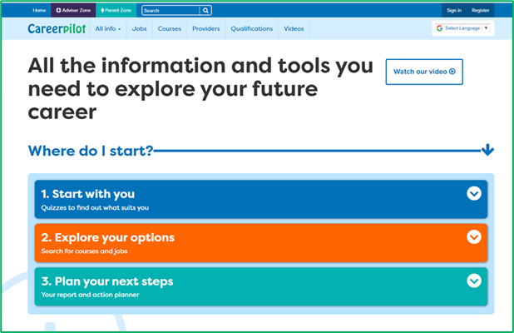
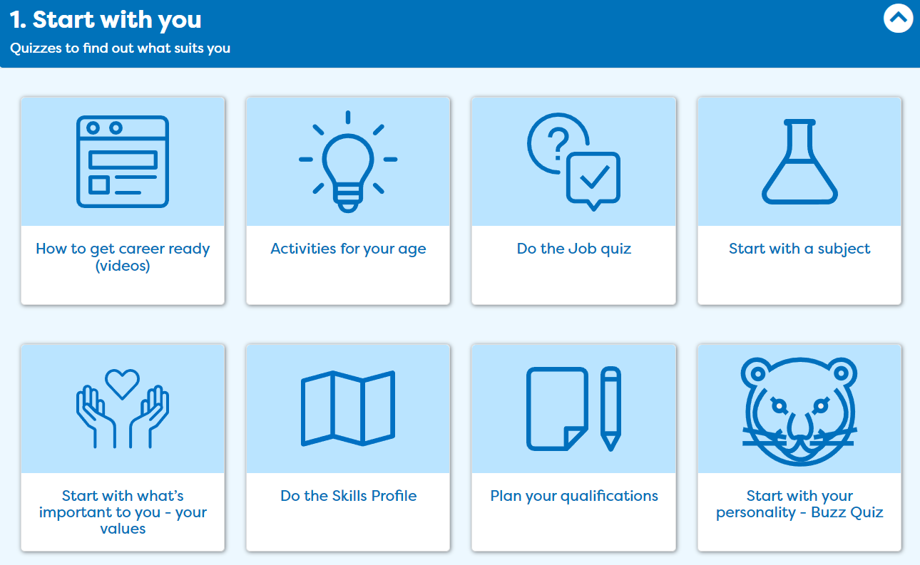
But what might suit you?

Slide 11
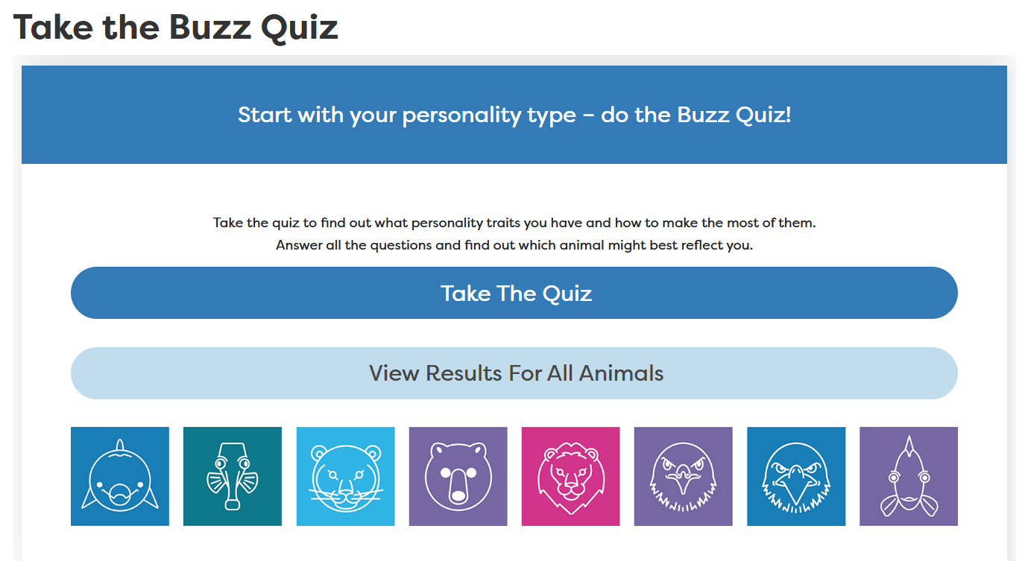
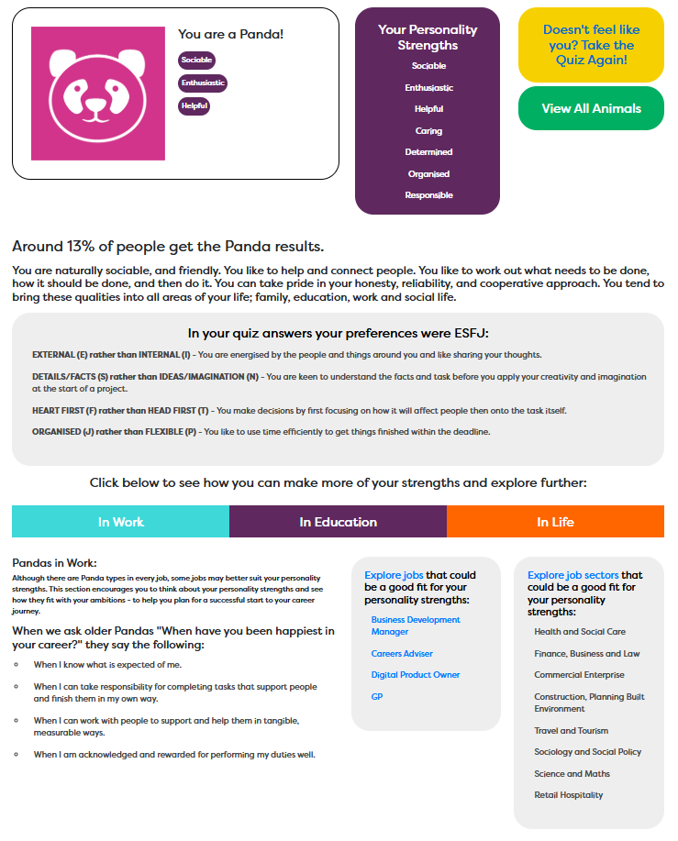
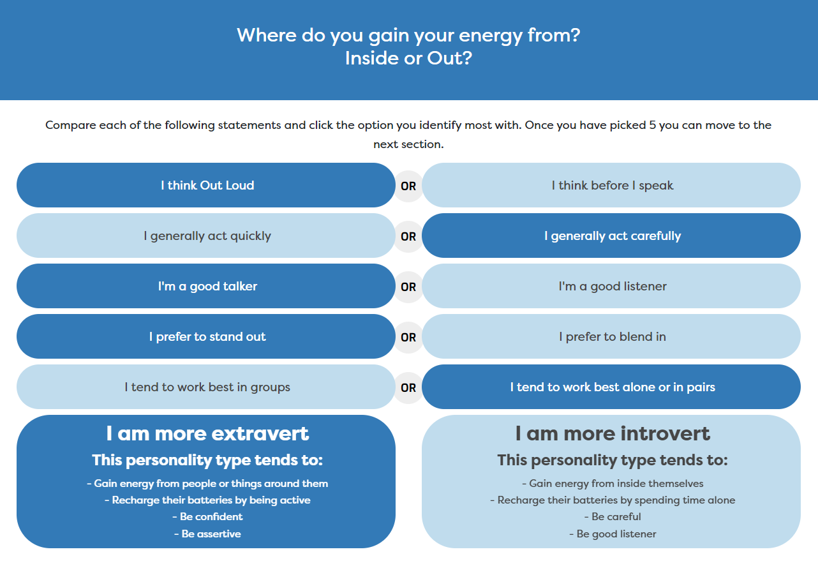
We all have different types of personality traits, what are yours?

Slide 12
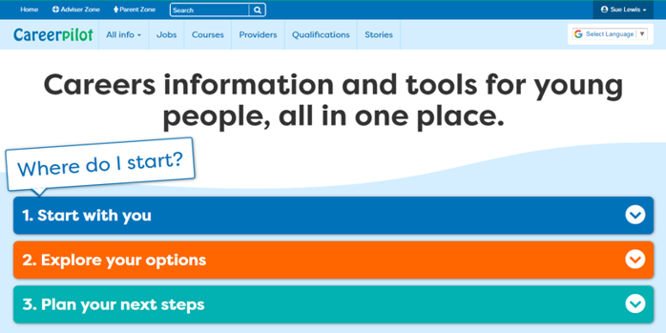
What would you like from a future job?

Slide 13
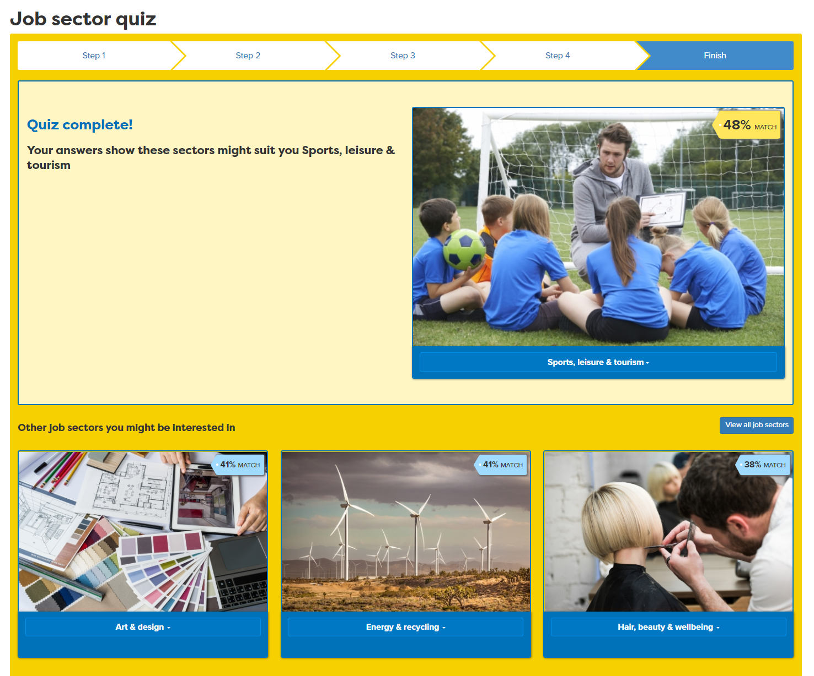
Click on any pictures that match what you want

Slide 14
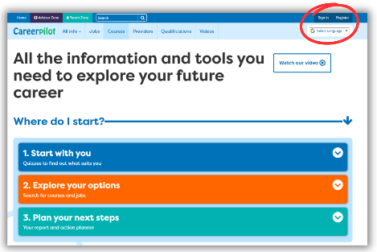
Task
Register/sign in to Careerpilot
This has to be the email you used to register
2. Complete the Buzz Personality Quiz to discover your personality type. Make a note of your animal.
10 mins
3. Complete the Job Quiz

Slide 15

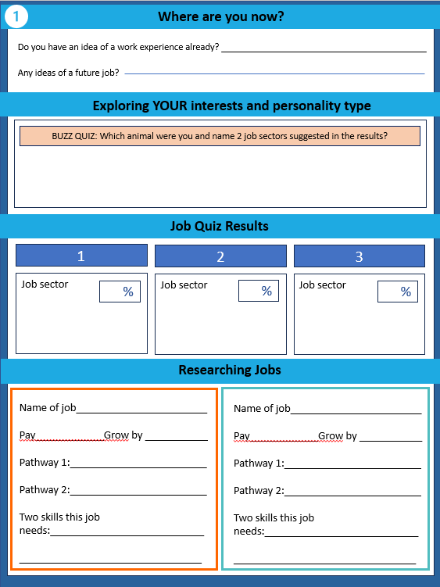

Workbook

Slide 16
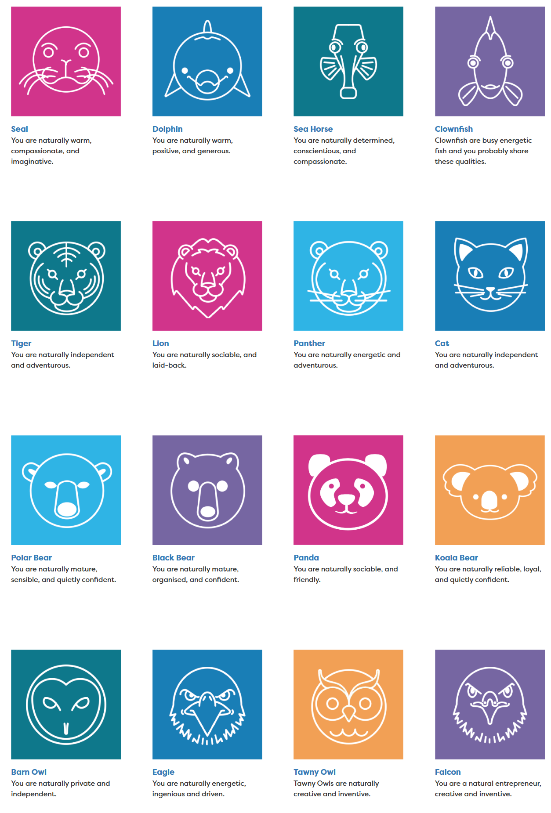


Feedback on your results
Your community/country/the world needs people of all types and people interested in all job sectors.
Notes:
Just ask a few people to put up hands if they were this animal, were recommended this job sector.
Mention that they are building skills as they go through the lessons.

Slide 17
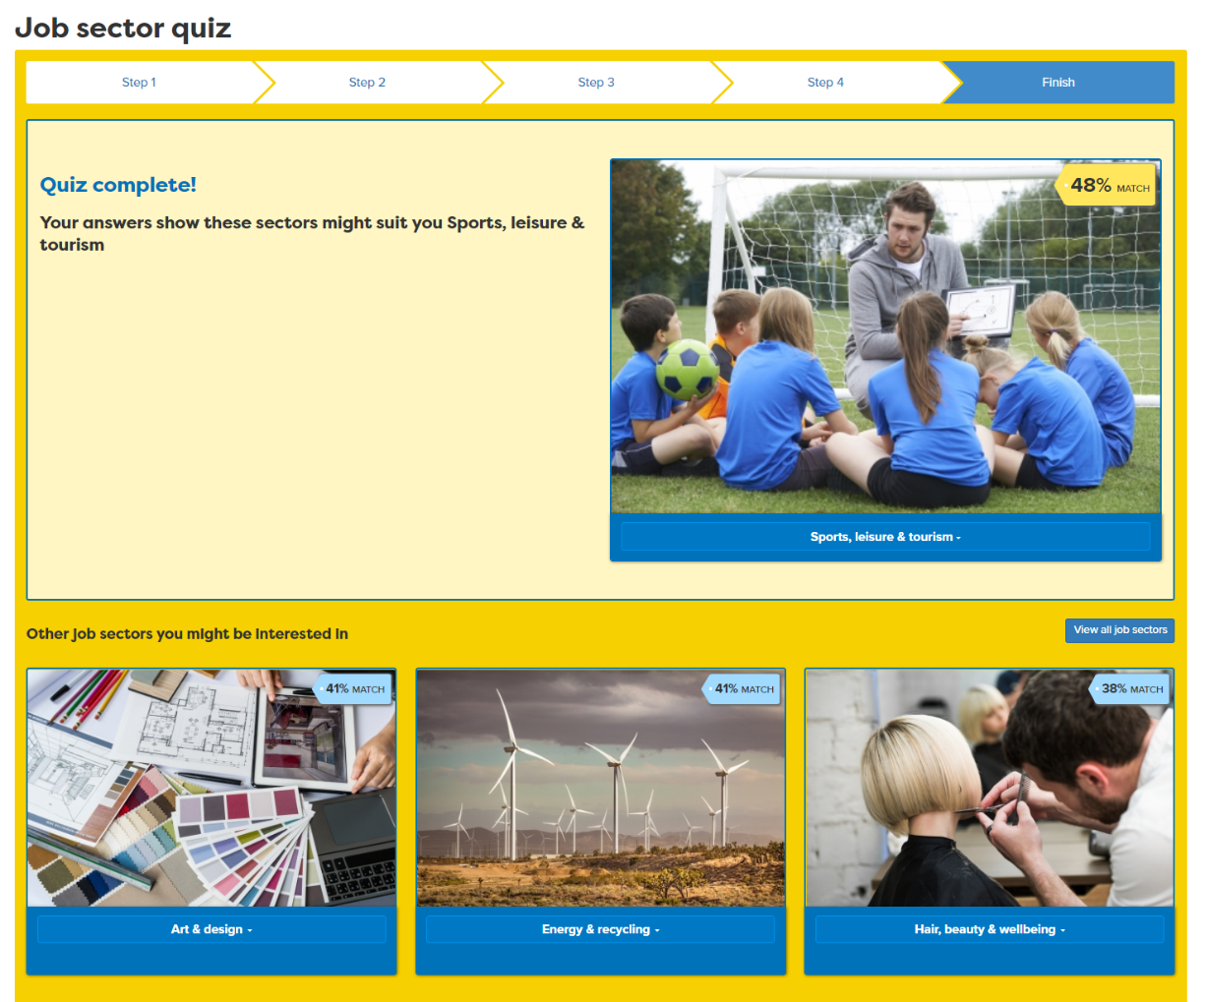
Use your results to start exploring
Notes:
Show how they can go from results to finding out what jobs are in that sector. Explain a job sector is the big thing and there will be lots of jobs in each one.

Slide 18
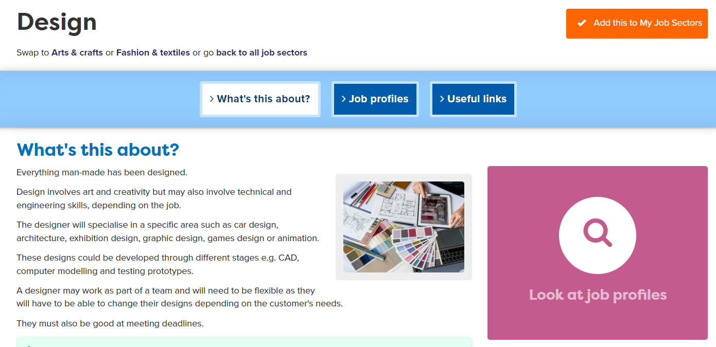
Exploring Jobs
Notes:
Show how there will be lots of jobs, some they will know a bit about but some might be completely new.

Slide 19
What are the routes into jobs?
What pathways can you choose at the end of Y11?
Academic
Vocational/Technical
Apprenticeship
Mostly in a 6th Form or 6th Form College
Mostly in a
local college but some also in schools
Mostly in a workplace
Notes:
Before get into detail of a jobs good to check their understanding of pathways as that will be mentioned on the job profile.
Explain pathways at 16, see what they know

Slide 20






The qualification ladder
Academic
Technical/Vocational
Apprenticeship
Degree Achieved
Degree Year 2
HND
Foundation Degree Y2
Higher and Degree Apprenticeship
Degree Year 1
HNC
Foundation Degree Y1
Higher and Degree Apprenticeship
A levels
T LEVEL other Level 3 - BTEC/OCR
Advanced Apprenticeship
5 x GCSEs 4 - 9
T Level Foundation and other Level 2
Intermediate Apprenticeship
GCSEs 1 - 3
Notes:
Quick show of big picture to show where they are now and explain how can get to Level 6 degree from any pathway.

Slide 21
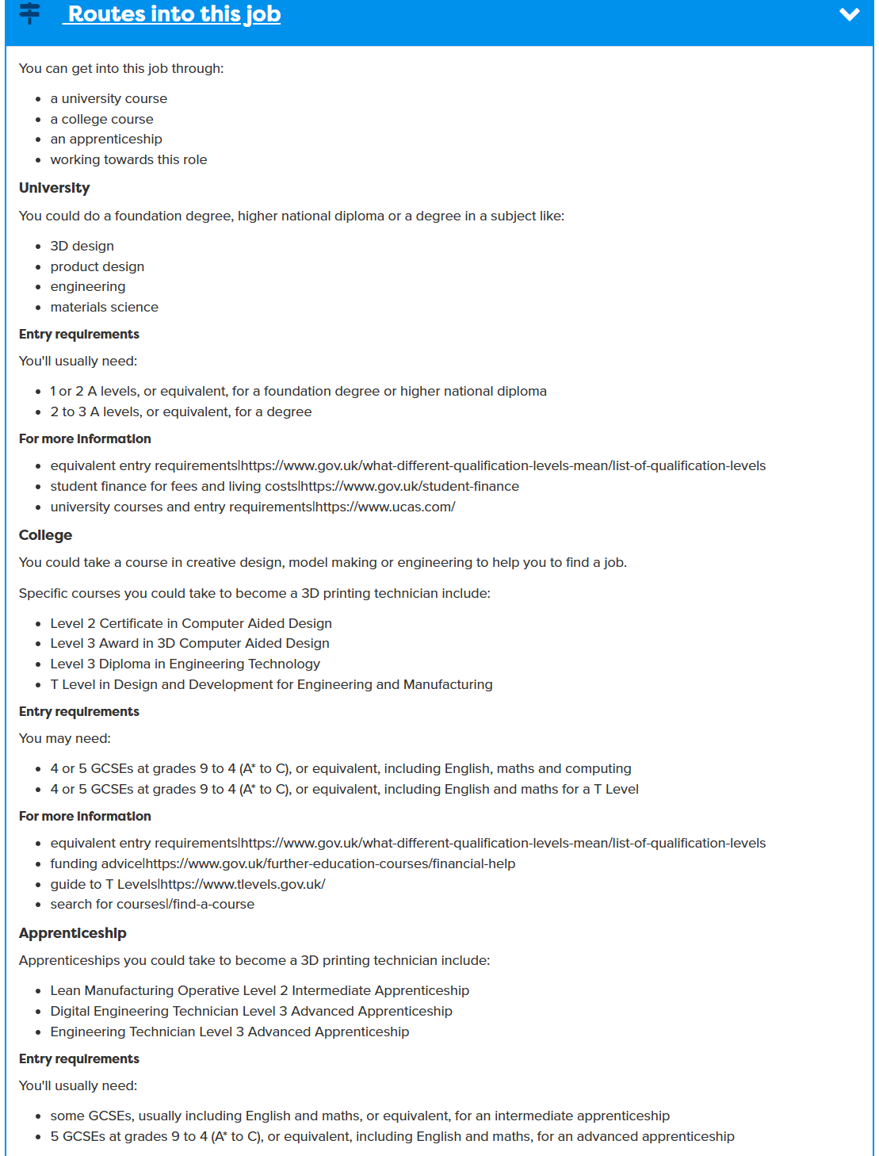
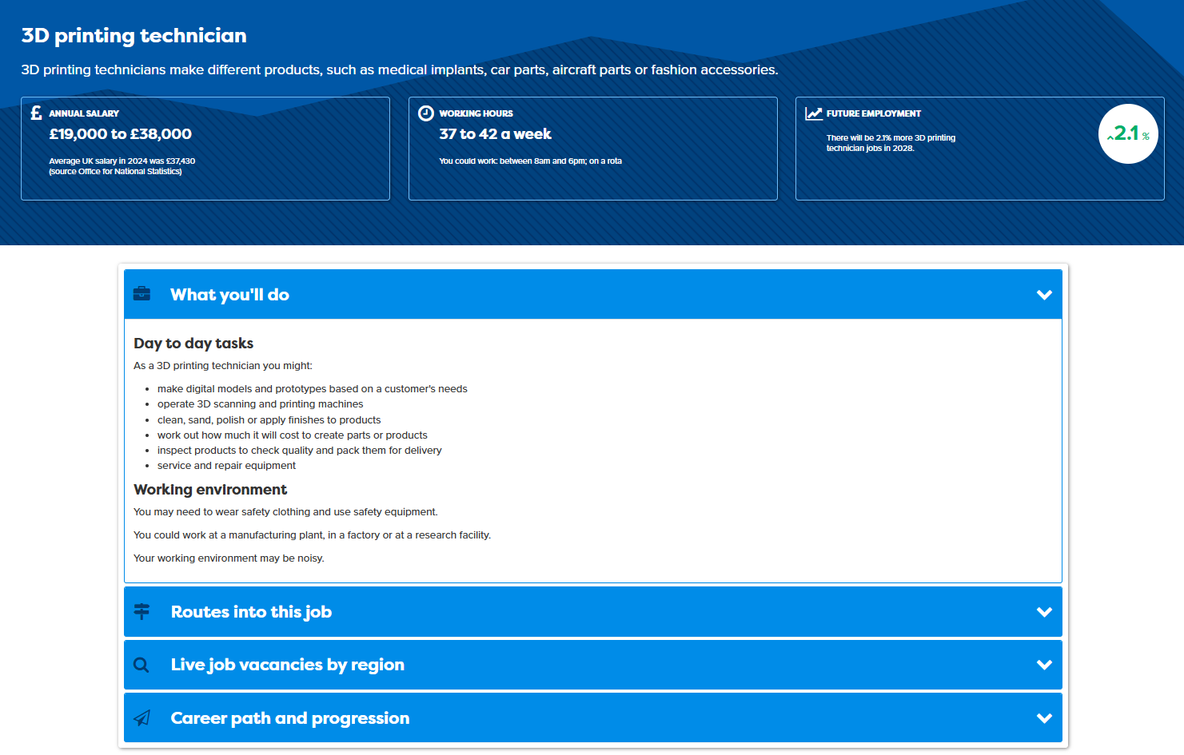
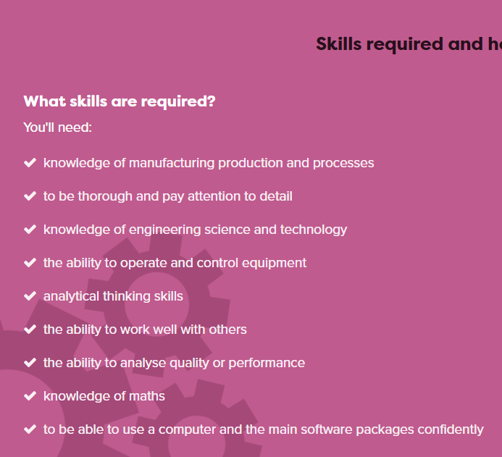
Researching jobs
Look at 2 jobs
Notes:
Explain job profile, salary, grow by, pathways, and further down on pink background, skills

Slide 22
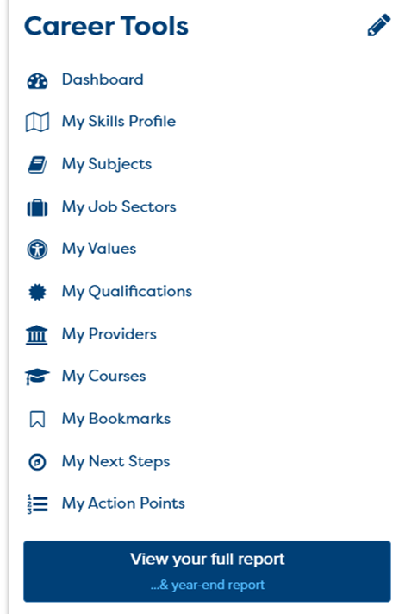
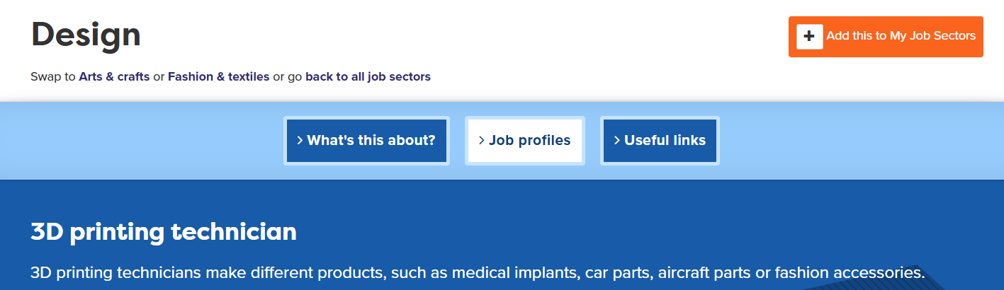
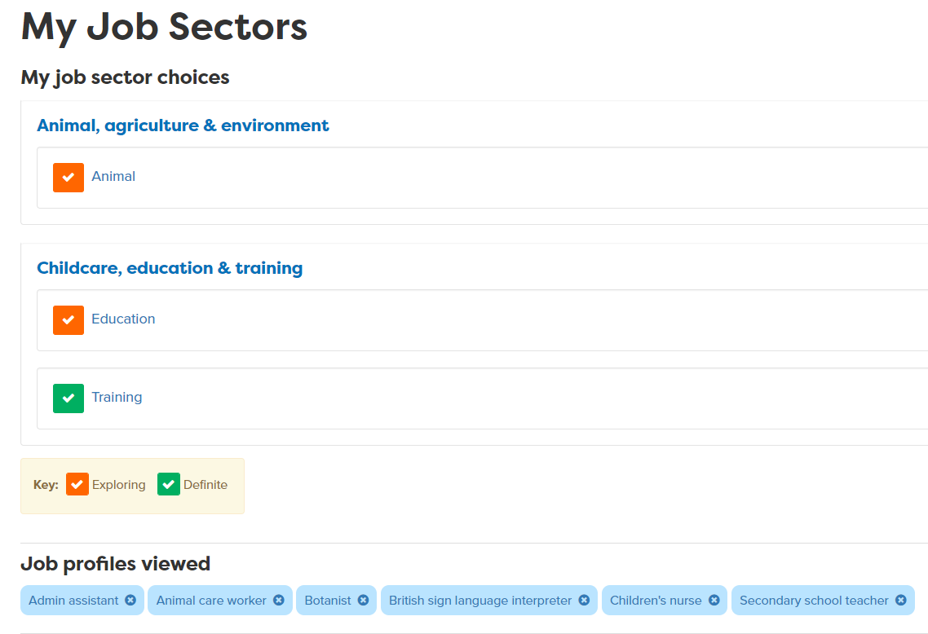
Add any job sectors you like to your Career Tools

Slide 23
In this session you completed:
1
  Understand the benefits of work experience and how it fits with your career journey
2
  Identify your interests and explore how these can inform future careers.
3
  Look at a few jobs to see how you might get into them.
careerpilot.org.uk
Notes:
Three key things to be covered in this session

Slide 24

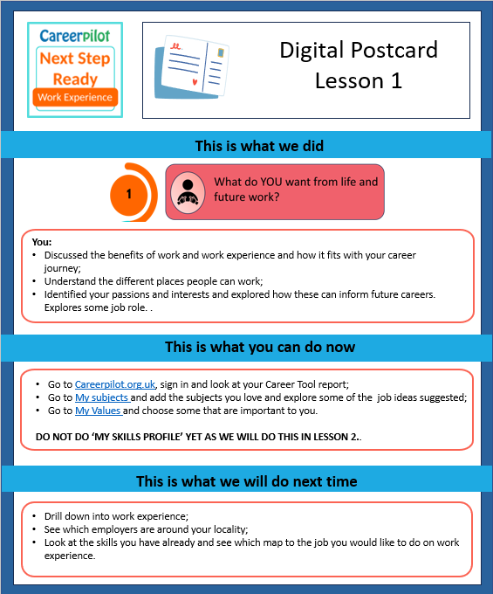
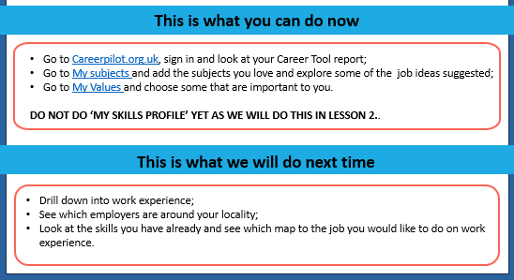
What now?
LESSON 2
Next session: XX
careerpilot.org.uk
Notes:
Please send digital postcard to main link teacher and ask them to send to the students

