Slide 1

Introduction to Careerpilot for Parents and Carers
careerpilot.org.uk
Notes:
Introductions of attendees – webinar protocol – cameras on to say hi, then ok to turn mic and cameras off for the session if preferred. Use chat for any questions throughout – we will check questions to answer at the end of presentation.

Slide 2
Agenda
The changing careers landscape
Introducing Careerpilot
Careerpilot Parent Zone

Slide 3


What does the future look like for our young people?
Careers in the past
Careers in the future?
Notes:
Before looking at Careerpilot its worth looking at the bigger picture, in terms of the careers landscape.
There has been a move away from the idea of a ‘job for life’ to a more varied and squiggly career path. It’s important for young people to keep up with what is happening and how things are changing, equipping them with the skills they need to be proactive, to adapt and build resilience for the future.
Research shows young people born in 2002, are likely to live to 100 and have 17 different jobs!

Slide 4

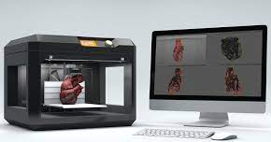
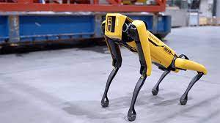

The growth in automation is impacting on some jobs
Notes:
The employment landscape is constantly evolving. Jobs are changing with the growing use of AI and automation impacting on tasks and skills needed in the workplace. This could result in a decline in some jobs that involve repetitive tasks that can be automated, but a growth in many other jobs that rely on uniquely human skills, along with many new roles needed to work with emerging technologies.

Slide 5




Which employment sectors are predicted to grow?
Medical, Health Science and Care
Digital and IT
Engineering and Construction
Environmental/Green Jobs
Notes:
Its important for young people to keep up with what is happening and how things are changing.
Job sectors that are expected continue to grow include medical and health, IT and technology, engineering and construction and environment or green jobs.
There are many routes into these sectors, including academic, vocational and apprenticeships that students need to be aware of.

Slide 6

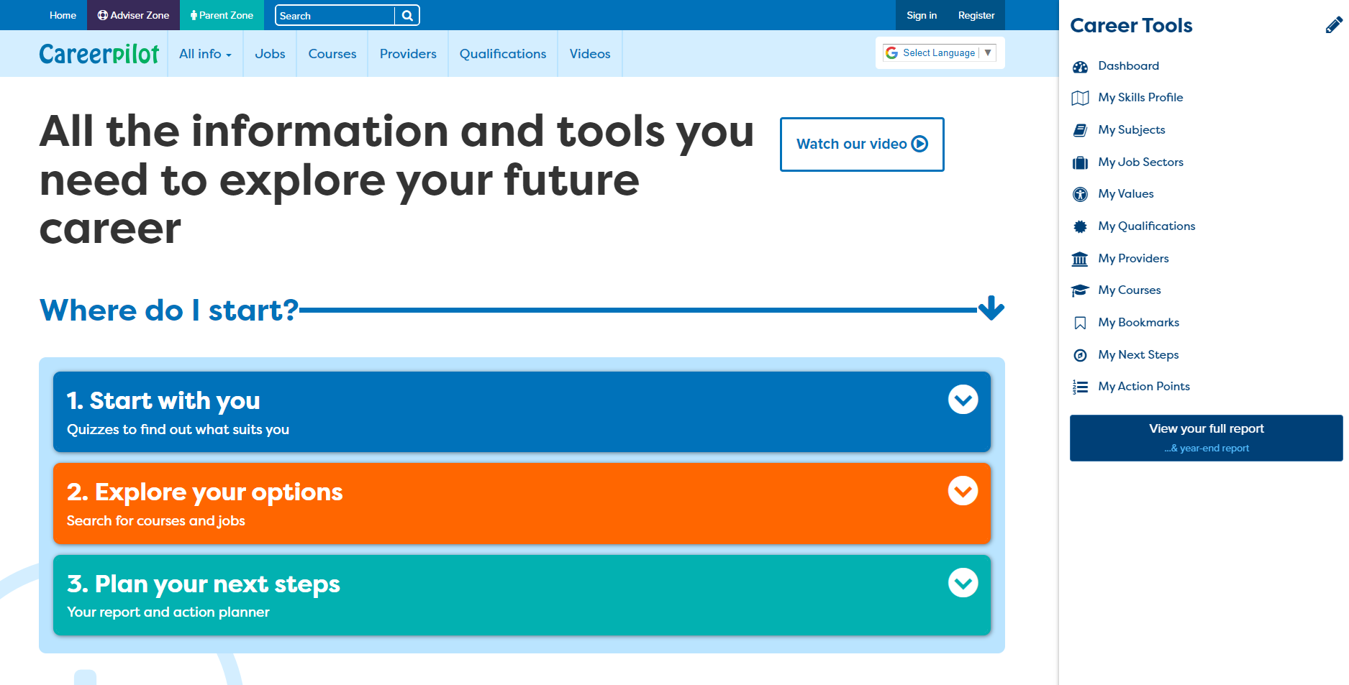

The Student Zone
v
Notes:
Careerpilot is a website that can support students to explore future careers and the pathways into them.
Students can register straight onto the site, when they use the career Tools this creates data in the Reporting Zone

Slide 7
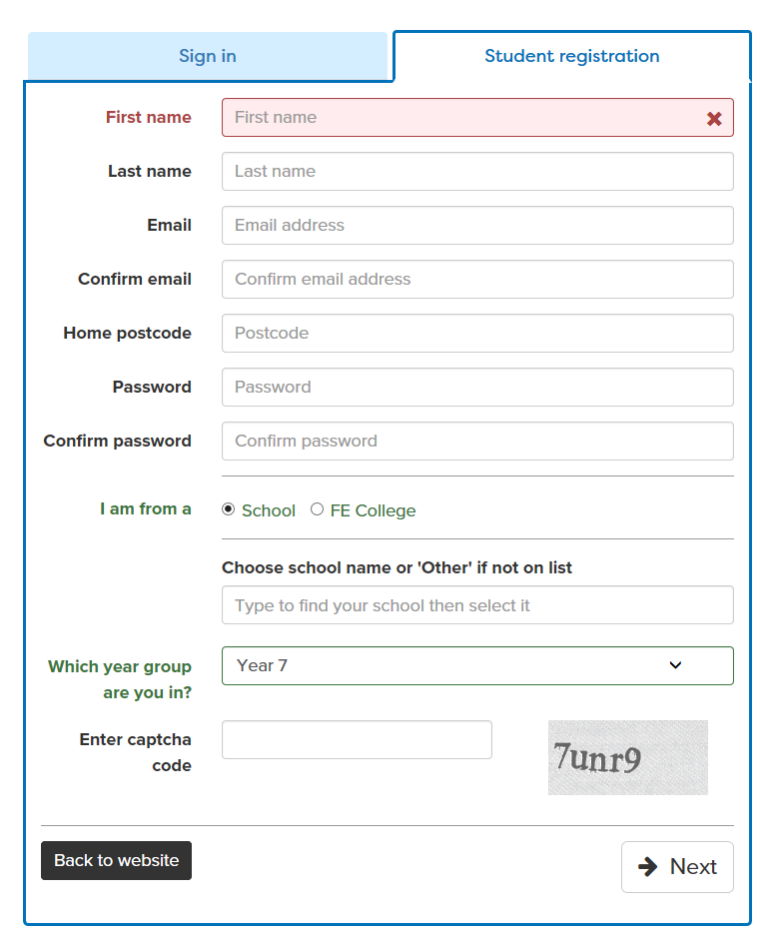
Student registration
Students can set up a FREE account on Careerpilot
Notes:
Registration is easy and self explanatory. They can use personal or school email address. The most critical thing is that they attach themselves to your school or college so that if you would like to access their progress, you can do this via your school.

Slide 8
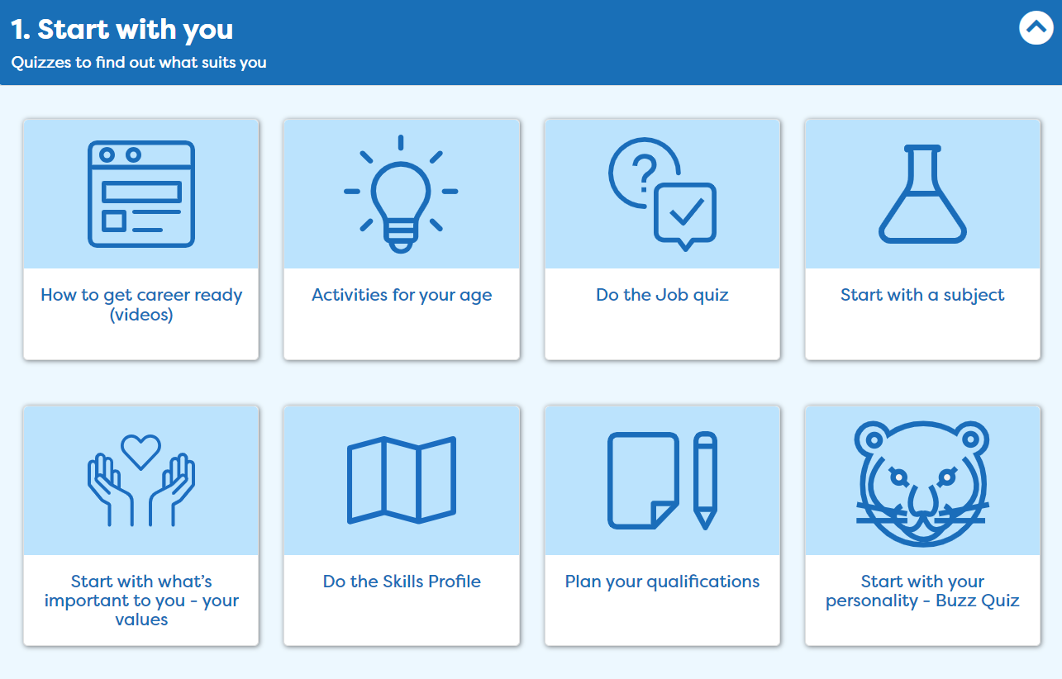
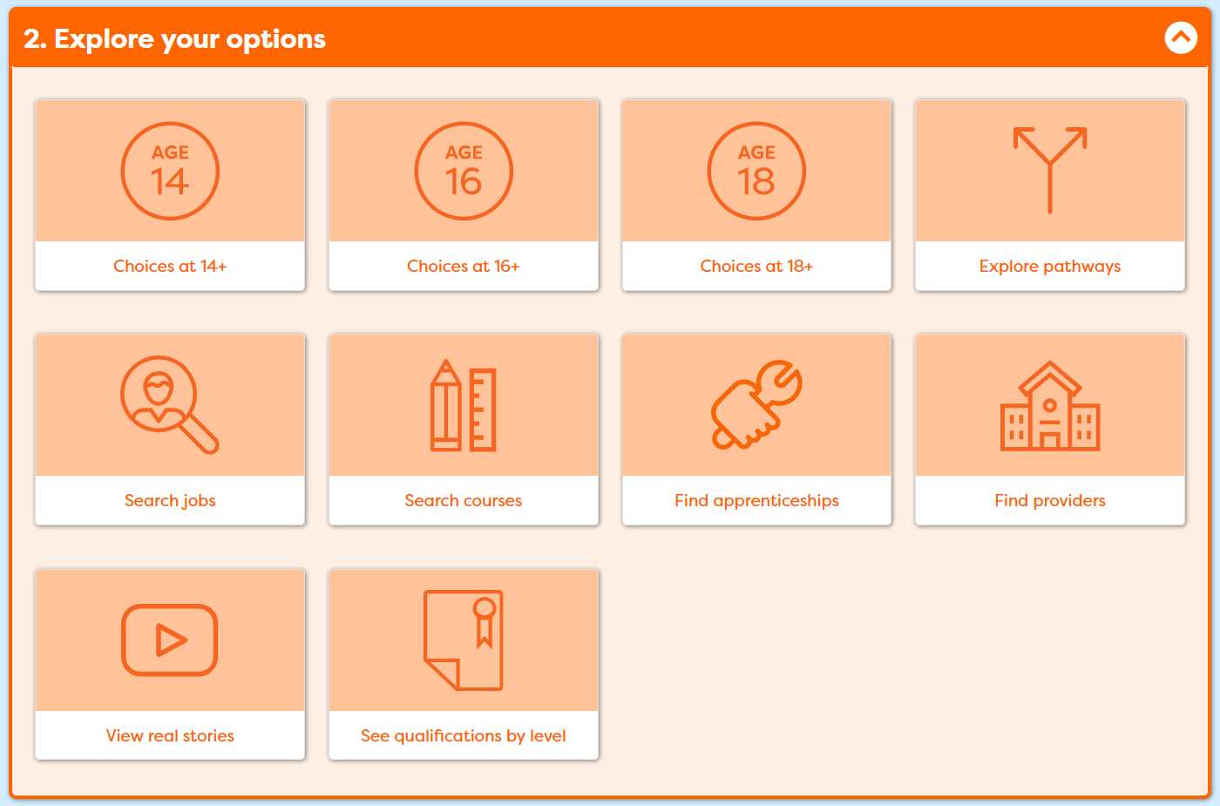
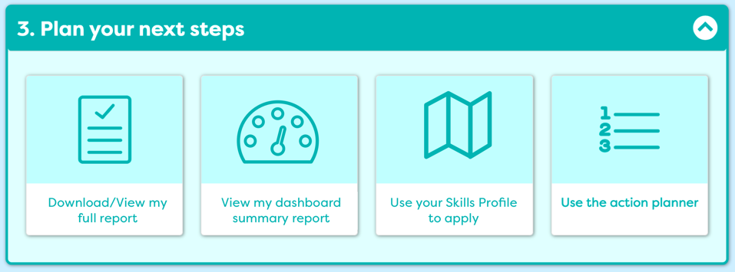
Three Stages of Career Decision-making
Notes:
Ok so how does Careerpilot work - This is the Careerpilot homepage. You will see three sections – Start with you, Explore your options and Plan your next steps. The website is built on theoretical knowledge of decision making and is run by Level 6 Careers Advisers .

Slide 9
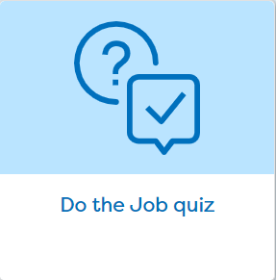
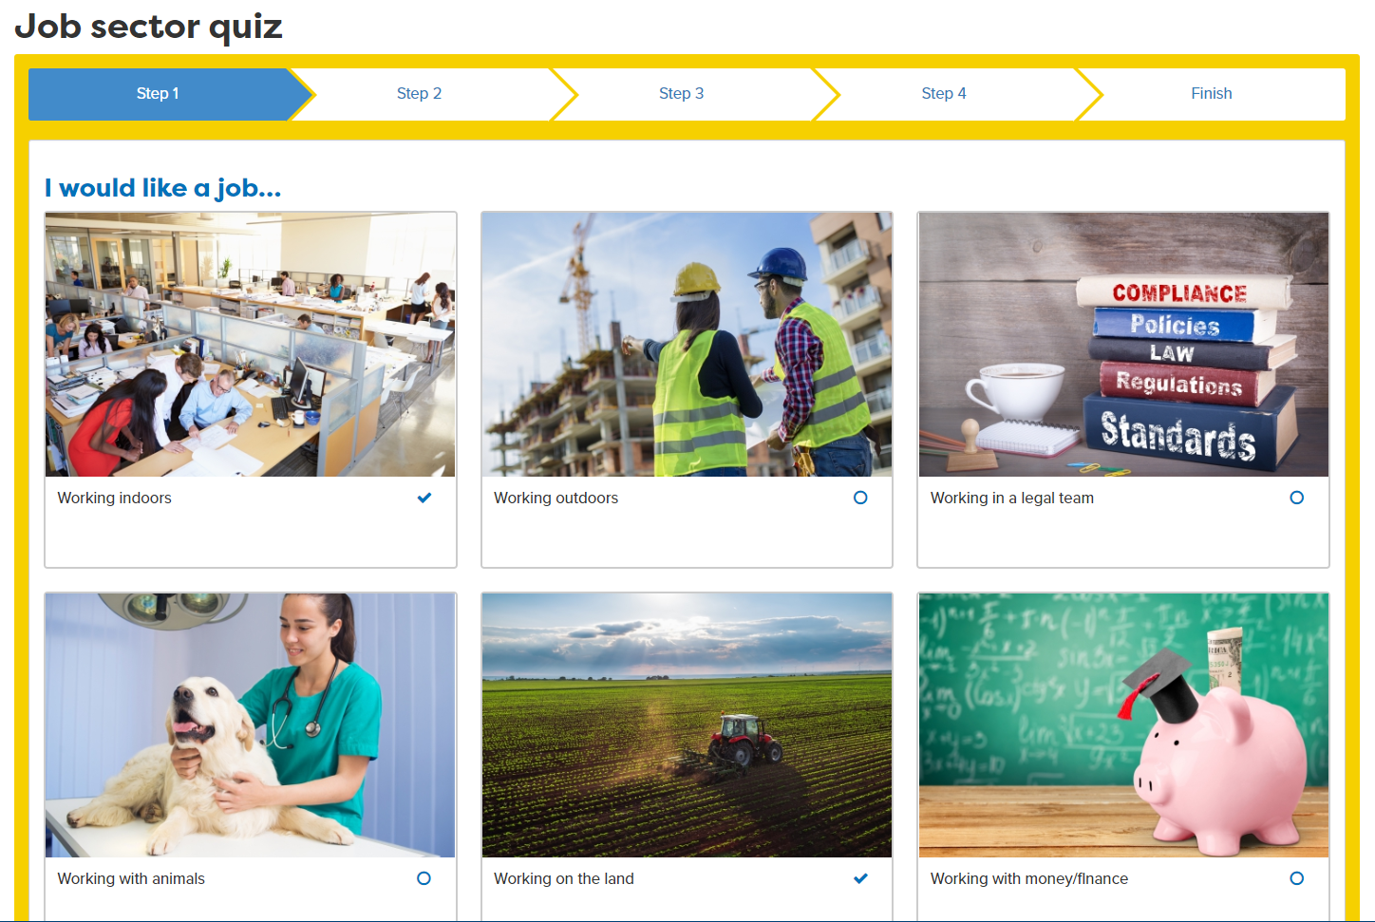
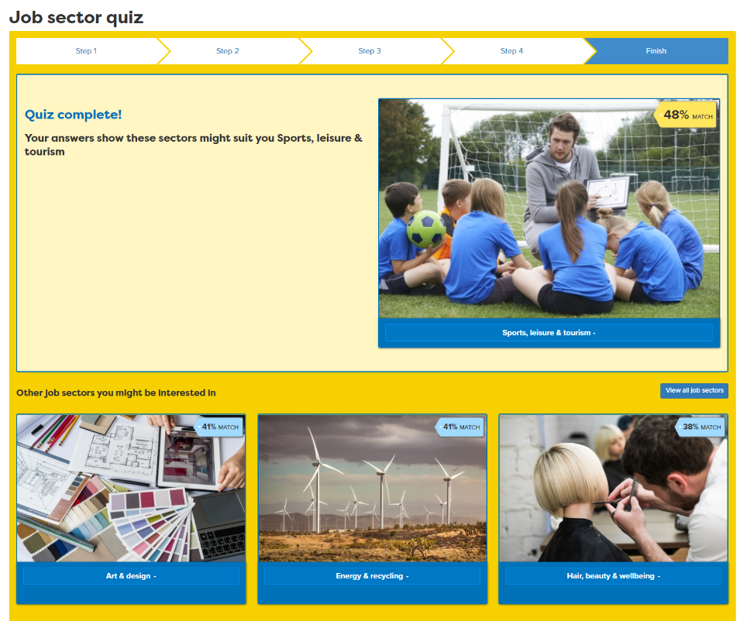

Notes:
One of the most popular tools on the site is the Job Sector quiz, which asks students questions about what they want from their working life. It then matches them with jobs sectors that may suit their interests. They can then explore the job roles within the sectors to find out more about the types of roles that exist to see if there are any of interest.

Slide 10
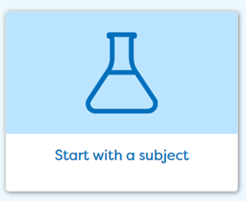
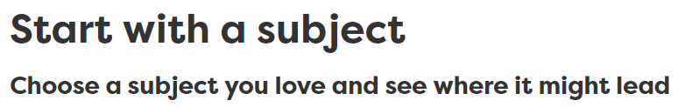
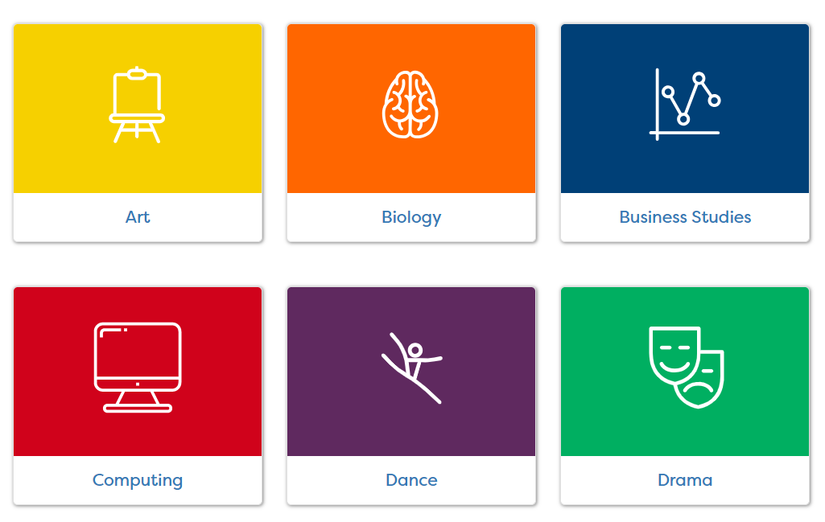
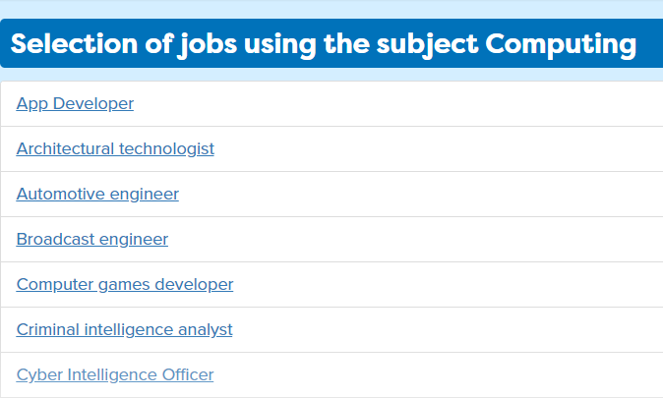
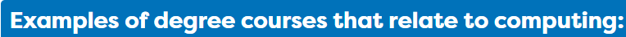




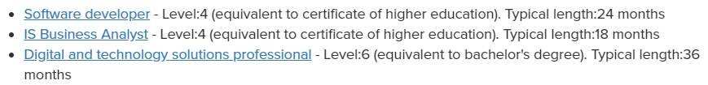
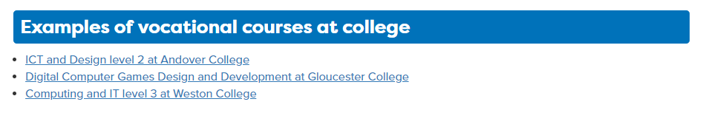
Notes:
Careerpilot also links to the curriculum and links courses and jobs through ‘Start with a subject’ . In this section students can pick subjects they are interested in and read more about jobs, courses and online activities they can take part in which are related to the subject.

Slide 11

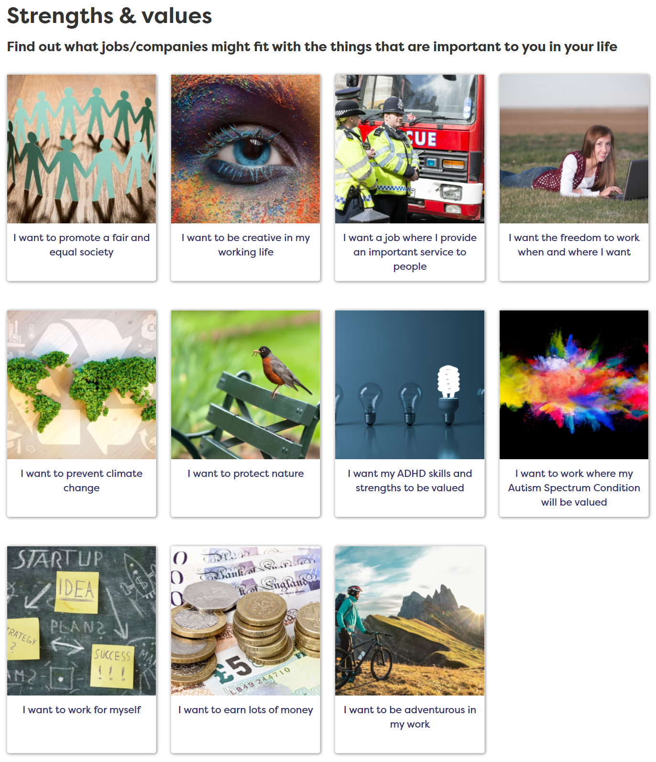
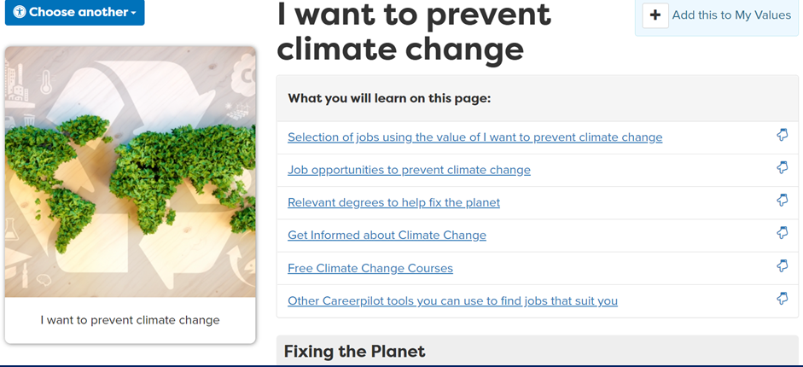
Notes:
They can look at ‘Start with what’s important to you’ and see what jobs fit with their values and get ideas of how to make the most of this value.

Slide 12
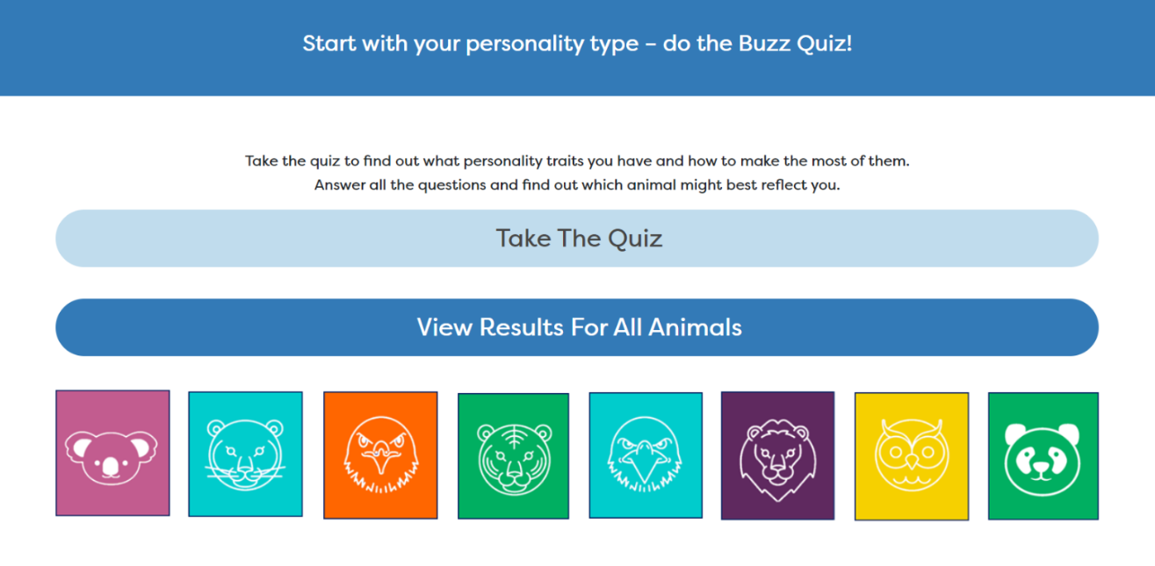
Notes:
They can also take part in a simple personality quiz to find out what animal personality type they are matched to and get some suggestions for jobs that may suit them.

Slide 13
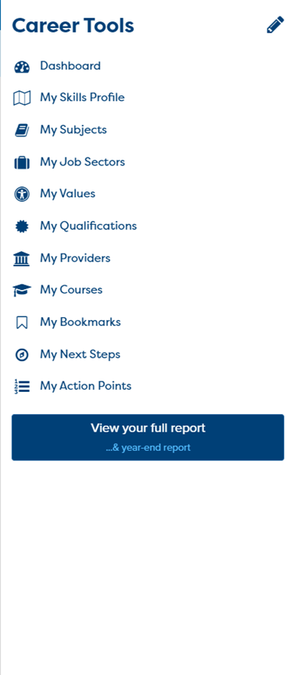
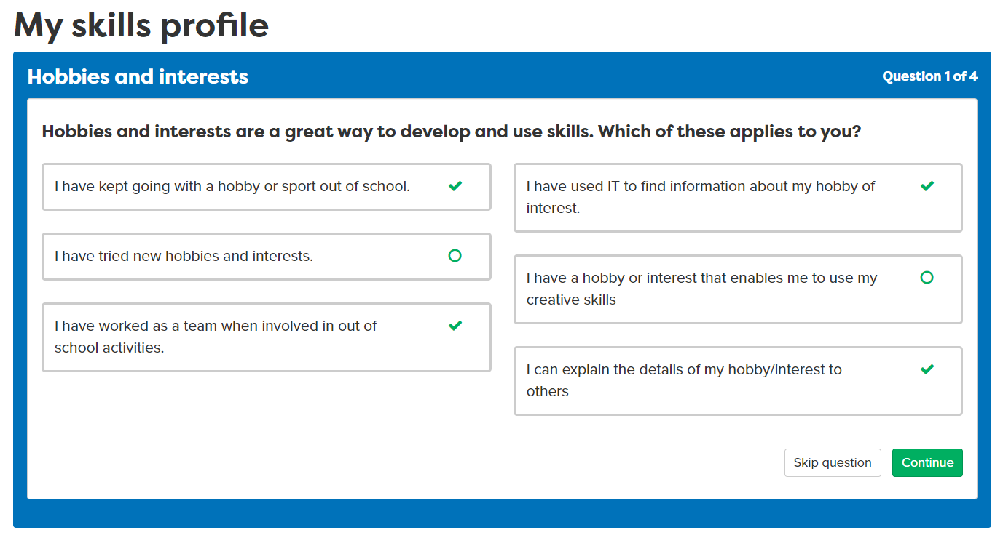
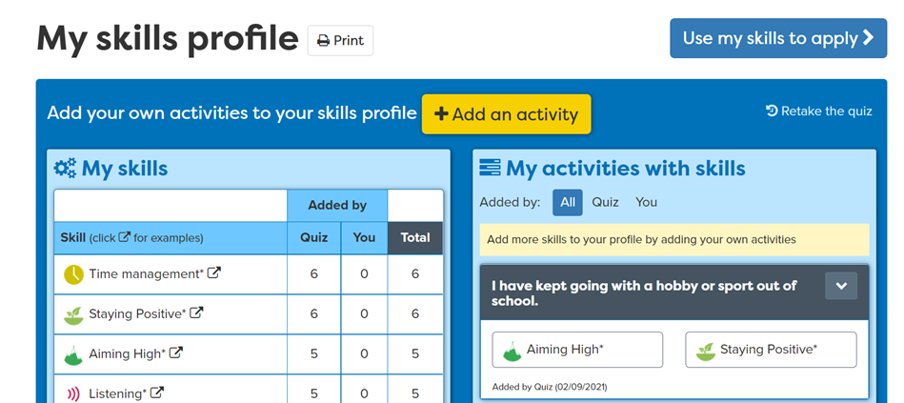
Notes:
The Skills Profile is questionnaire which helps a student understand the skills they have developed/or are yet to develop, based on easy to answer questions. Eg ‘I have kept going with a hobby or sport out of school’.
Working with Skillsbuilder, this maps activities to particular skills that can be transferrable into a career.

Slide 14
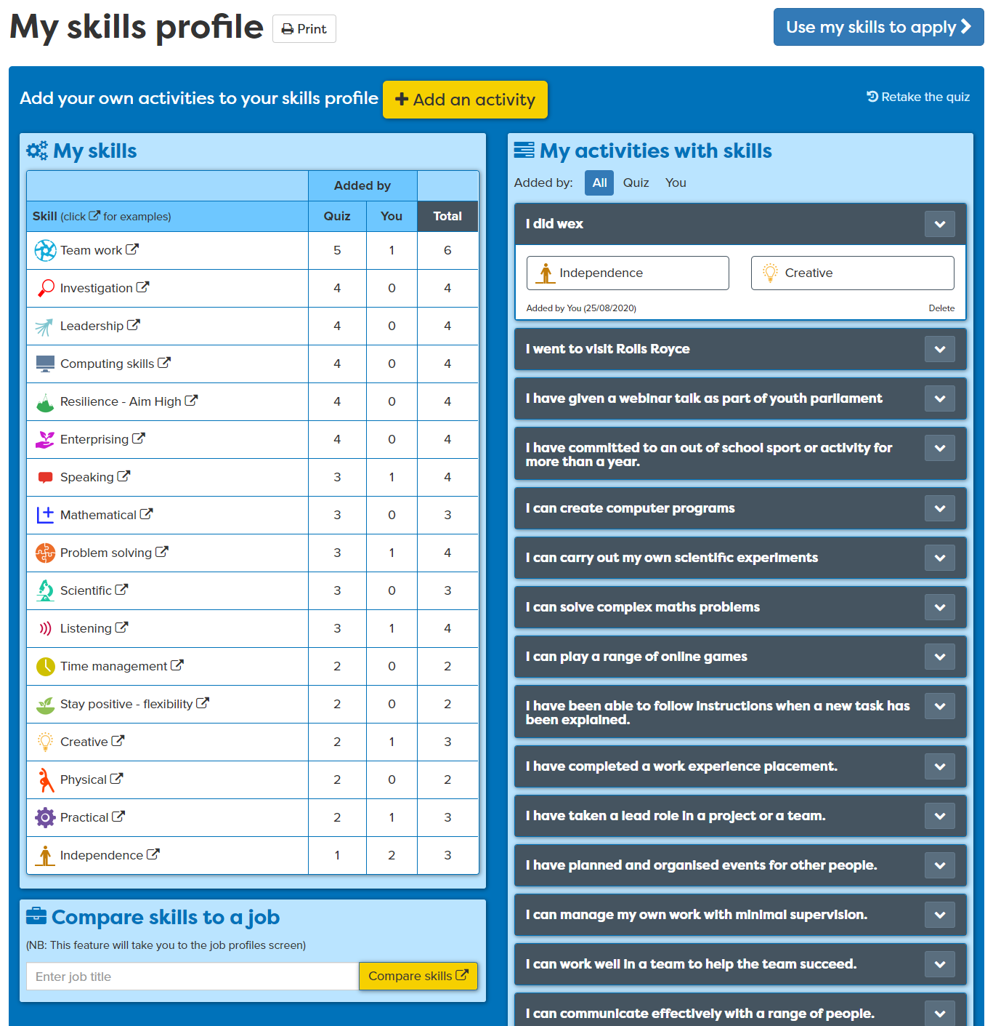
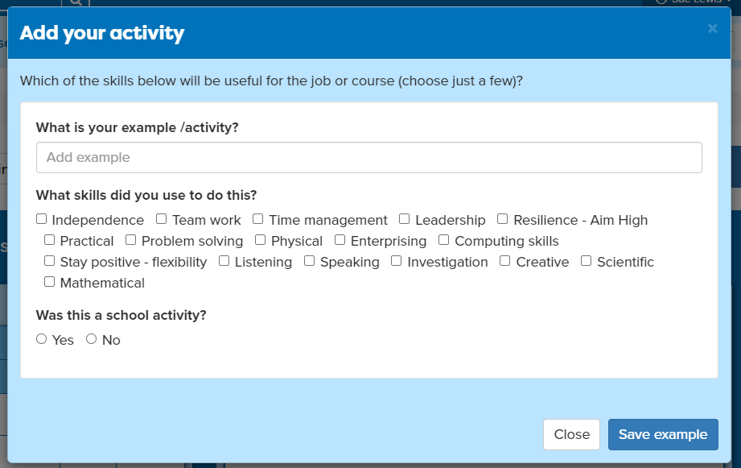
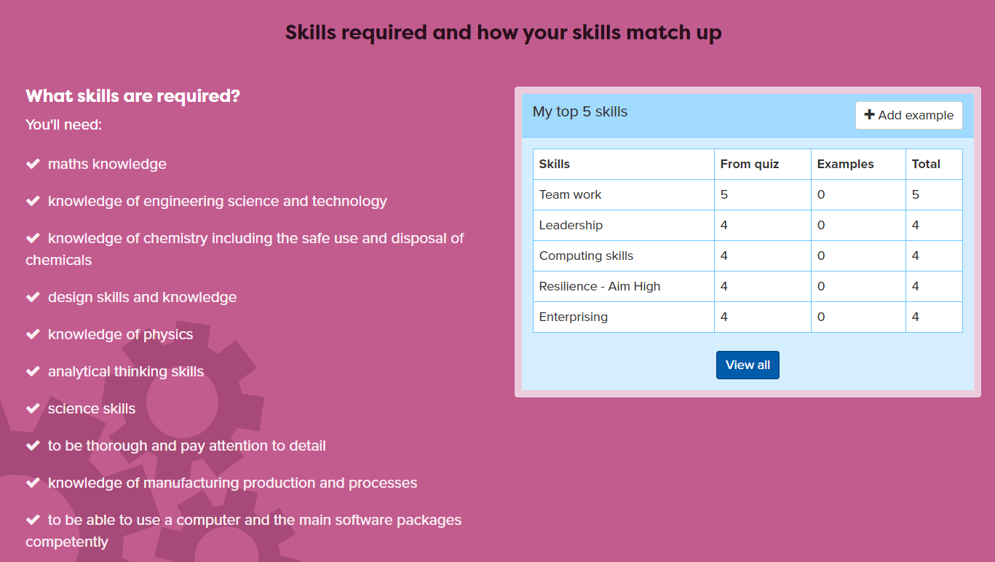
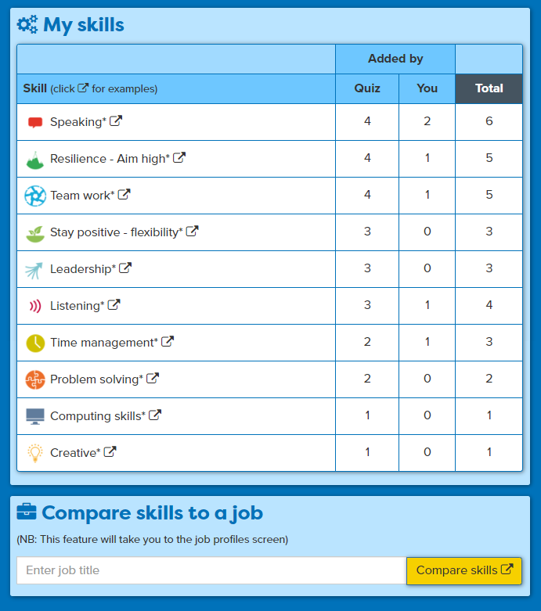
Add your own examples
All skills are ‘banked’ for later when they want to apply
See how skills compare to a job
Notes:
All their skills will be put in the Skills Bank, they should add at least one example of their own in the lesson but keep going back to add things over time. The Skills Bank can then be used when they come to apply.

Slide 15
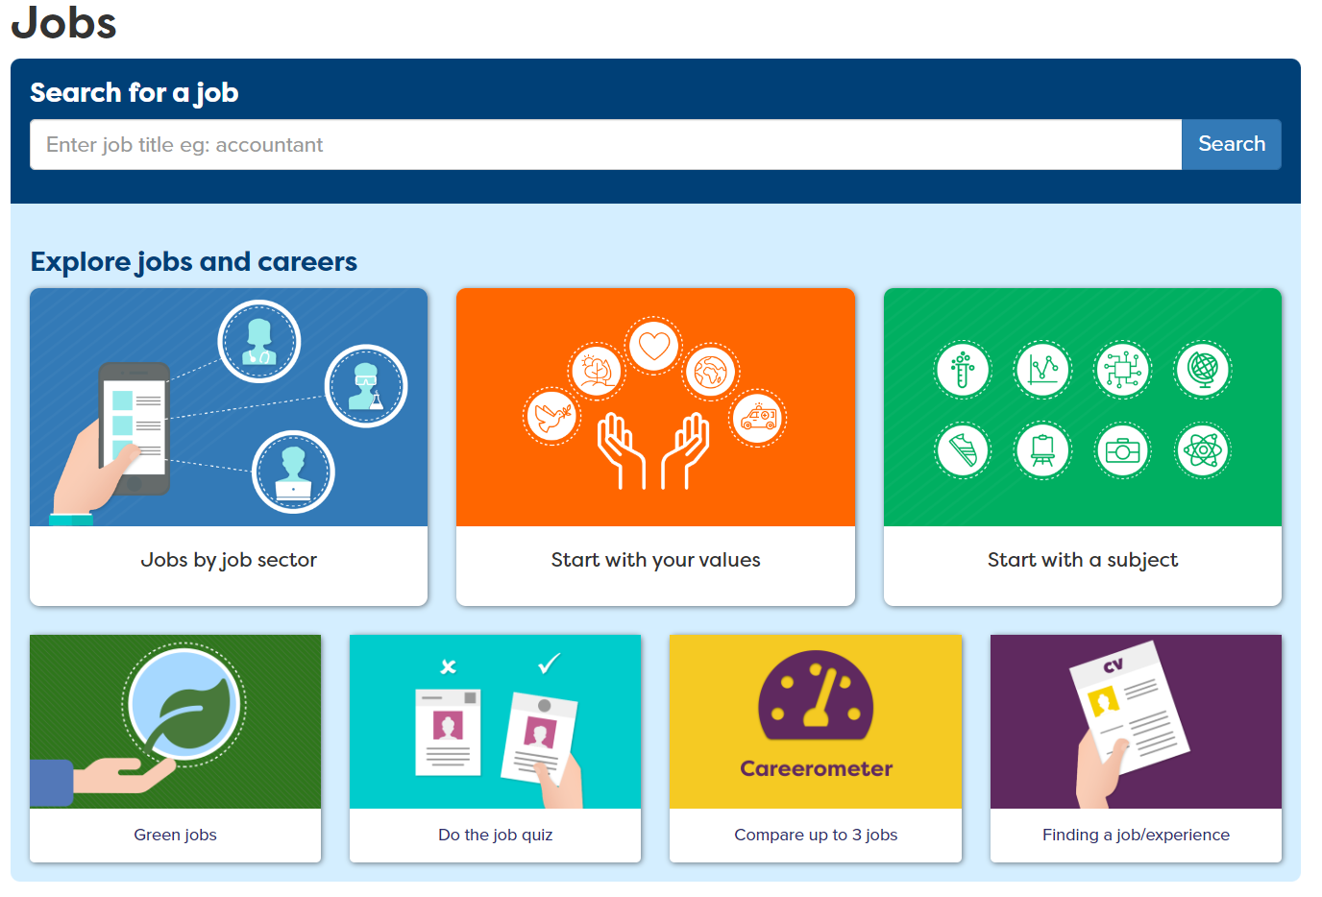
Notes:
Students can also explore jobs by job title using the job search or they can browse job sectors.

Slide 16

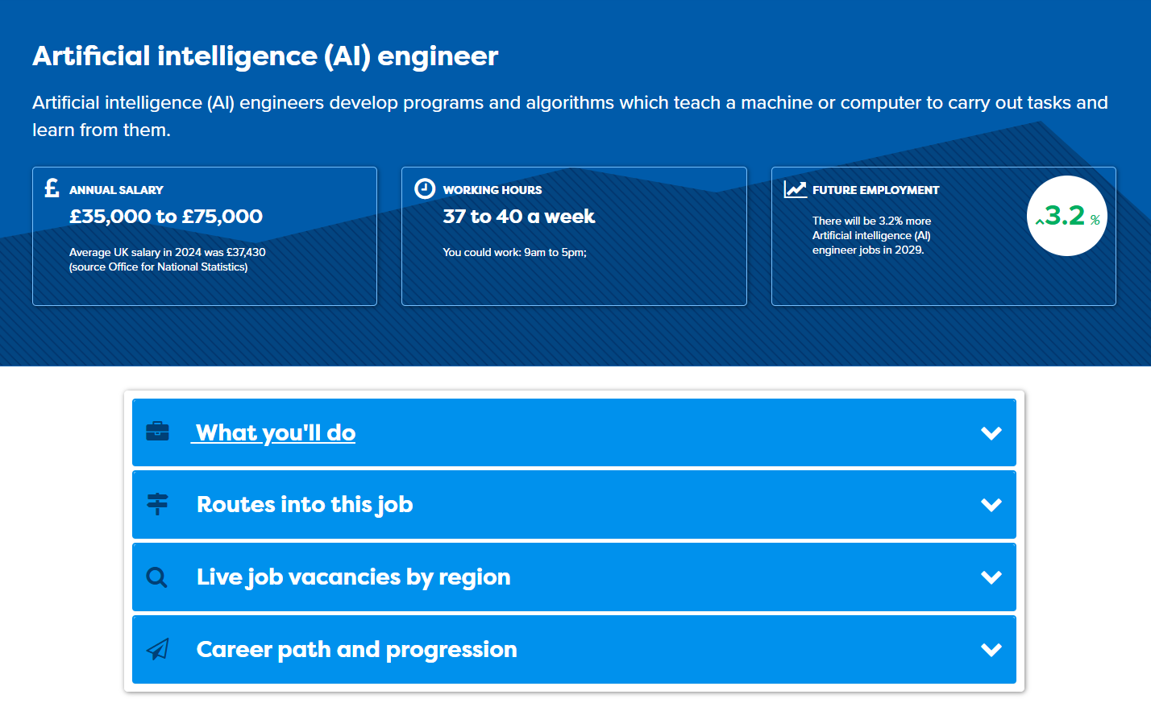
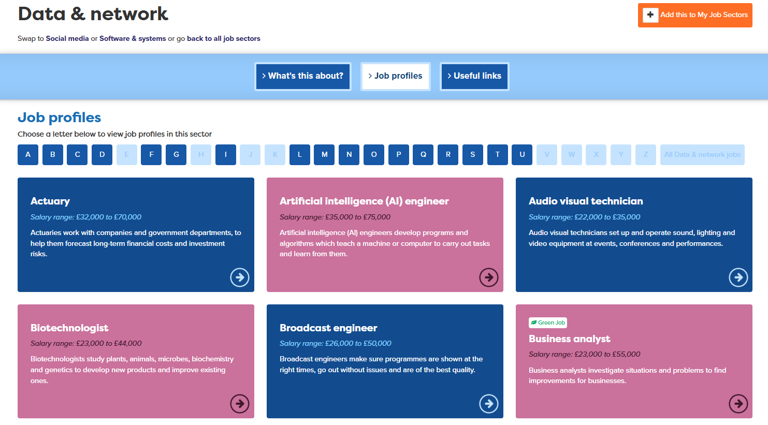
Notes:
Each job sector has three subsectors, each with links to a range of job profiles in that industry sector. Students can browse the profiles and click on any to open a full profile where they can explore useful labour market information including salary, future job growth, day to day tasks and the routes in. There are also links to job adverts related to the job profile.

Slide 17
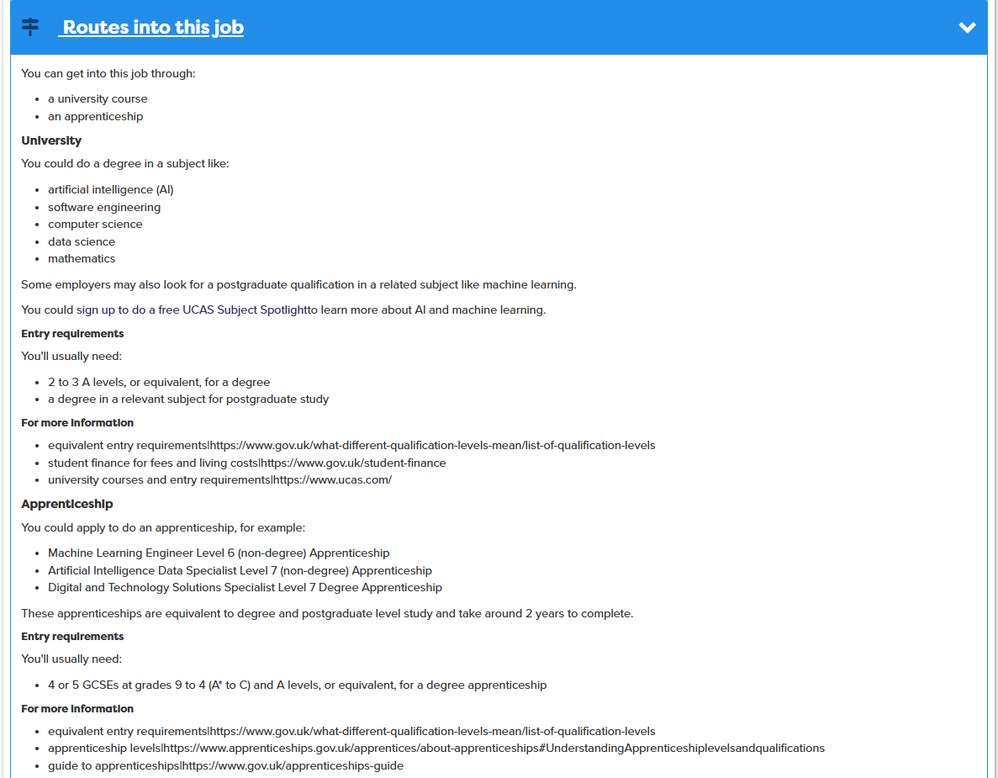
Notes:
Within the profile students can see what the possible routes into the job are – they can see what qualifications they may need and if there is an apprenticeship route.

Slide 18

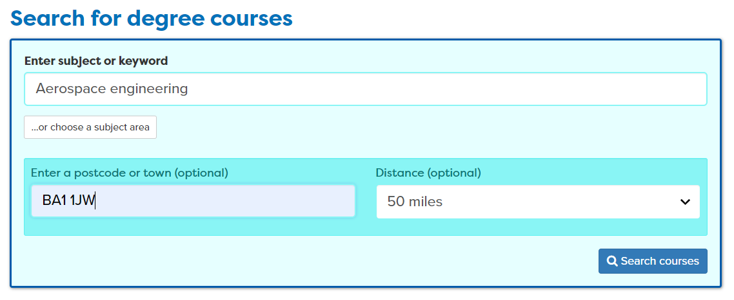
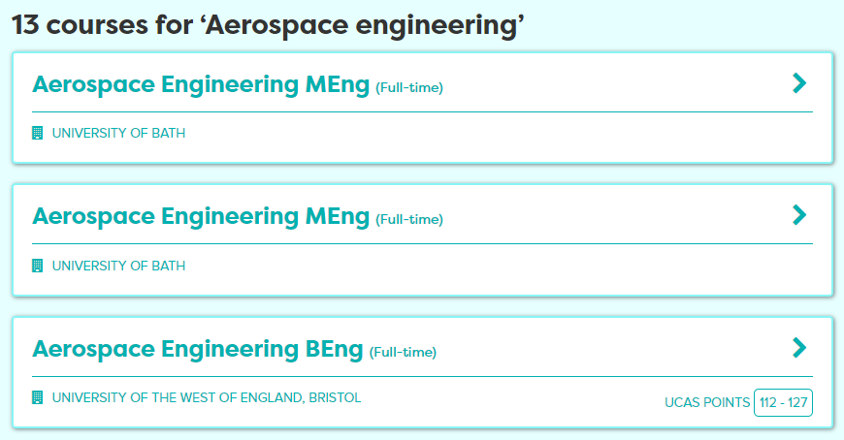
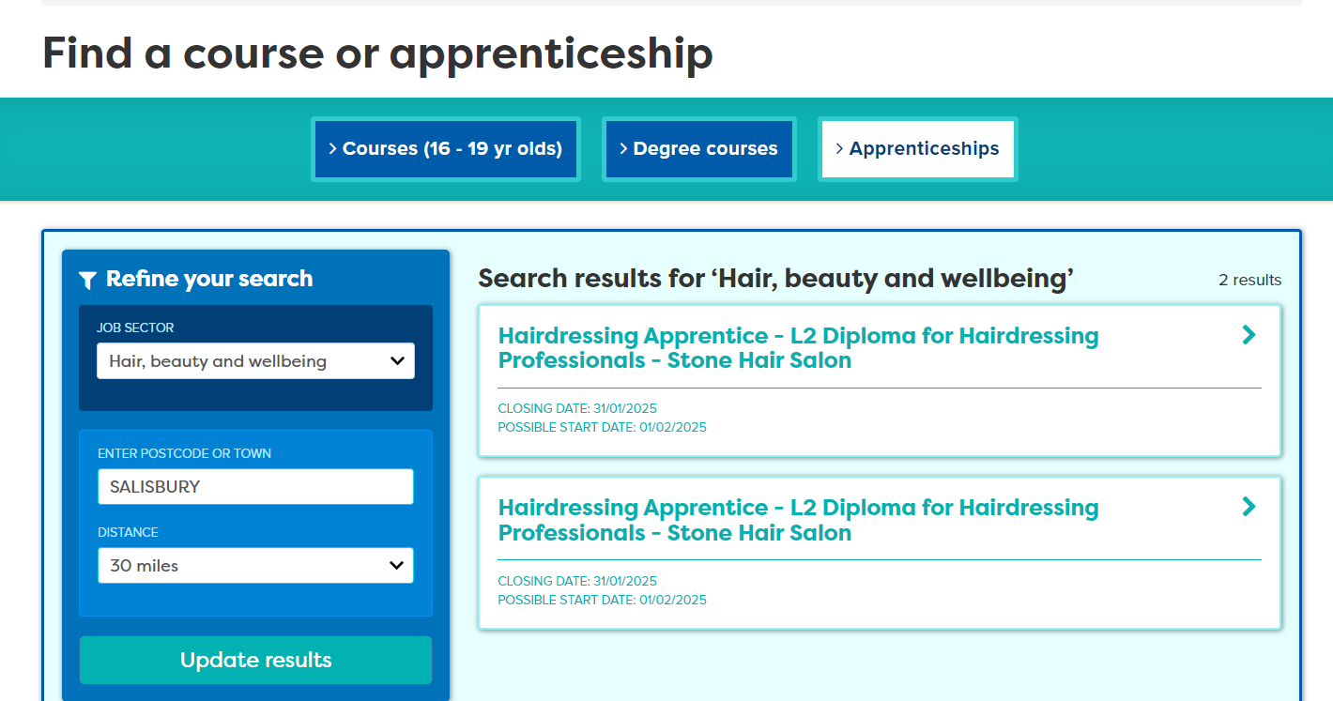
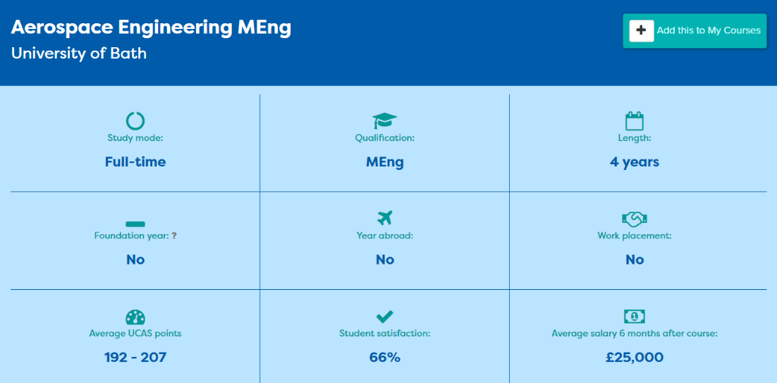
Notes:
They can then search for where to study courses near them by checking local education provider offers, they can search for degree courses and look at live apprenticeship vacancies.

Slide 19
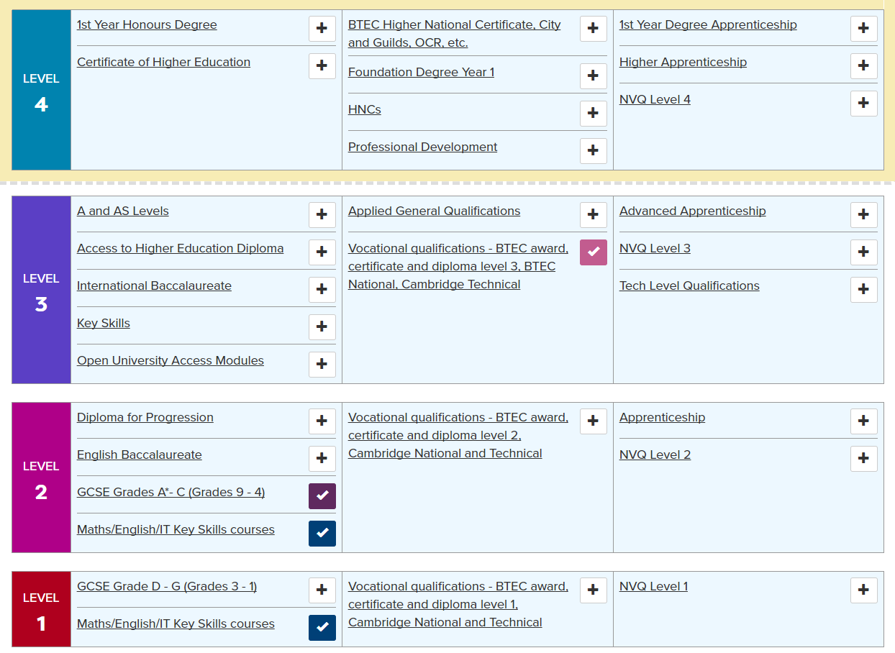

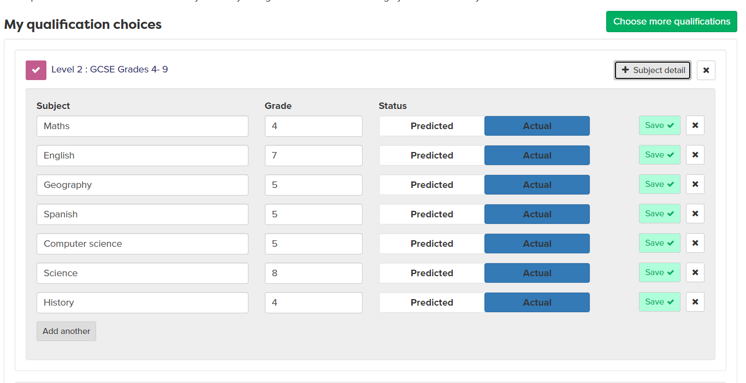
Notes:
Users can chose quals through the levels and indicate done, doing and considering.
When they have chosen they can then add their predicted or actual grades.
They can search for providers near to where they live

Slide 20
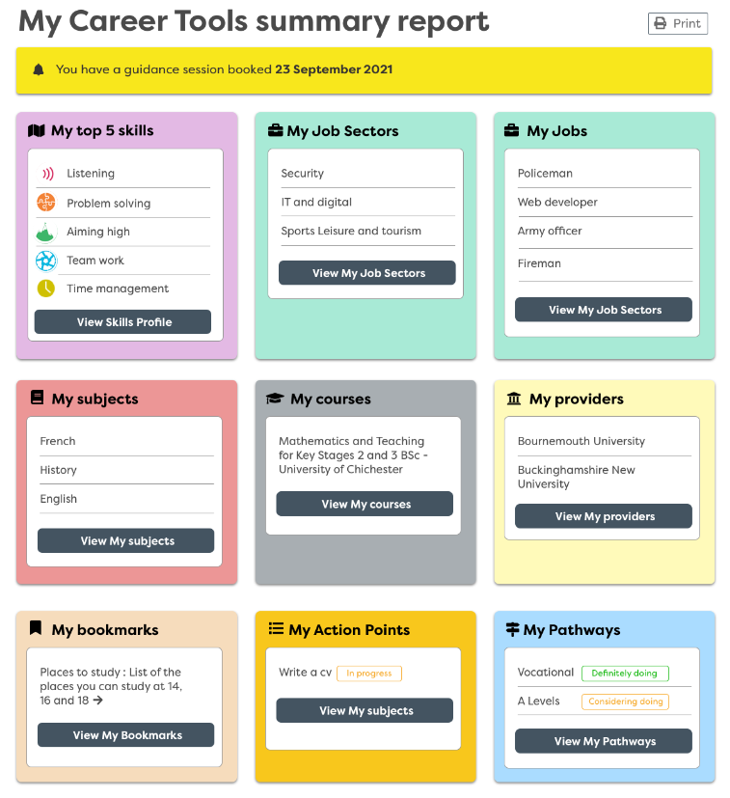
Notes:
This is a summary of the students Careerpilot journey – highlighting the importance of tagging and using it as often as possible.

Slide 21
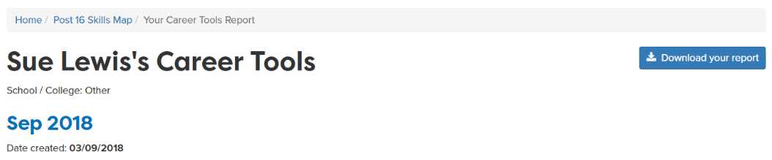

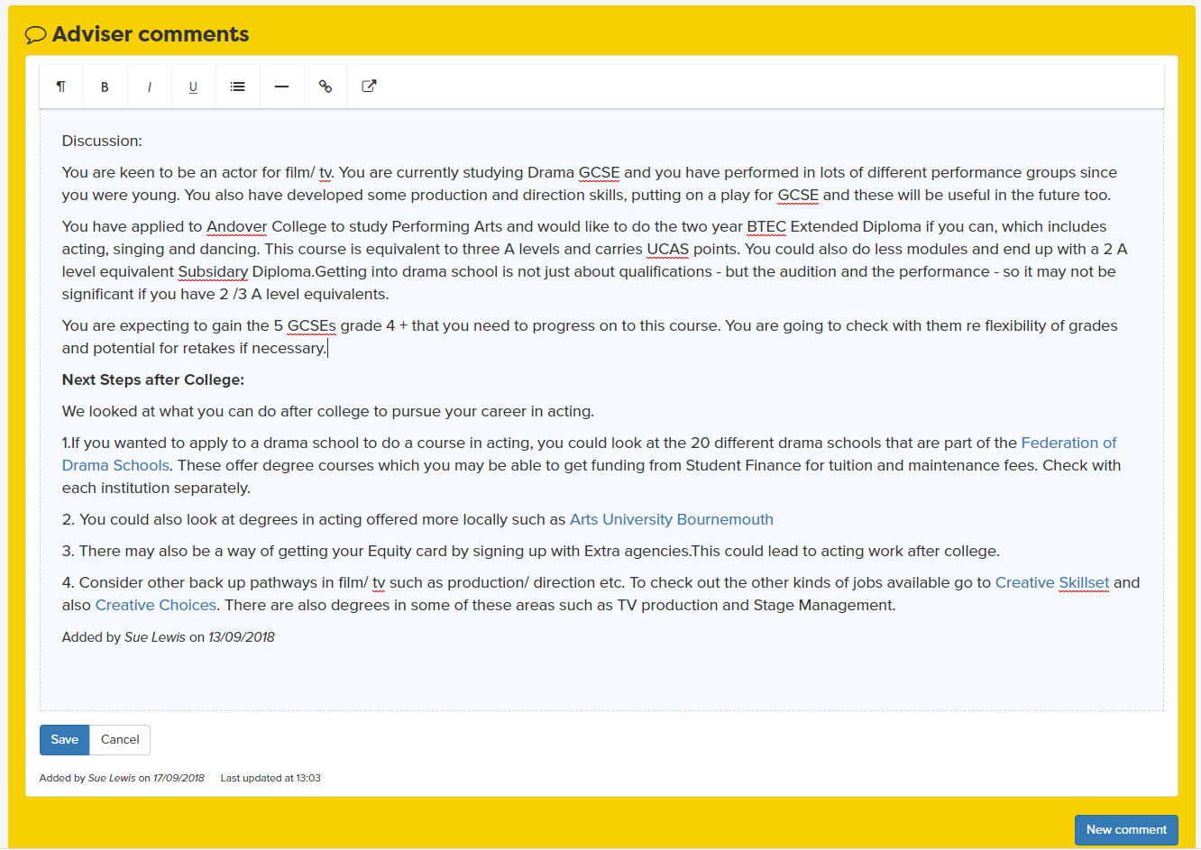



Notes:
This is a summary of the students Careerpilot journey, showing pages they may have viewed or saved, and the results of quizzes and tasks completed.

Slide 22
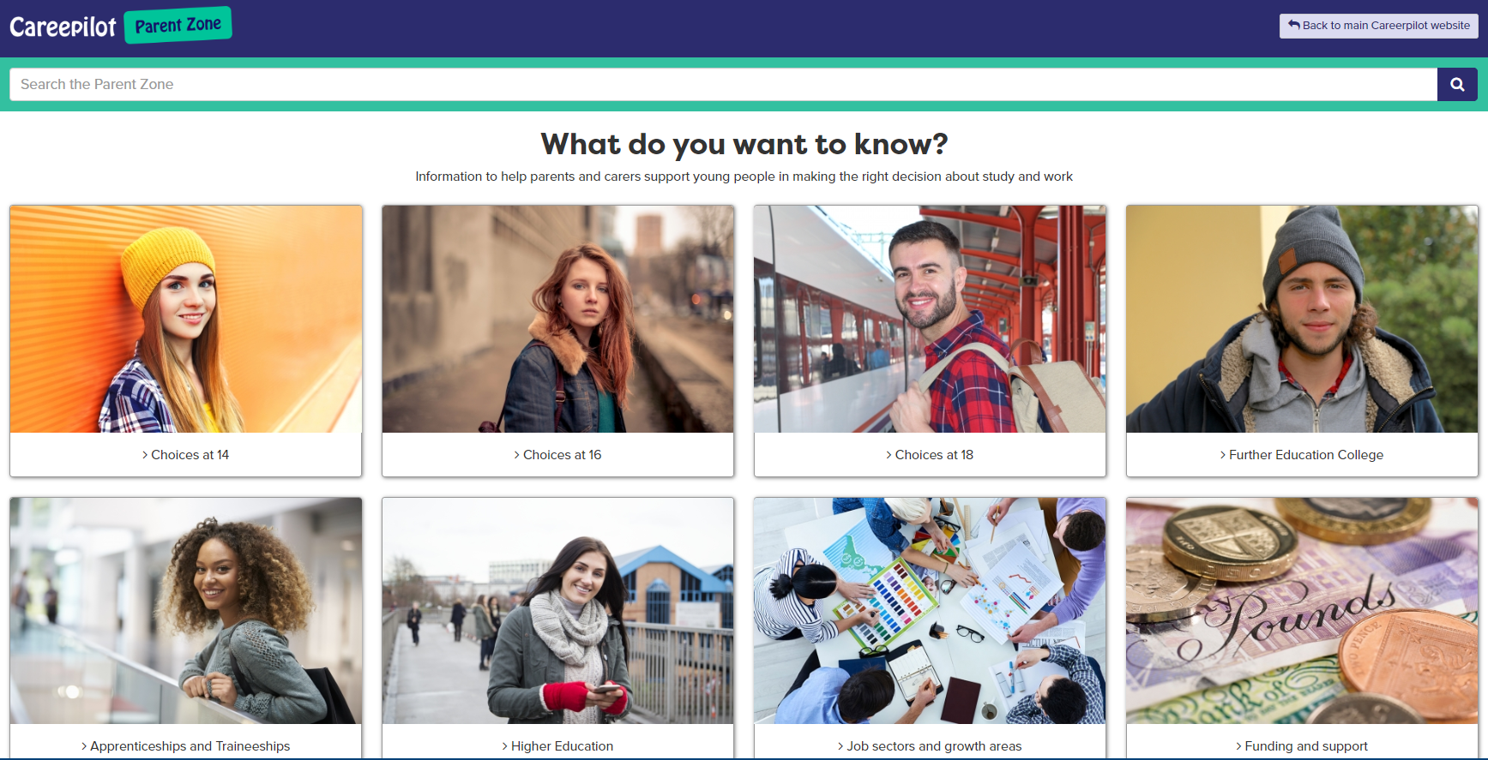
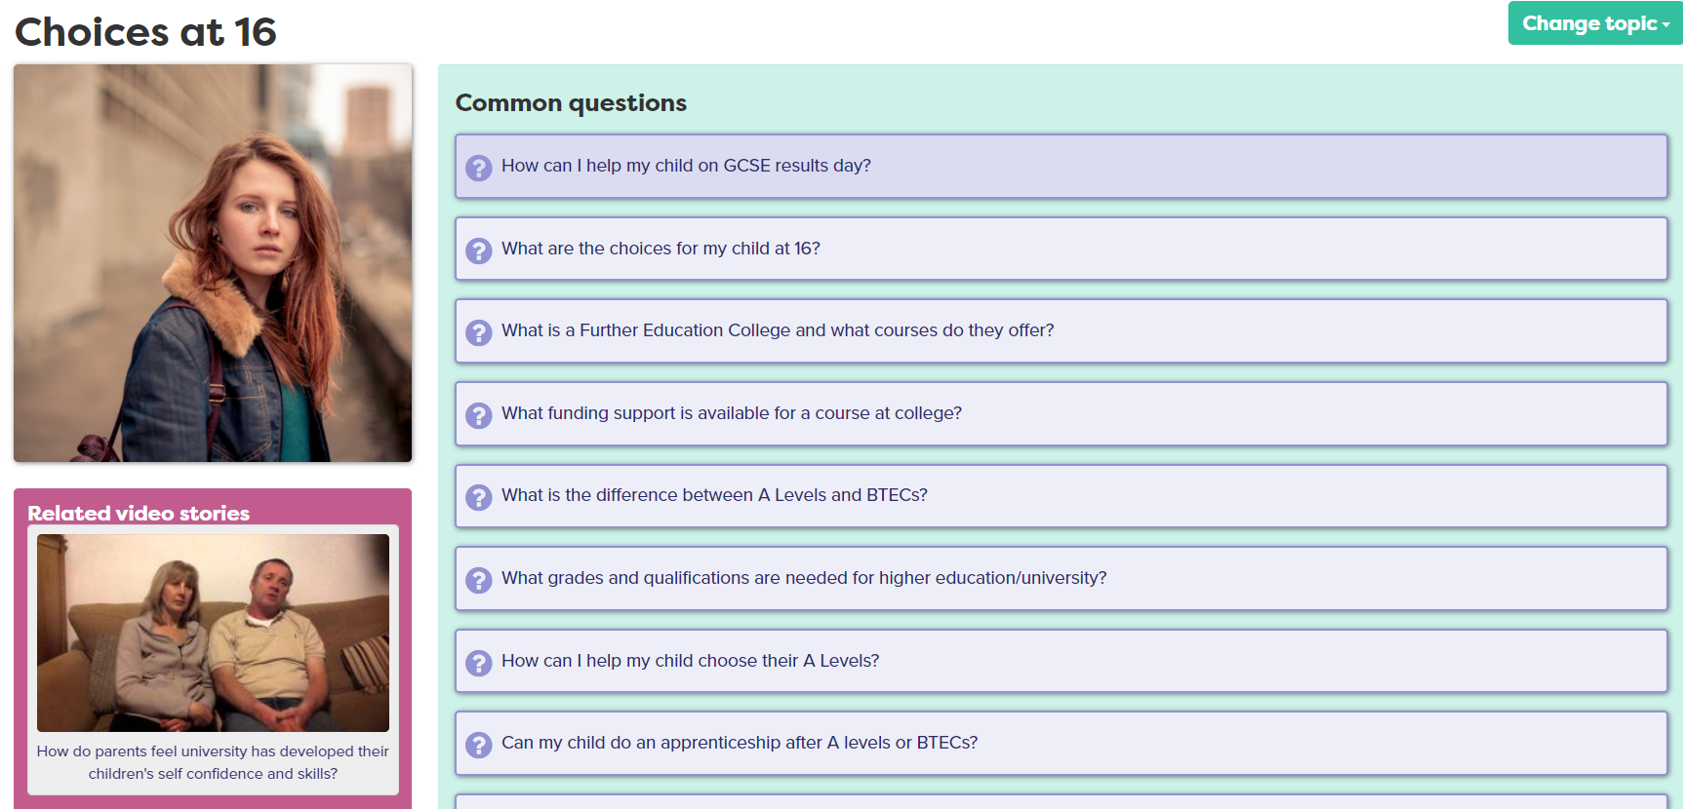
Parents and Carers
www.careerpilot.org.uk/parent-zone
Notes:
We also have a dedicated part of the site for parents and carers with the answers to lots of frequently asked questions about careers and pathway choices.

