Slide 1


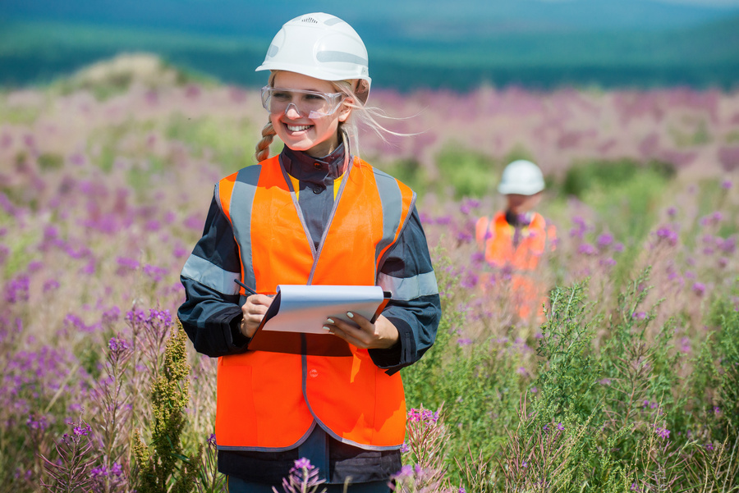


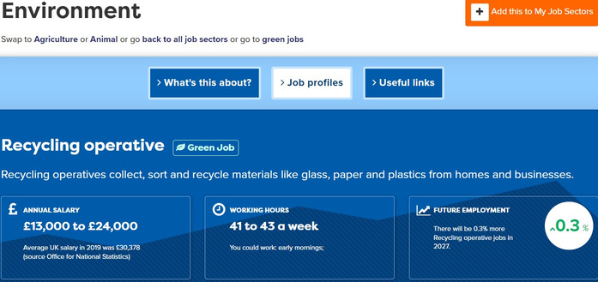




Green Job
Green Hot Jobs Activities: Teacher Notes
This set of 5 Hot Jobs classroom activities introduces students to a different Green Job that is predicted to grow over the coming years with the final session giving time for students to explore other green jobs. The activities can be delivered in 15-20 minutes, so could be used in tutor time or as part of a longer lesson.
For each Hot Jobs classroom activity students will:
  Watch a video about the job (3-5 minutes). There is a link to the video from the individual lesson page or from the menu on slide 4. Right click on the link and open the video in a new tab to play the video to your class.
  Find out more about the job from the Careerpilot job profile or printed posters (5 minutes). There is a link to the relevant Careerpilot job profile from the menu page on slide 4, or from the individual lesson pages to share from the front (right click to open in separate tab to view). Students can also find the job profile independently using the Green Job search on Careerpilot (use slide 2 to show how). You can also print out the relevant Hot Job posters which feature a QR code to access the job profile using a phone using this link – see slide 3.
  Students can then work in pairs or as a class to answer questions about the job role using the information from the video and in the job profile (5-10 minutes).
Add a little bit of body text
Add a little bit of body text
Add a littl of body text
These classroom activities support your students to building the following essential skills:
careerpilot.org.uk

Slide 2
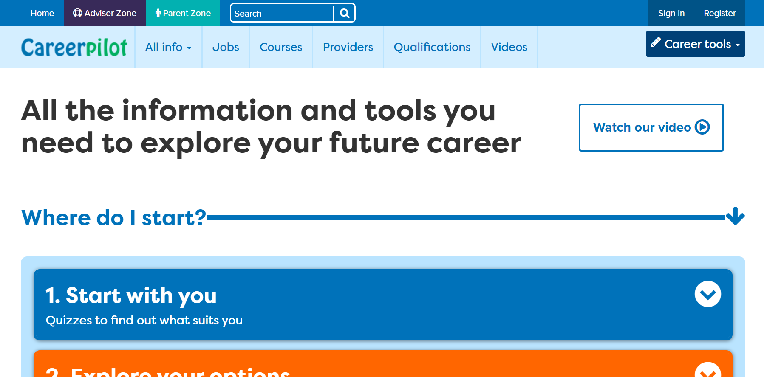
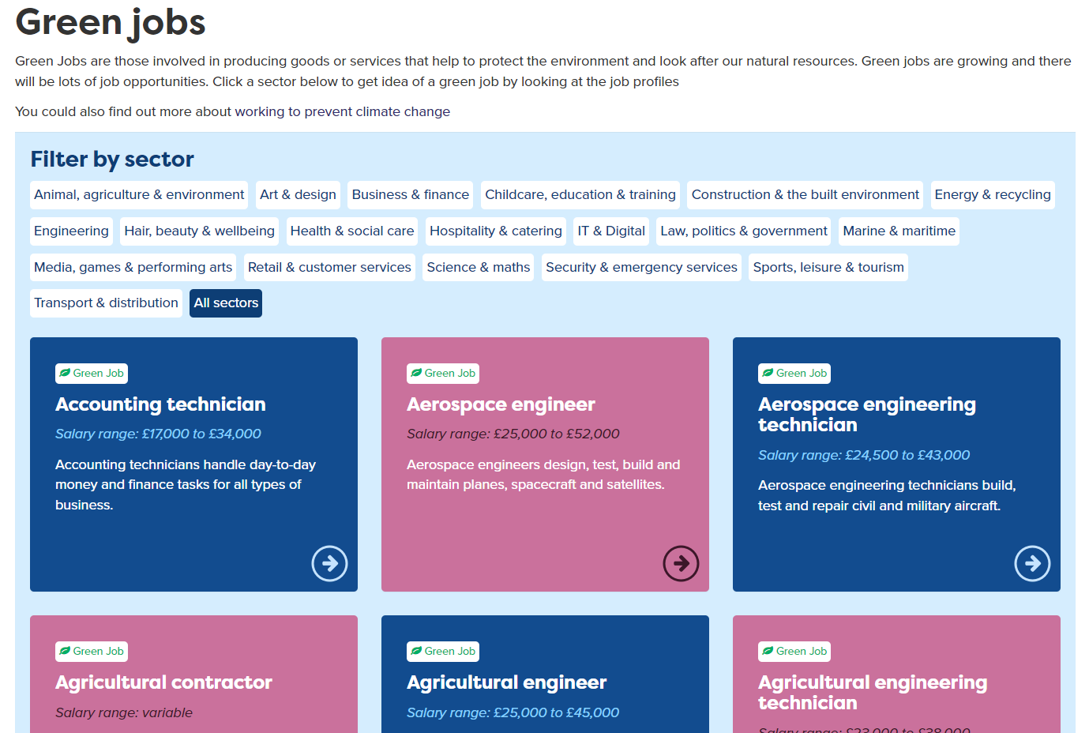
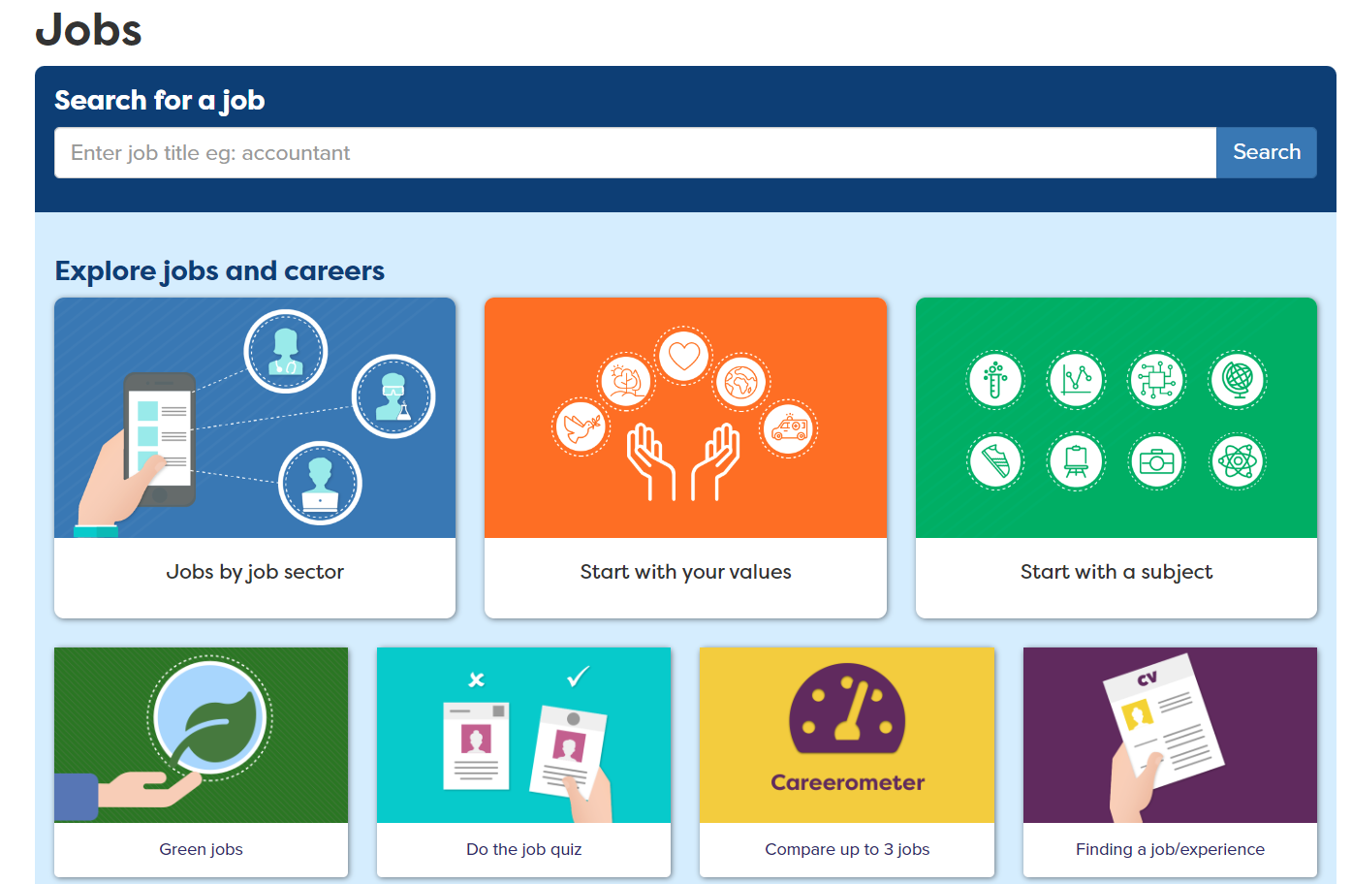
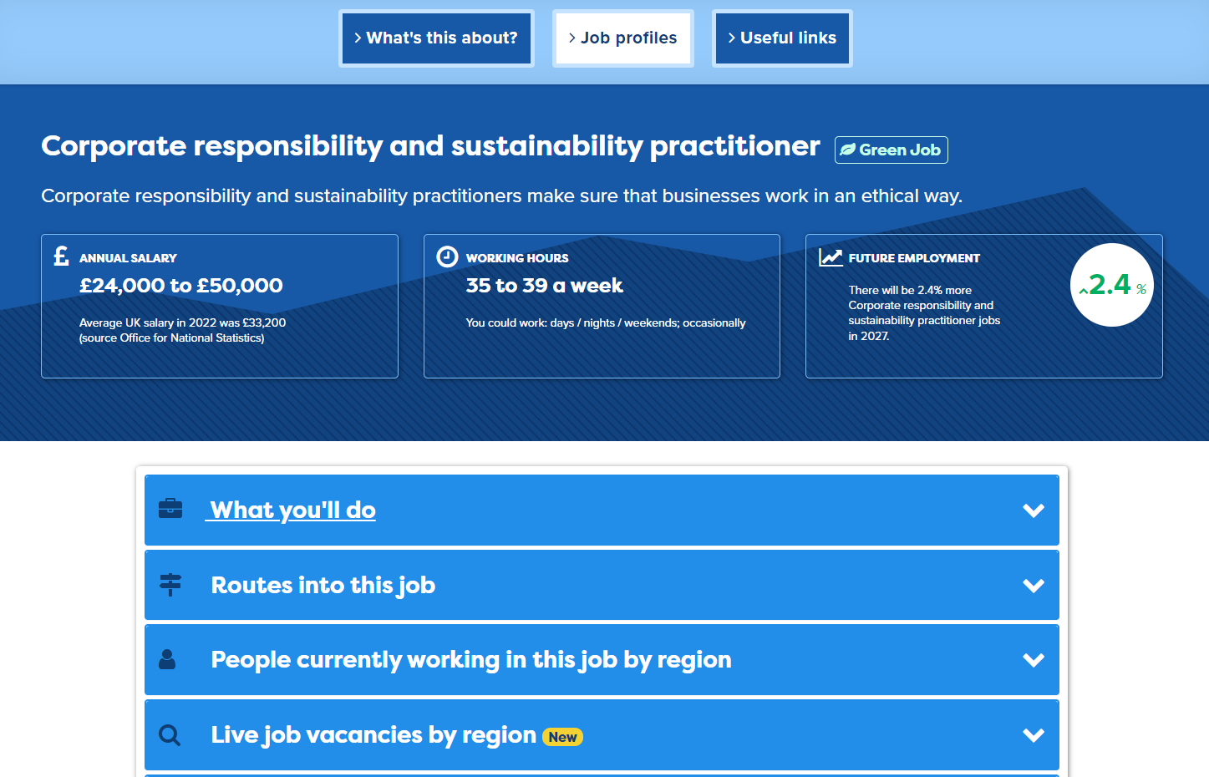
Green Job
Accessing Green Jobs Profiles
1. Go to careerpilot.org.uk and click on ‘jobs’
Add a little bit of body text
Add a little bit of body text
Add a littl of body text
3. Find the job profile you need
2. Click on Green Jobs
careerpilot.org.uk

Slide 3
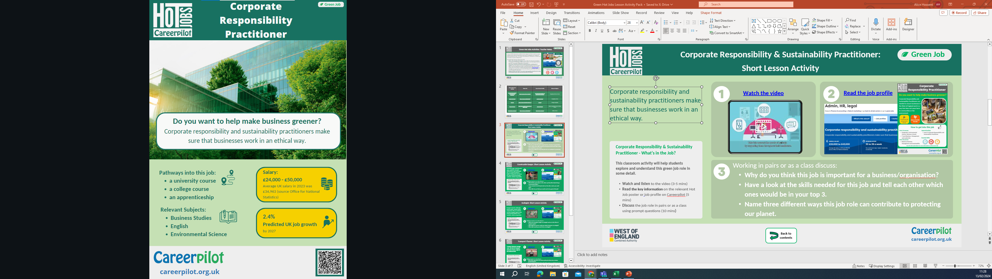
Green Job
Green Hot Jobs Posters
Posters available to print from Careerpilot Advisor Zone. Log in to Careerpilot then go to Hot Jobs Resources – Green Hot Jobs Resources
Careerpilot : Adviser Zone : Hot Jobs Resources : Green Hot Jobs Resources
Add a little bit of body text
Add a little bit of body text
Add a littl of body text
Find pathways in this job and relevant subjects
Find average salary and predicted job growth
careerpilot.org.uk

Slide 4
Green Job Lesson Activity | Video Link | Green Hot Job Profile | Relevant Subjects
1. Corporate Responsibility and Sustainability Practitioner | https://careerpilot.org.uk/stories/let-s-talk-about-corporate-social-responsibility | Corporate Responsibility and Sustainability Practitioner | Geography, Business, Science
2. Ecologist | https://www.careerpilot.org.uk/stories/how-to-become-an-ecologist | Ecologist | Biology, Geography
3. Transport Planner | Careerpilot : Video stories : Transport Planning Student | Transport Planner | Maths, Geography, Business Studies, Science
4. Wind Turbine Technician | Careerpilot : Video stories : Day in the life of a Wind Turbine Engineer | Wind Turbine Technician | Maths, Science
Add a little bit of body text
Add a little bit of body text
Add a littl of body text
careerpilot.org.uk

Slide 5




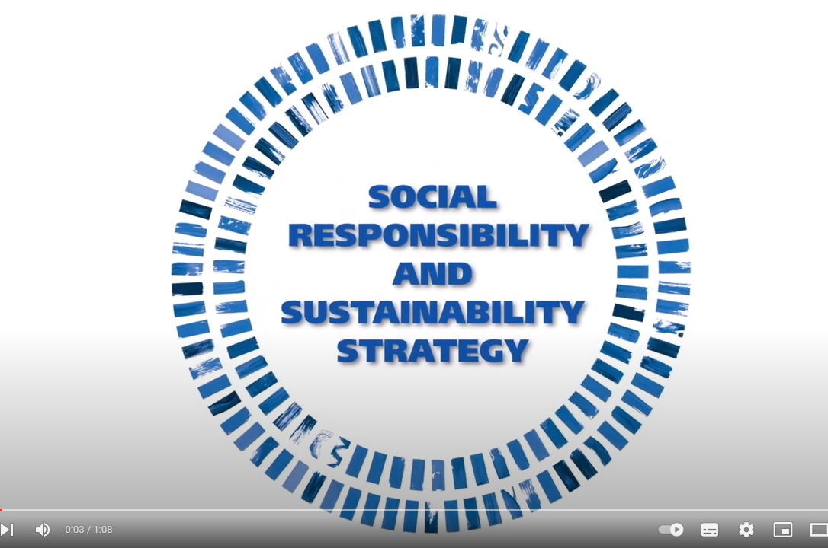
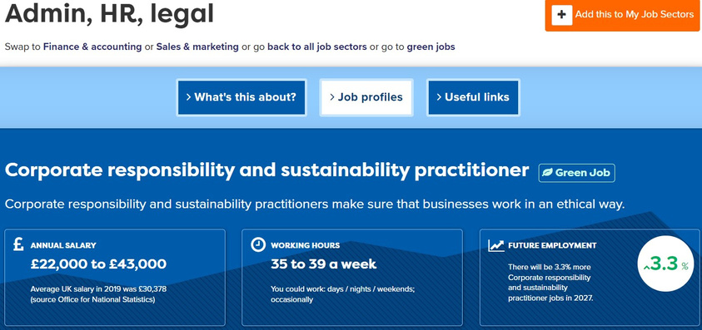


Corporate Responsibility & Sustainability Practitioner:
Short Lesson Activity
Green Job
Corporate responsibility and sustainability practitioners make sure that businesses work in an ethical way.
Watch the video
Read the job profile
Corporate Responsibility & Sustainability Practitioner - What’s in the Job?
This classroom activity will help students explore and understand this green job role in some detail.
  Watch and listen to the video (3-5 mins)
  Read the key information on the relevant Hot Job poster or job profile on Careerpilot (5 mins)
  Discuss the job role in pairs or as a class using prompt questions (10 mins)
Add a little bit of body text
Add a little bit of body text
Add a littl of body text
Working in pairs or as a class discuss:
  Name two activities you might be involved in as a sustainability practitioner?
  Looking at the job profile or poster, by what percentage is this job predicted to grow by 2029?
  Name three different ways this job role can contribute to protecting our planet.
Back to contents
careerpilot.org.uk

Slide 6
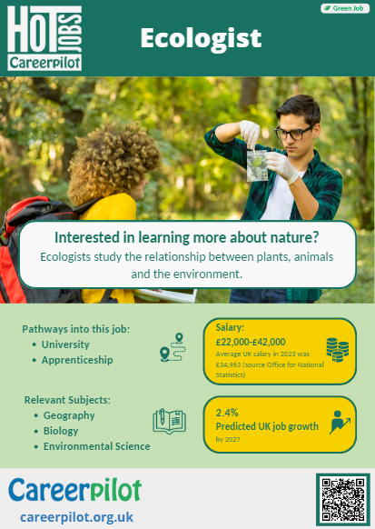
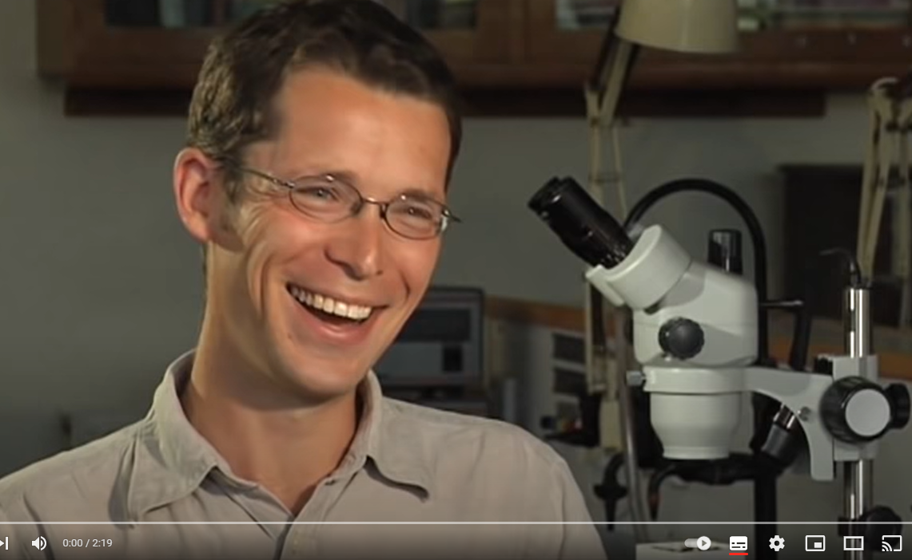
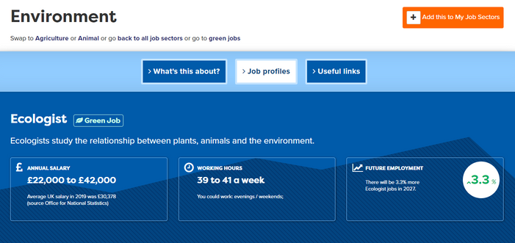
Green Job
Ecologist: Short Lesson Activity
Ecologists study the relationship between plants, animals and the environment.
Watch the video
Read the job profile
Add a little bit of body text
Add a little bit of body text
Add a littl of body text
Ecologist - What’s in the Job?
This classroom activity will help students explore and understand this green job role in some detail.
  Watch and listen to the video (3-5 mins)
  Read the key information on the relevant Hot Job poster or job profile on Careerpilot (5 mins)
  Discuss the job role in pairs or as a class using prompt questions (10 mins)
Working in pairs or as a class discuss:
  What sort of projects might an ecologist work on?
  Looking at the job profile or poster, what subjects would be useful to study if you would like to become an ecologist?
  What skills do you think would you need to be an ecologist?
Back to contents
careerpilot.org.uk

Slide 7
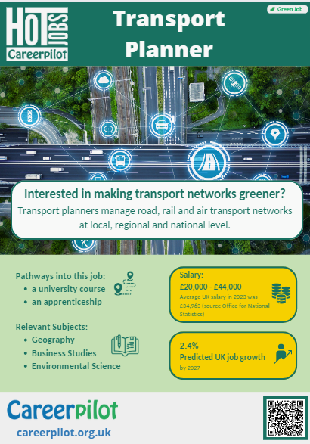

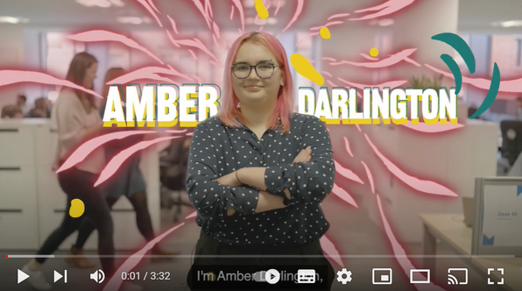
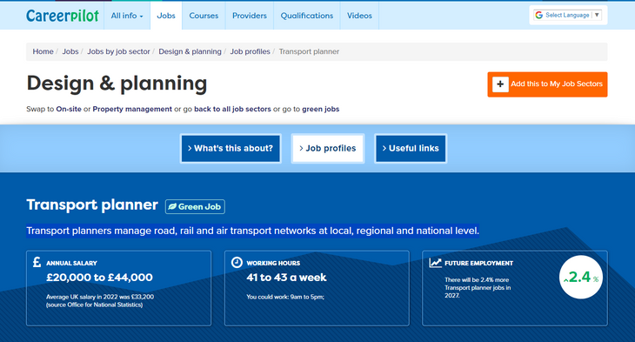
Green Job
Transport Planner: Short Lesson Activity
Transport planners manage road, rail and air transport networks at local, regional and national level.
Watch the video
Read the job profile
Add a little bit of body text
Add a little bit of body text
Transport Planner - What’s in the Job?
This classroom activity will help students explore and understand this green job role in some detail.
  Watch and listen to the video (3-5 mins)
  Read the key information on the relevant Hot Job poster or job profile on Careerpilot (5 mins)
  Discuss the job role in pairs or as a class using prompt questions (10 mins)
Add a littl of body text
Working in pairs or as a class discuss:
  What did the apprentice in the video say they do in their role as a trainee Transport Planner?
  How do you think a Transport Planner can be a ‘green job’?
  Looking at the job profile or poster, what are the different routes you could take to become a Transport Planner?
Back to contents
careerpilot.org.uk

Slide 8
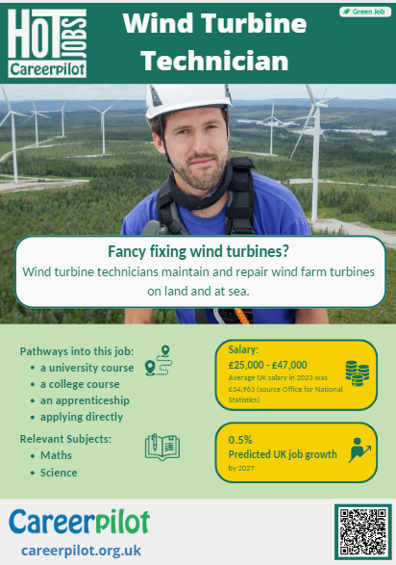
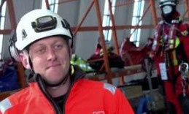

Green Job
Wind Turbine Technician: Short Lesson Activity
Wind turbine technicians maintain and repair wind farm turbines on land and at sea.
Watch the video
Read the job profile
Wind Turbine Technician- What’s in the Job?
This classroom activity will help students explore and understand this green job role in some detail.
  Watch and listen to the video (3-5 mins)
  Read the key information on the relevant Hot Job poster or job profile on Careerpilot (5 mins)
  Discuss the job role in pairs or as a class using prompt questions (10 mins)
Add a little bit of body text
Add a little bit of body text
Add a littl of body text
Working in pairs or as a class discuss:
  What personal qualities would you need to work as a wind turbine technician?
  What would be the most challenging part about doing this job?
  What skills have you picked up in and outside school that would be good for this job?
Back to contents
careerpilot.org.uk

Slide 9
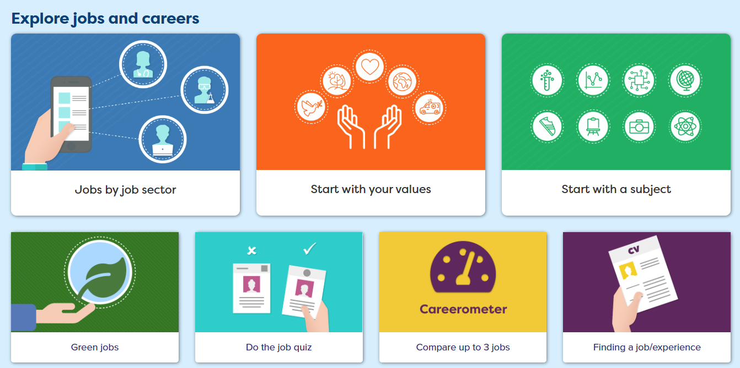
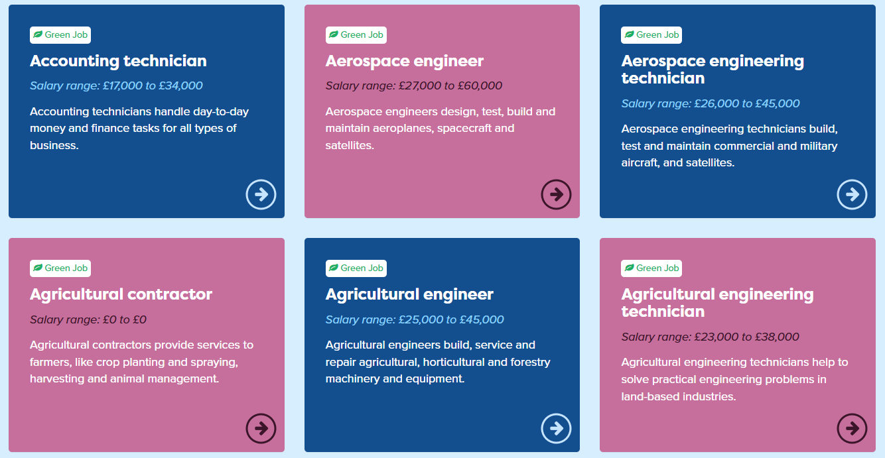
Green Job
Explore more green jobs: Short Lesson Activity
Find other green jobs on Careerpilot and explore the pathways into them.
Go to the Careerpilot Jobs Search
Choose 2 green jobs to explore that interest you
Teacher notes - What’s in the Job?
This classroom activity will help students explore and understand about more green job roles and the pathways into them.
  1. Visit the Careerpilot job search page and click on ‘Green Jobs’
  2. Choose 2 job profiles to explore in more detail, including job growth, salary and the pathways into them
  3. Discuss the job roles in pairs or as a class using prompt questions
Add a little bit of body text
Add a little bit of body text
Add a littl of body text
Working in pairs or as a class discuss:
  What 2 green jobs did you choose to explore?
  What are the different pathways you can take to get into this job?
  What skills do you think you would you need to do either of these jobs?
Back to contents
careerpilot.org.uk

