Slide 1

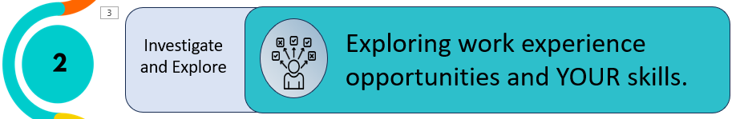


Delivery Notes
Before session 2, ensure the students will be able to access Google Map and do Google searches.
All students to have own computer with Internet access.
Deliverer to have whiteboard for presentation.
Timings | Slides | Activity | Notes | Key task
10 mins | 2 - 8 | Benefits of WEX and their personal goals | Workbook | Yes
5 mins | 9 | Thinking about the range of jobs at a big company
20 mins | 10-13 | Using Google maps to find an employer locally | Workbook | Yes
10 mins | 13 – 16 | Introducing skills and do Skills Profile | Workbook | Yes
10 mins | 17 - 18 | Matching skills to a job role | Workbook | Yes
5 mins | 19 - 21 | Wrap up
After session 2, send school summary of what covered and Digital Postcard for session 2 to send to each students. Remind the school of what you need for session 3 – each students to be able to download documents from Careerpilot.

Slide 2






Session Two: Welcome back
What do YOU want from life and future work?
Introduce and Inspire
Investigate and Explore
Exploring work experience opportunities and YOUR skills.
Having what YOU need to apply for and have a great work experience
Apply
and Demonstrate

Slide 3

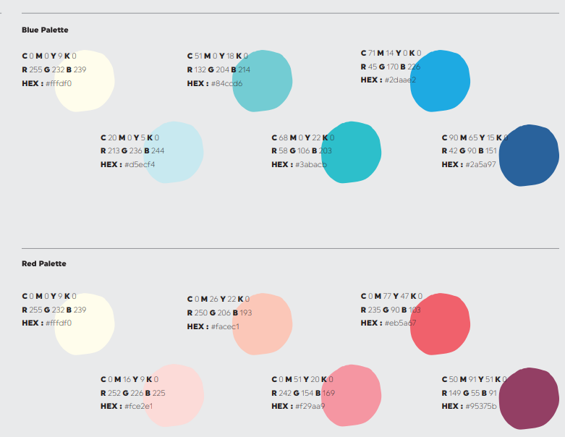

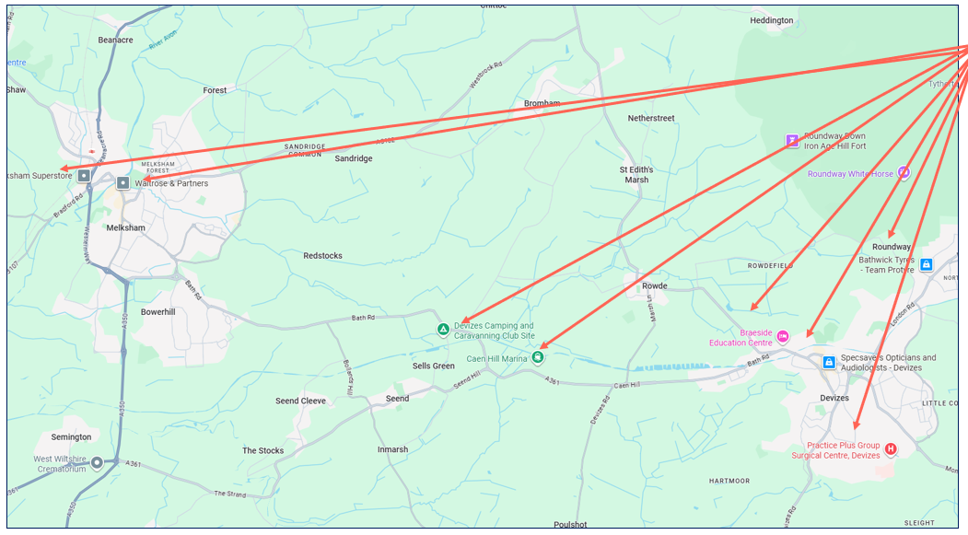
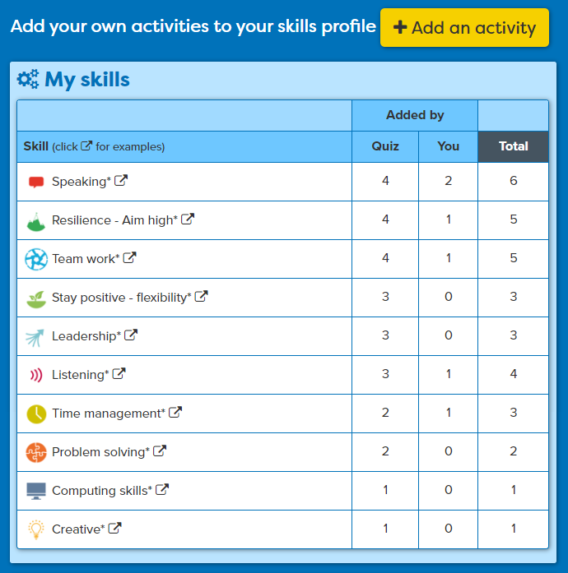
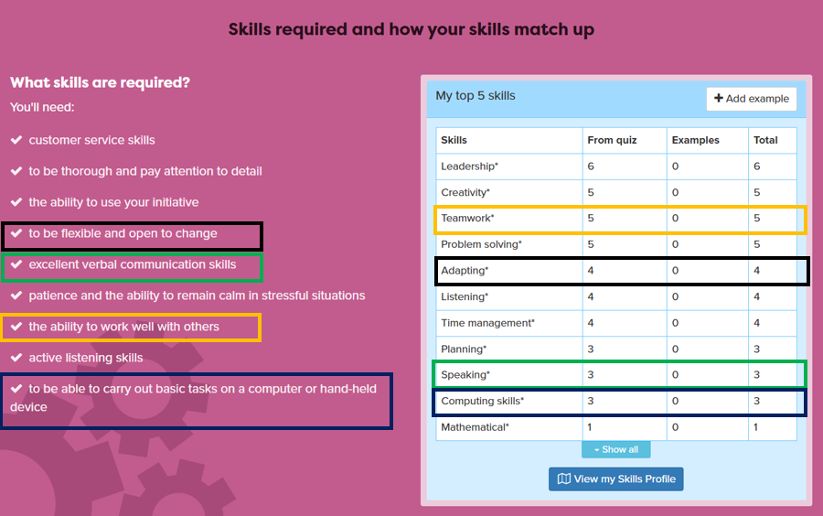
In this session you will:
1
  Be able to identify a range of job roles in a specific working situation.
2
Explore local companies that might offer work experience placement opportunities
3
  Recognise the essential workplace skills you have and match to a job role
careerpilot.org.uk

Slide 4

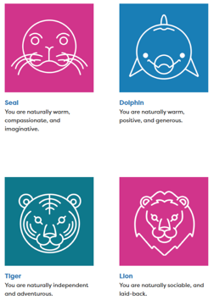
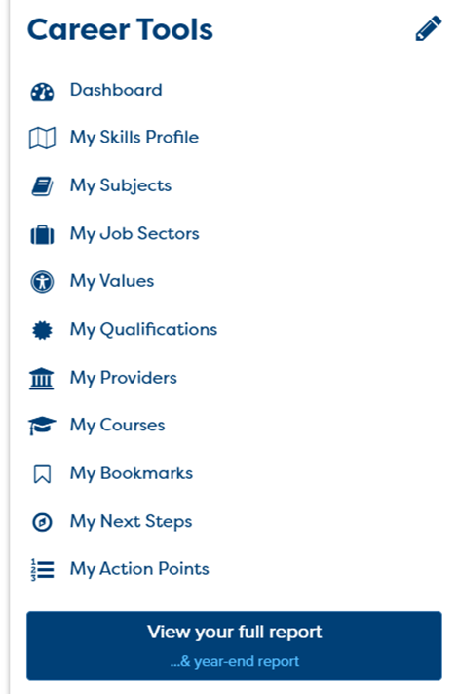

Sign in and review of session 1
Notes:
Review what they did in session 1 by looking at Career Tools – the Buzz Quiz results have to be accessed by going to the Buzz Quiz and finding their animal.

Slide 5



What was their first job?
Taylor Swift: Singer, songwriter, musician
Beyonce – American singer
Harry Styles – Singer
Christmas Tree Farm
Hair salon floor sweeper
Worked in a bakery
Where you start your working life is not always where you end up!
Notes:
See if they know who they are and what they did as a first job.

Slide 6
Why do work experience?
To find out about a company
To learn/practice skills
To try out a job role
To be seen as a future worker
Is this the sort of job I like?
What skills will I need to do it?
What is the best way to talk to a boss?
Notes:
Could show video here (as on last slide)
Can ask them for ideas but to be quick just go through them in overview

Slide 7

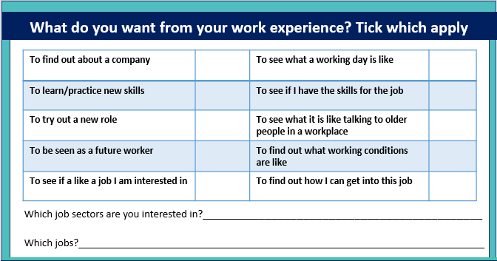


Which sectors/jobs are you interested in for work experience?
Write down a few things you want to get from YOUR work experience
And which job sectors and jobs you are interested in for work experience
5 mins
Notes:
In workbook – what do they want to get from WEX. Tick as many as they want. Add a sector and even a job they are thinking of for WEX.

Slide 8

One workplace can have loads of different jobs
CEO
Manager
Human resources
Marketing
Admin
Stock control
Home shoppers
Drivers
Loaders
Trolley staff
Car park attendants
Maintenance
Packers
Cleaners
Cashiers
Cashier
Shelf stackers
Security
Butcher
Baker
Fishmonger
Supermarket
Farmers
Suppliers
Builders
5 mins
Notes:
Can do Railway station, Sports stadium as alternatives but supermarket good as lots of WEX jobs
Just a 5 minute activity so if no time to get their ideas then just click through suggestions.

Slide 9
Ways to start looking at places for work experience
Local companies you know
Parents/ friends
School list/database
Google maps
Google search
?
Notes:
See what they can come up with before giving answers.
Some schools has access to a database of possible WEX and use the system to record and check H&S. Tell the students to ask their teachers about this if they are not sure.
IN THIS LESSON – will be focusing on some online ways to start looking

Slide 10
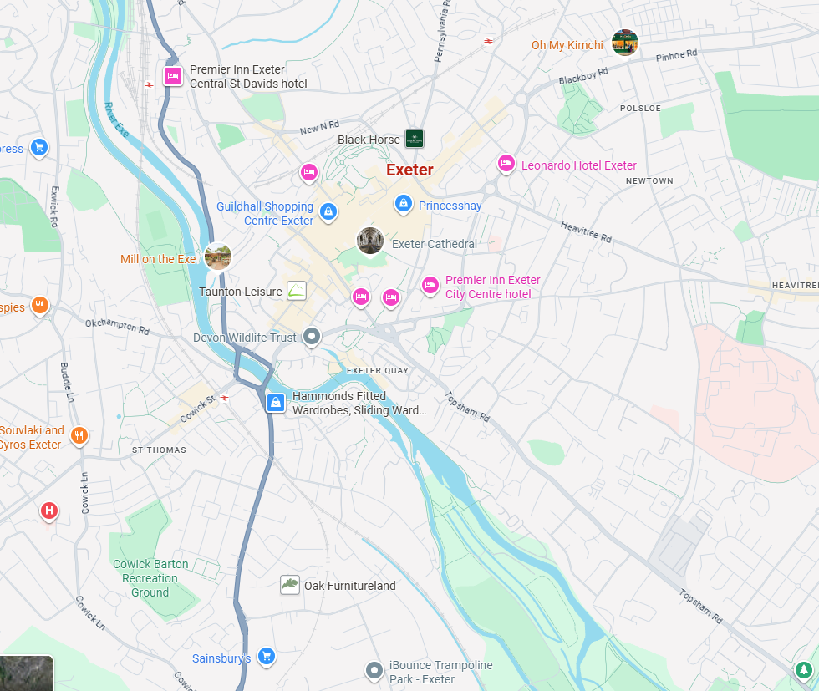
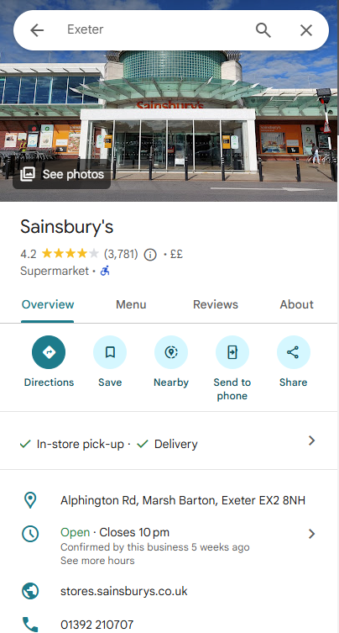

Online: Google Maps can give you ideas
Notes:
Example of putting the word ‘Exeter’ into Google Maps search, what employers can they see?
Then add arrows.
Show what they get to see if they click on one – in this example Sainsburys.
Explain teamwork – each find one placement but will have list for whole group by session 3.

Slide 11
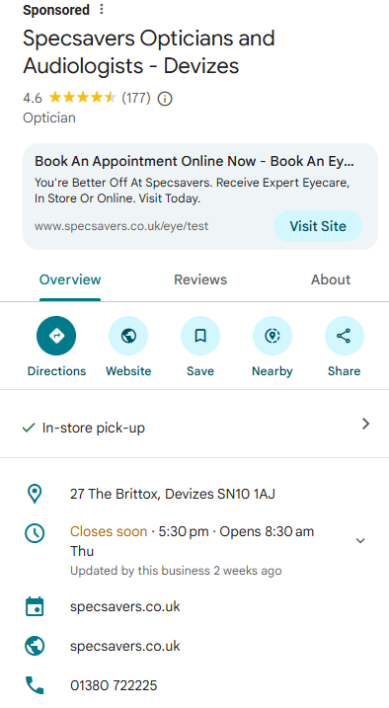

Task:
Go to Google Maps - Put in name of town near you or your home postcode
Click to get the details
Search for info. about work experience on their website – try and find a contact email
Write the details down in your workbook
20 mins
Notes:
1: Students use Google maps from their home postcode or nearest town to see what is around them.
2. Find one and click on it to get details as shown.
3. Write down information in workbook.
4. Look at their website and search for work experience or careers and see if they can fine a contact email or what they say about work experience
Could ask students to feedback to group the name of the place they found – if time.

Slide 12
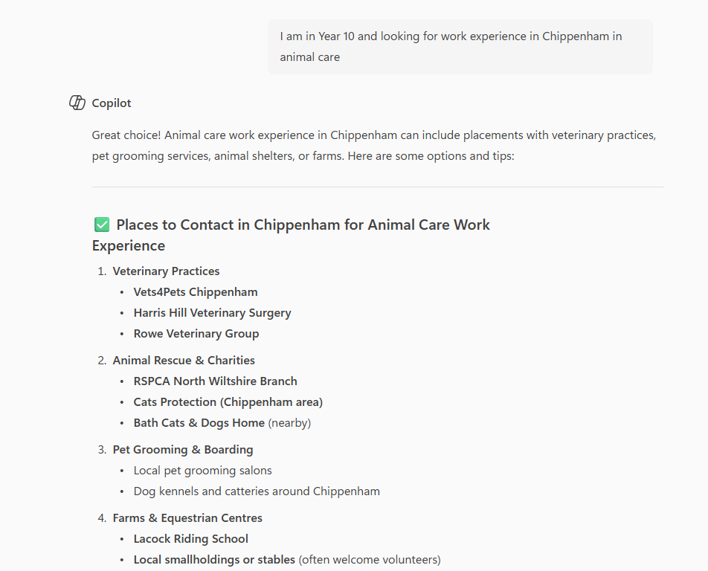
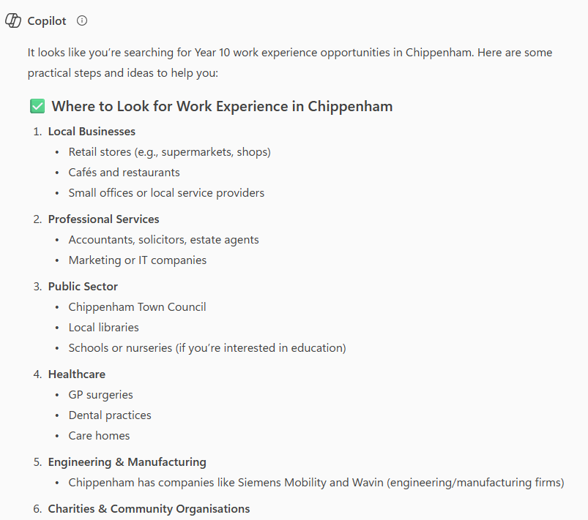
AI Tools: Gemini/Copilot
Ask very specific questions:
“I am in year 10 looking for work experience in health care in Chippenham”
DO NOT INCLUDE ANY PERSONAL DETAILS IN YOUR SEARCH
Notes:
Explain about other more in-depth AI tools that they can use at home. Remind them not to share any personal data when using AI tools.
Check what the school tells students about using AI – especially when 15/16 as Chat GPT requires parental approval if under 16.

Slide 13

Focus on skills and what you have to offer
Essential in ANY job
Some jobs need other technical skills
IT Skills
Practical
Scientific
Physical
Notes:
Explain the 8 essential skills.
Mention that some jobs also require additional tech skills.
The 8 are the ones we are focusing on.

Slide 14
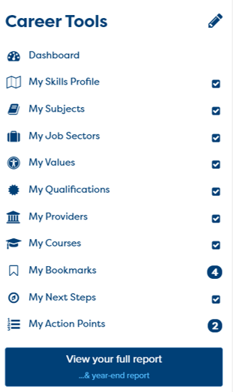
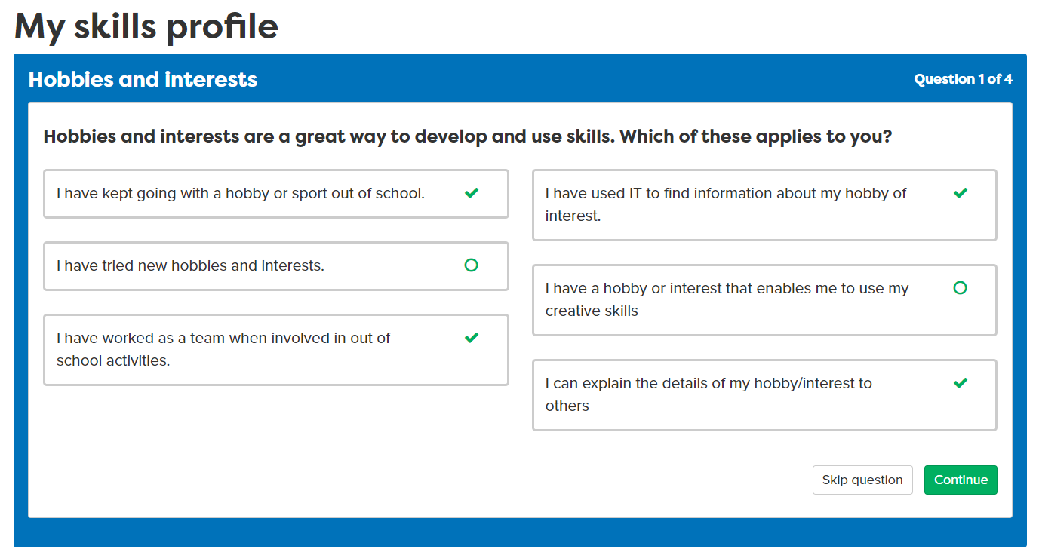
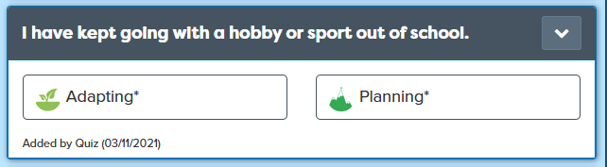
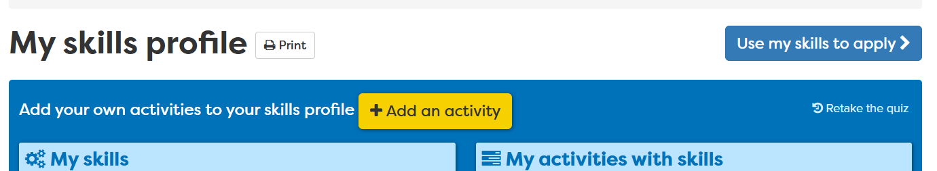
What skills do you have already?
Retake if you have done it before and edit answers
Notes:
Even if done before want them to do this again so the list is up to date.

Slide 15
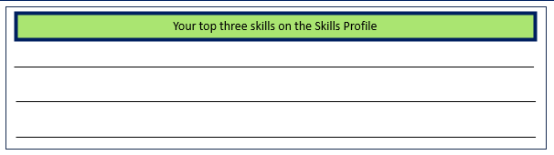
What skills have you got already?
Today: Add at least 1 or 2 of your examples
Add your own examples
All your skills are ‘banked’ for later when you want to apply

Slide 16
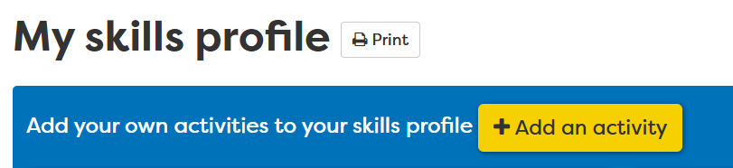
Task
10 mins
Do the Skills Profile – call it ‘Y10’.
2. Add one or two examples of your own

Slide 17
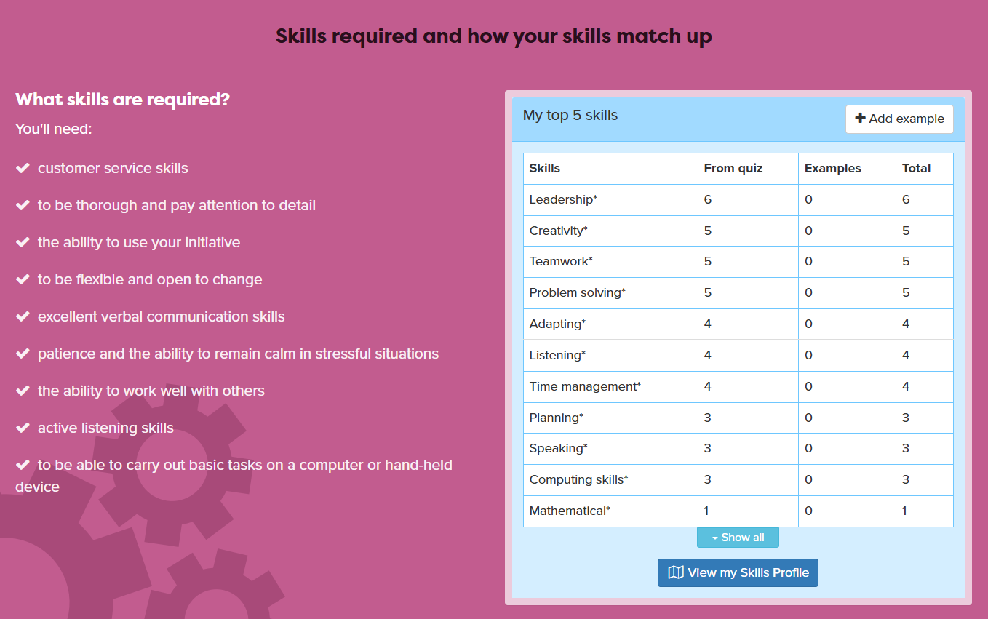
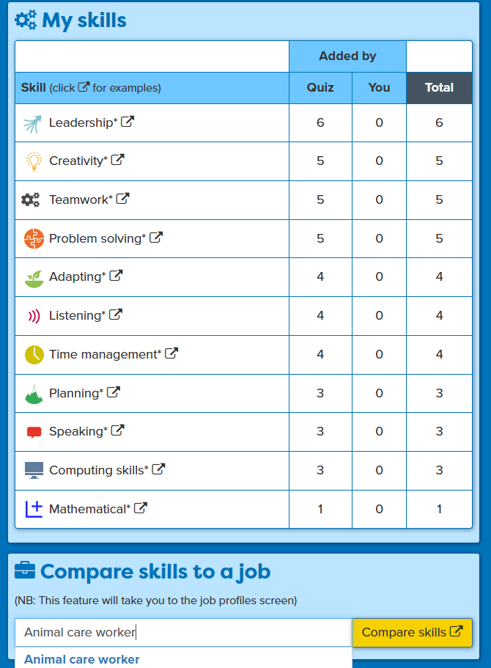
Matching your skills to a job
Notes:
Student puts in nearest job role that matches with their WEX. When they open job profile on pink bit will show skills job requires alongside their own. The language employers use might be a bit different so need to make that point e.g communication rather than speaking and listening.
In workbook write down three or four skills they have and the job wants.

Slide 18
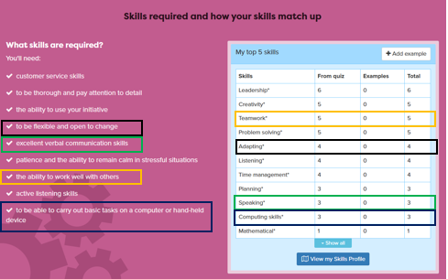
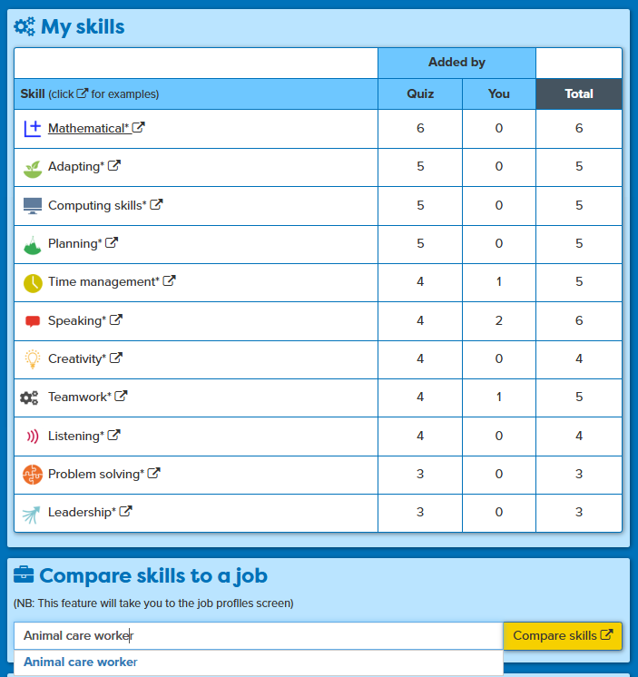
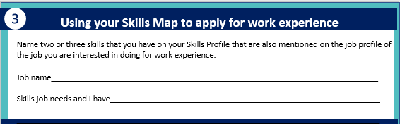
Find three skills the job needs that you have examples of
2
10 mins
3
1
3
Notes:
Summary of the task,

Slide 19
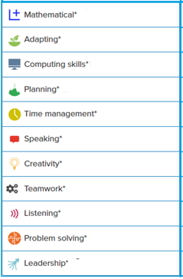

Wrap-up
What company did you find?
Which were your top skills?

Slide 20
In this session you completed:
1
  Be able to identify a range of job roles in a specific working situation.
2
Explore local companies that might offer work experience placement opportunities
3
  Recognise the essential workplace skills you have and match to a job role
careerpilot.org.uk

Slide 21

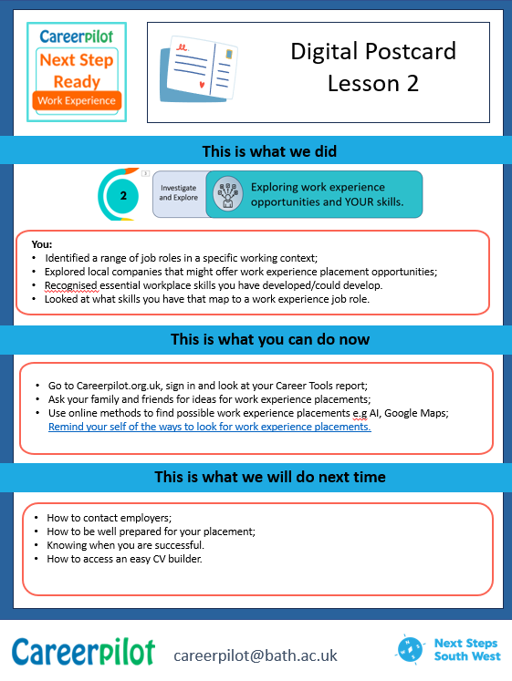
What now?
careerpilot.org.uk

Slide 22

Some tips..
https://careerpilot.org.uk/stories/how-to-prepare-for-work-experience
https://www.youtube.com/watch?v=hmk_-bOceC0&t=17s
Notes:
This video is 1.47 long. Nice overview of WEX but not a problem if you have to leave it out if no audio, etc.
Explain will be writing letter next lesson.

