Slide 1






What inspires you?
Look at Jobs and pathways
Explore courses and make plans

Slide 2








What you will get from this lesson
How can you manage your future career?
What skills have you got?
What do you love to do?
Discuss your ideas

Slide 3

What is a career?
A career is an individual's journey through life, learning and work.
It is all about YOU!
Throughout your career you may have many jobs
Notes:
Ask students if they know what a career means?
Encourage students to explain what is meant by the word career then reveal the answer.
Ask students to share it they have any idea about what sort of job or work they might like to do one day?

Slide 4




How can you manage your career?
https://www.youtube.com/watch?v=OWZxyyK6OuA
Notes:
Play video with sound
Ask students if they can remember what four things you need to do to get ready for your future career, before revealing them on the slide.

Slide 5


Getting to know you
Take turns to tell the group your name and one thing you really enjoy – e.g. favourite food, music, hobby.
Notes:
Quick ice breaker activity to practice speaking and listening skills

Slide 6




What’s next on your career journey?
Y9
Y10
Y11
Y12/Y13
Choosing GCSE exam subjects
Choosing post 16 courses
Choosing post 18 options
Trying out work
Exploring post 16 options
In the UK you have to be in education or training until you are 18

Slide 7



What’s going to help you?
Helping YOU with YOUR personal career journey
A website with all the information you need to help you
Your school’s career programme

Slide 8

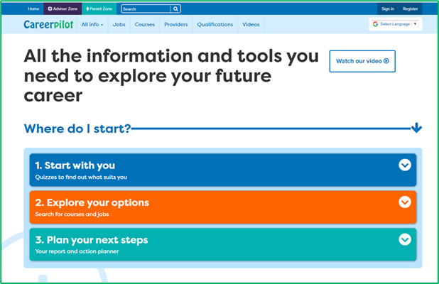
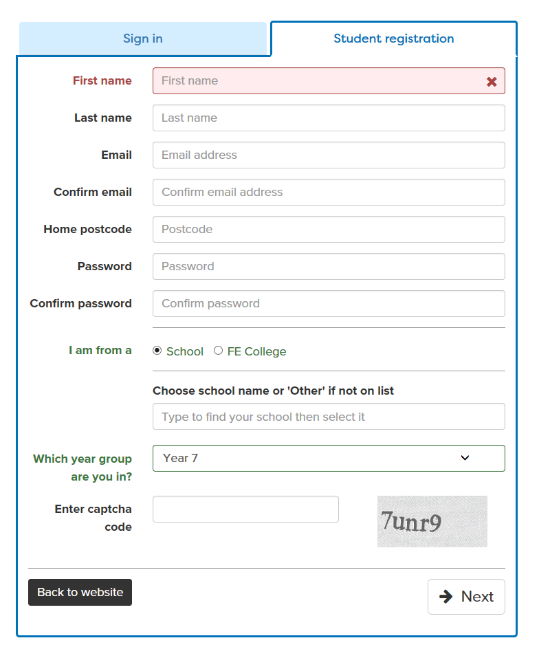
Register or sign in to Careerpilot
careerpilot.org.uk
If you have registered before – sign in
Notes:
Show students that if they are new to Careerpilot, they need to register to use the website.
They must click on the ‘Register’ button in the top right corner to open up a short registration form that takes a few minutes to complete.
Remind students to use their school email address to register and to click on your school from the drop down list.
Students that have already registered just need to log in with their email and password.
There is an option to show the site in a different language if needed.

Slide 9

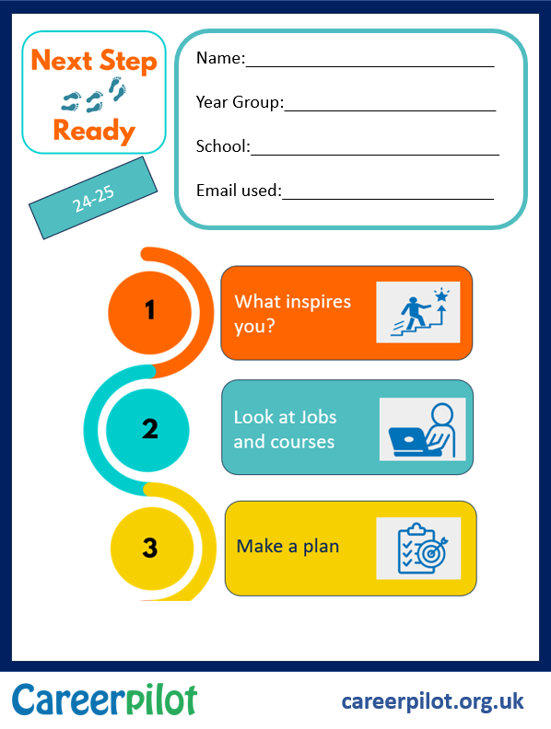
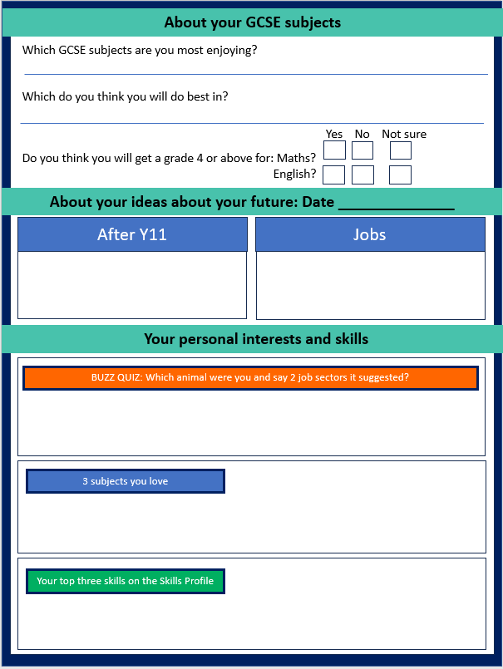
Workbook

Slide 10
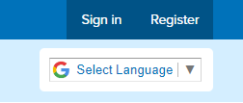
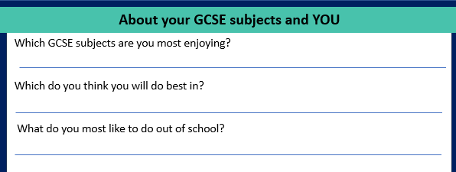
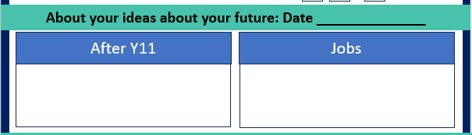
Getting started
Register or sign in careerpilot.org.uk
2. In workbook add you name, fill in the bit about your GCSEs and YOU
3. Add any career ideas to your workbook
10 mins
Notes:
Students can use their list subjects and those they are interested in as a starting point for exploring where they might lead.

Slide 11
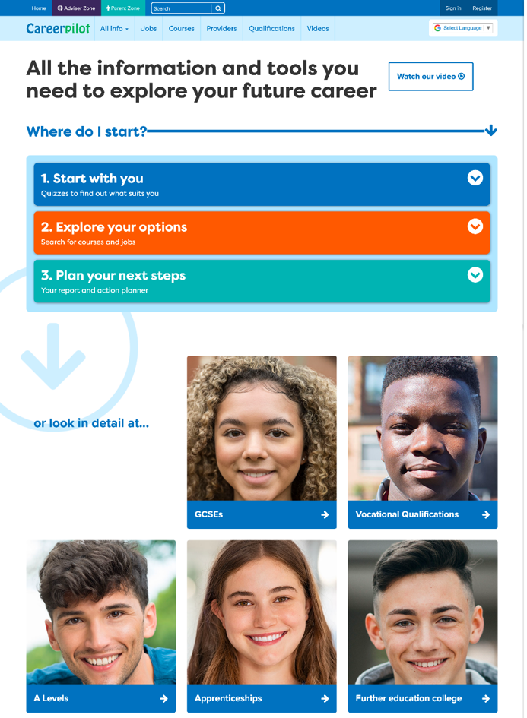
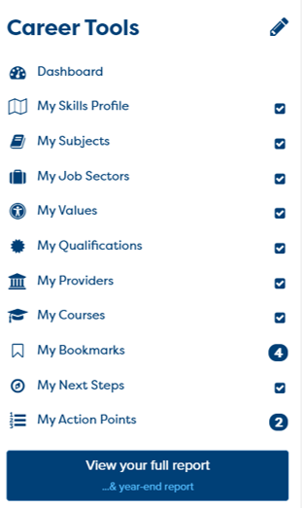
Build your personal career report

Slide 12
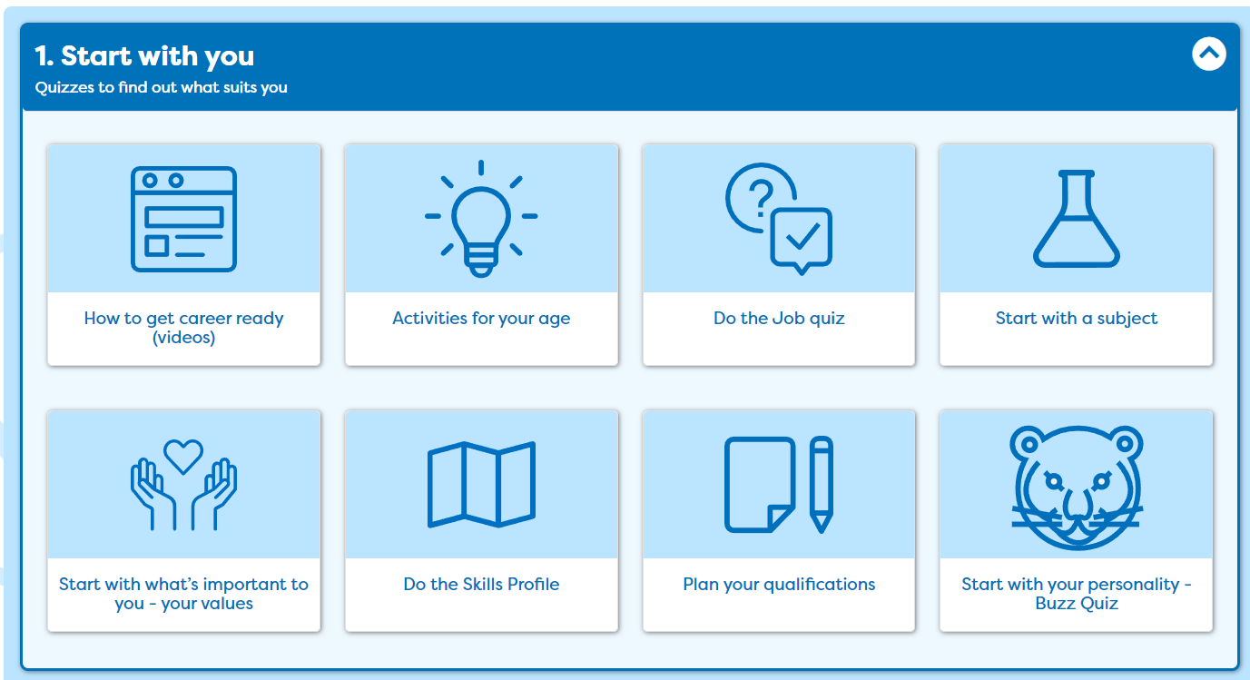
What personality type are you?

Slide 13
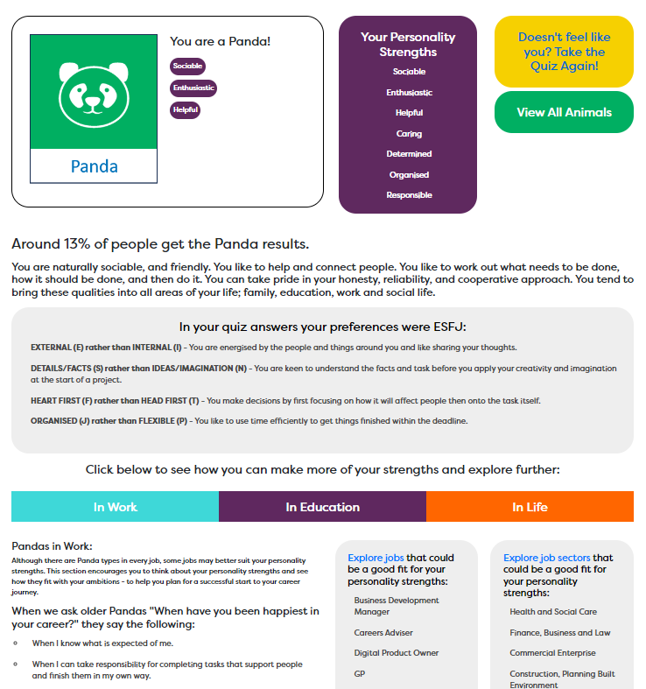
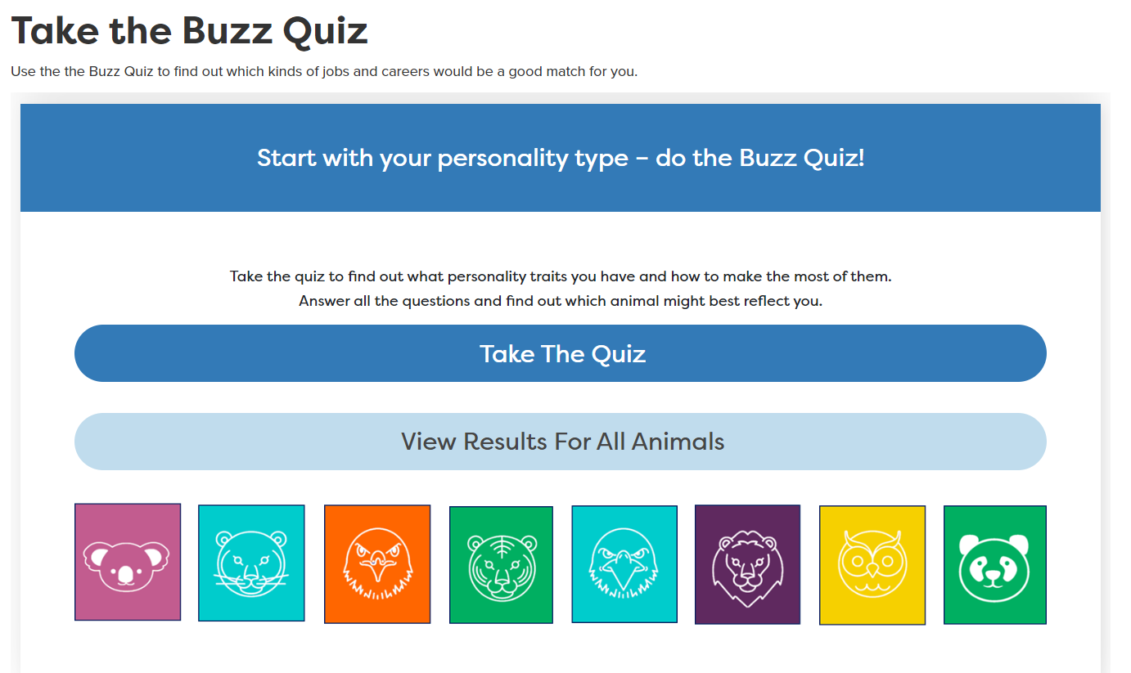
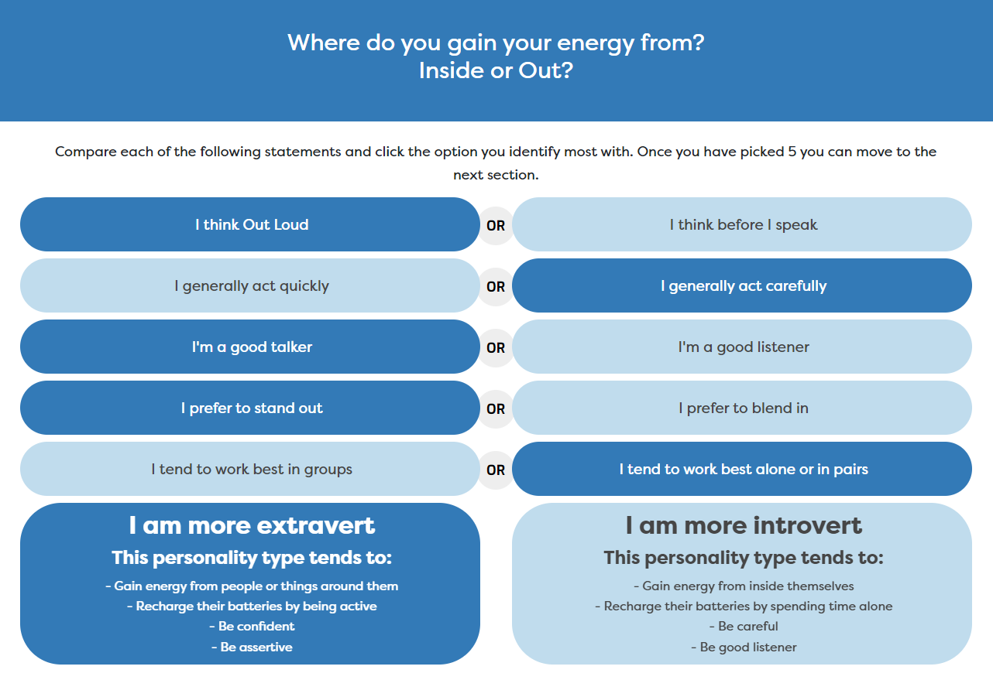
Buzz Personality Quiz
10
mins

Slide 14

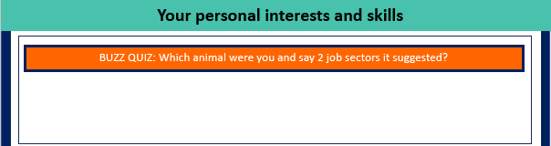
Buzz Personality Quiz: Feedback
Which animal were you, write it down and two job sectors that were suggested?

Slide 15
Start with a subject, Skills Profile

Slide 16
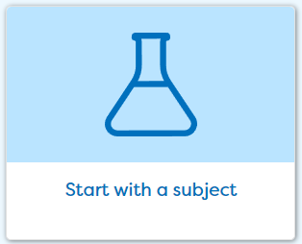
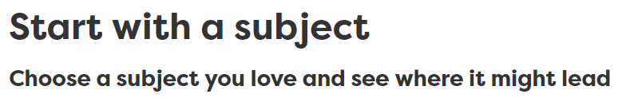
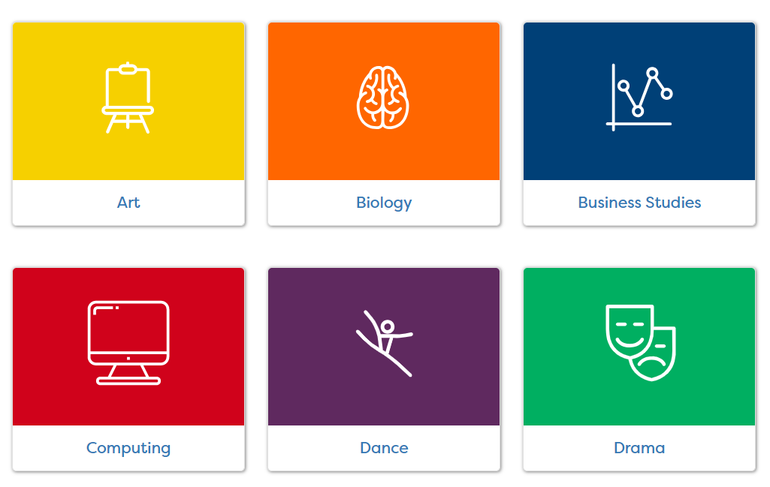
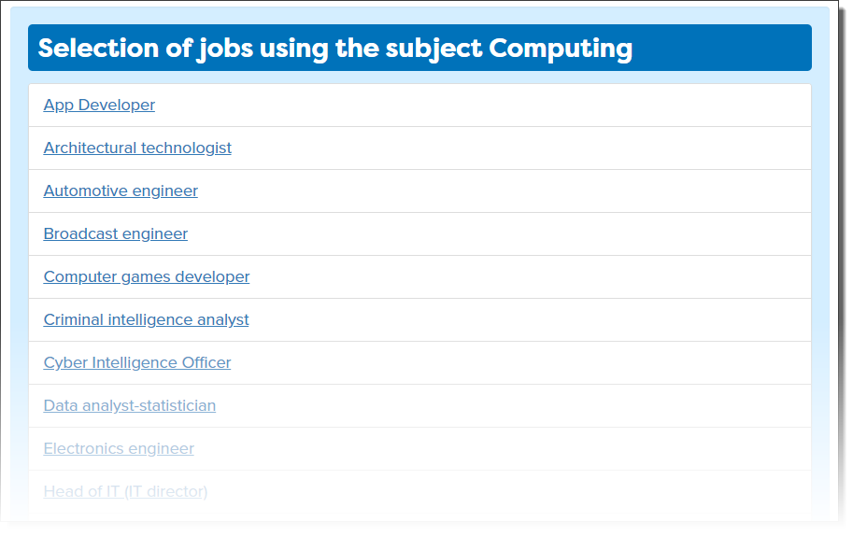
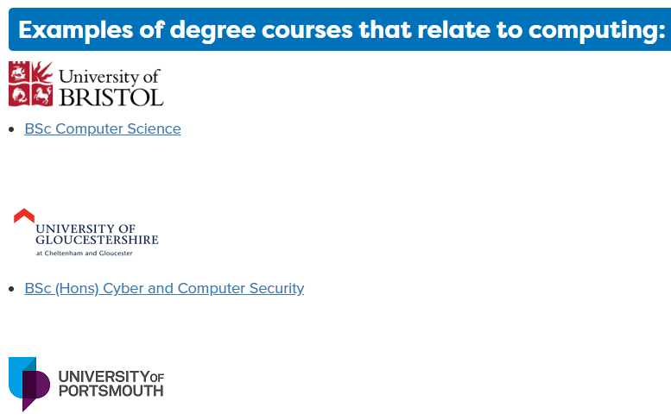



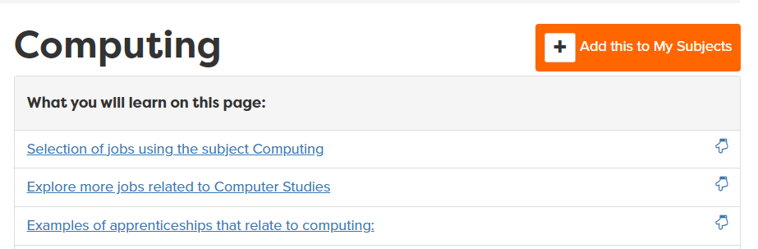
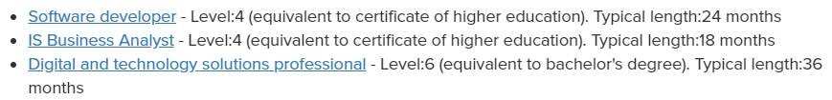
Tag your favourite three subjects
Tag 3 before you start looking at details
Notes:
Aside from the skills profile, Careerpilot also links to the curriculum and links courses and jobs through ‘Start with a subject’ . In this section students can pick subjects they are interested in and read more about jobs, courses and online activities they can take part in which are related to the subject. A direct way of Achieving Gatsby Benchmark 4

Slide 17

The Essential Skills
Other skills some jobs need
IT Skills
Practical
Scientific
Physical
Notes:
Reminder
These eight skills have been identified by employers as being essential to any job. They are people skills, so are all about how you communicate with others, how you manage yourself and come up with new ideas.
You can see them as four pairs of skills:
Communication skills - Listening and Speaking
Creative Problem Solving skills - Problem Solving and Creativity
Self-management skills - Staying Positive and Aiming High
Inter-personal skills - Leadership and Teamwork

Slide 18

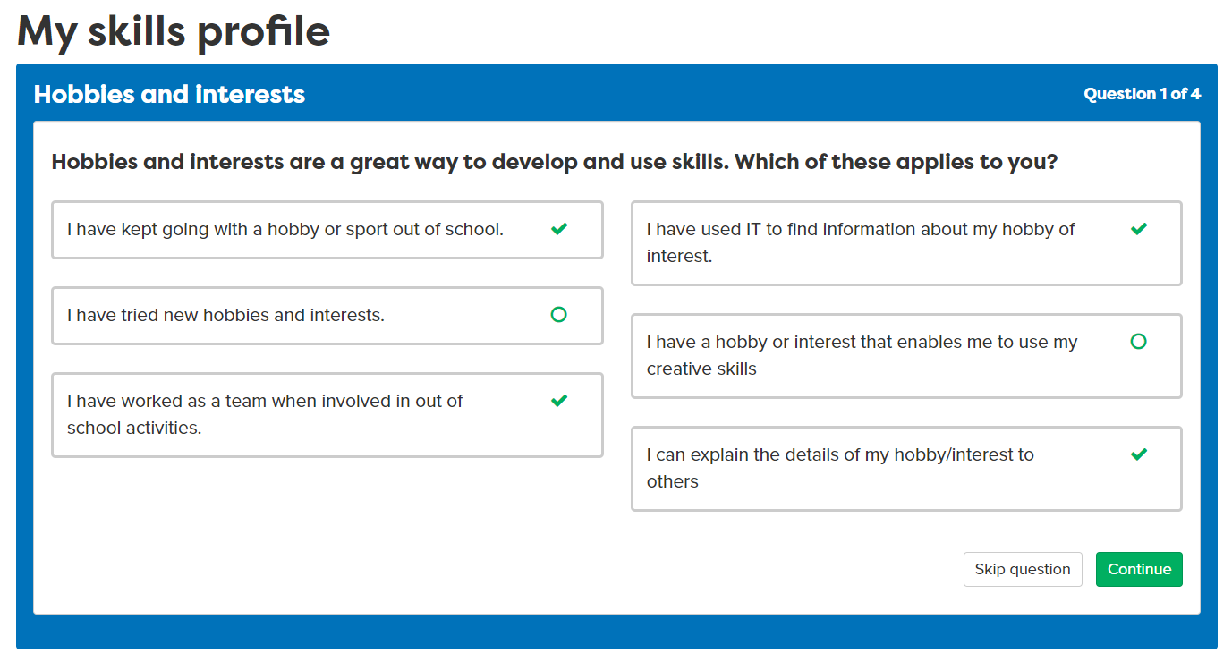
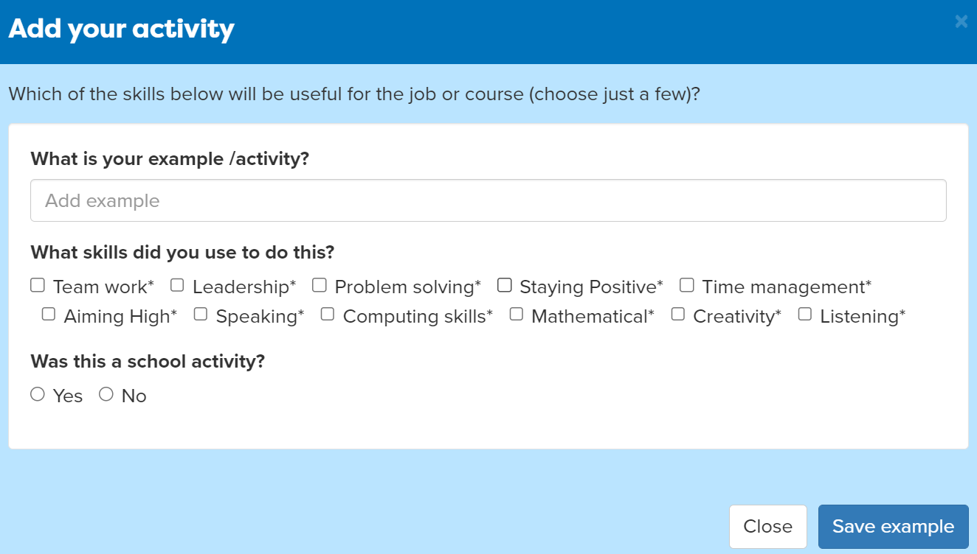
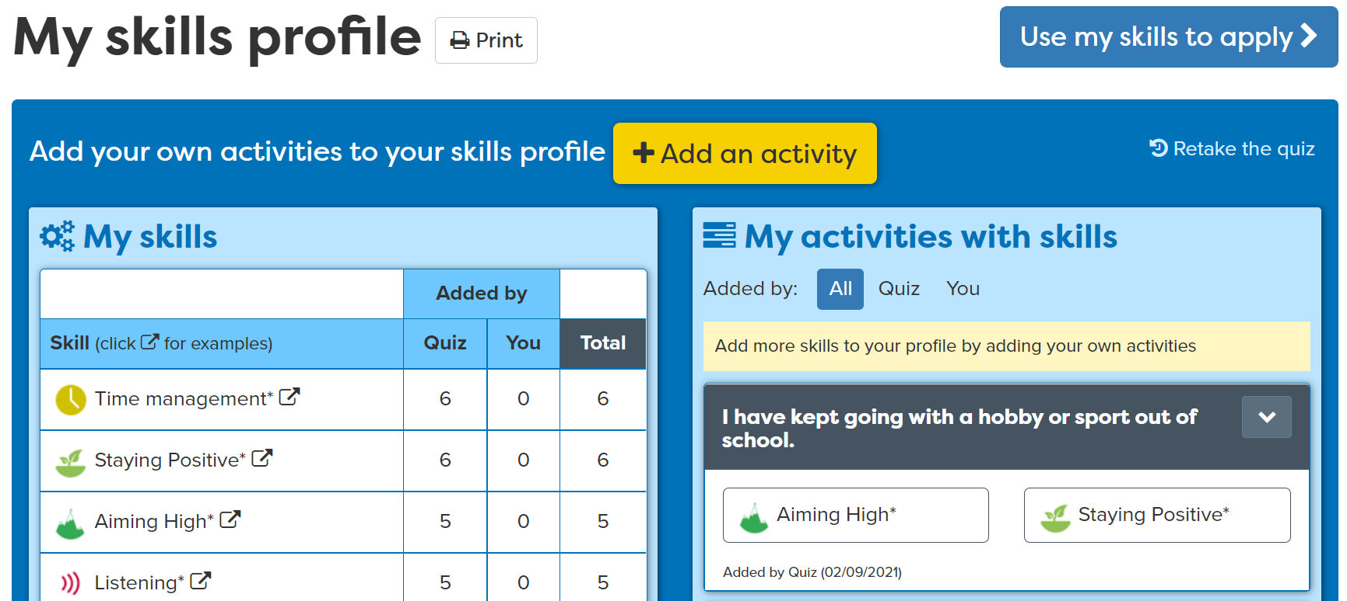
Add activities
Notes:
Students can add activities that they have completed where they have been building their skills.
For example, they may take part in a club outside of school where they use Teamwork skills.

Slide 19
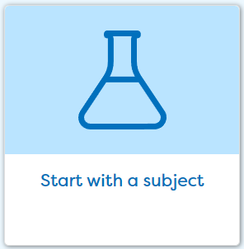

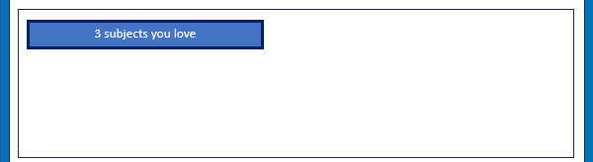

Subjects you love and skills you have
Click on ‘Start With You’ then ‘Start with a Subject’.
Tag at least three subjects you are interested in.
Click on ‘Start With You’ then ‘Do the Skills Profile’. Add an example of your own.
15 mins
Notes:
Students can use their list subjects and those they are interested in as a starting point for exploring where they might lead.

Slide 20


Discussing your interests
Tell the group your three favourite subjects and your top skills

Slide 21


Feedback on lesson
Final Feedback: Get ready to answer one of the questions
Hands up:
Do you know which animal matches your personality type?
Can you name one job that a subject you love could lead to?
Can you name one of your top three skills?
Digital Postcard:
What we did and what you could do now
careerpilot.org.uk
Notes:
Just ask each students to answer one of the questions.

Slide 22
What inspires you?
Look at Jobs and pathways
Explore courses and make plans

Slide 23







What you will get from this lesson
What do you want from a job?
Explore your choices at 16
Explore jobs
Discuss your ideas

Slide 24

Thinking about jobs – how many jobs can you think of in:
Train Station
5 mins
Notes:
Session leader: Choose one to look at
The Career Development Institute has developed a careers framework that shows the skills everybody needs to have to manage their future career.
This slide shows the students which of the career learning areas (CDI) that this lesson 1 links to.
You can also share the structure of the session with students.

Slide 25

Thinking about jobs – how many jobs can you think of in:
Supermarket
5 mins
Notes:
The Career Development Institute has developed a careers framework that shows the skills everybody needs to have to manage their future career.
This slide shows the students which of the career learning areas (CDI) that this lesson 1 links to.
You can also share the structure of the session with students.

Slide 26

Thinking about jobs – how many jobs can you think of in:
Sports Club
5 mins
Notes:
The Career Development Institute has developed a careers framework that shows the skills everybody needs to have to manage their future career.
This slide shows the students which of the career learning areas (CDI) that this lesson 1 links to.
You can also share the structure of the session with students.

Slide 27
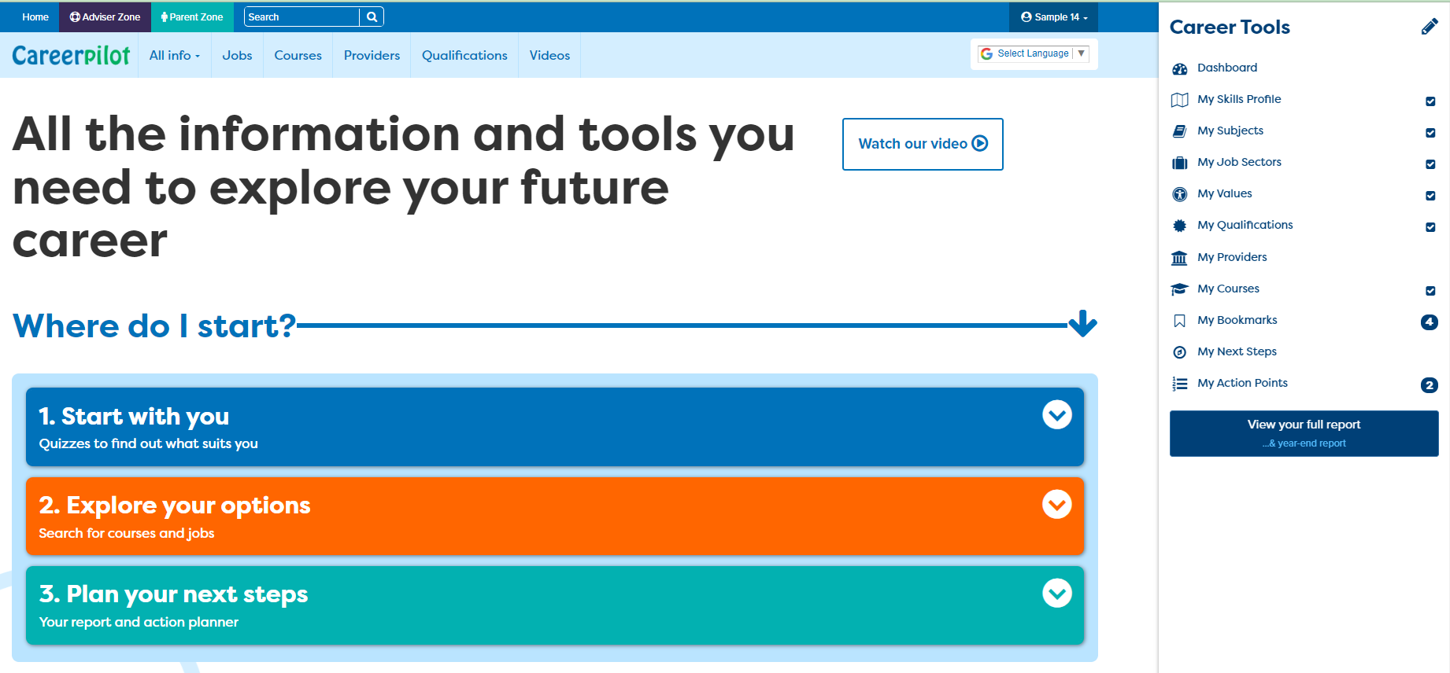
Sign in to Careerpilot, look at report
1
2
careerpilot.org.uk
Notes:
Show students that if they are new to Careerpilot, they need to register to use the website.
They must click on the ‘Register’ button in the top right corner to open up a short registration form that takes a few minutes to complete.
Remind students to use their school email address to register and to click on your school from the drop down list.
Students that have already registered just need to log in with their email and password.

Slide 28
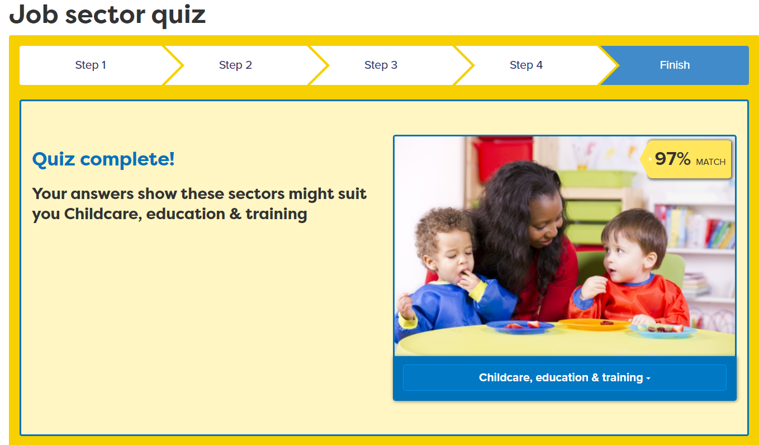
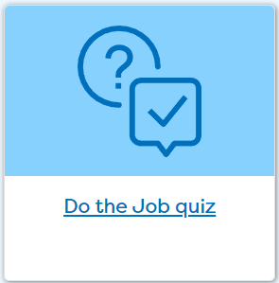
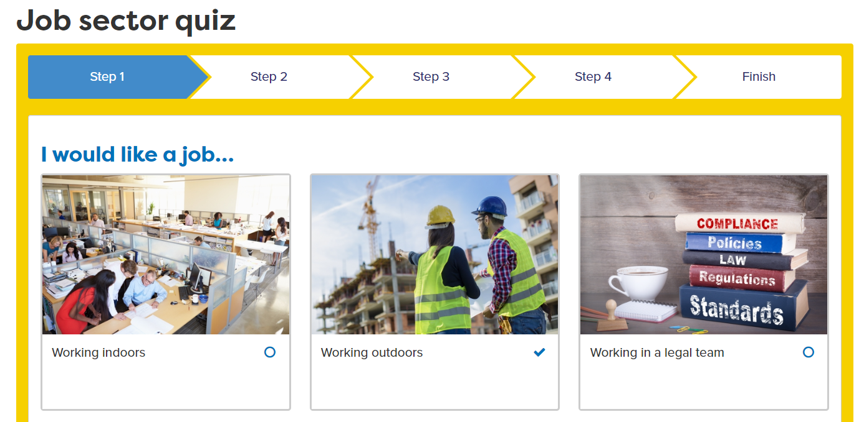

Explore job sectors
Notes:
Ask students to complete the job sector quiz – if they have previously completed it they can look at answers they gave before and review if still relevant and overwrite if necessary.

Slide 29
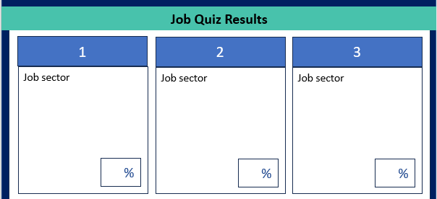
Task:
Do the job quiz
Add the three top job sectors to your workbook
10 mins
Notes:
When students find jobs of interest, encourage them to tag the job sector to add to their Career Tools.

Slide 30
What are the pathway choices?
What pathways can I choose at the end of Y11?
Academic
Vocational/Technical
Apprenticeship
Mostly in a 6th Form or 6th Form College
Mostly in a
local college
Mostly in a workplace
Notes:
Ask them to say what pathways they can do at 16.

Slide 31
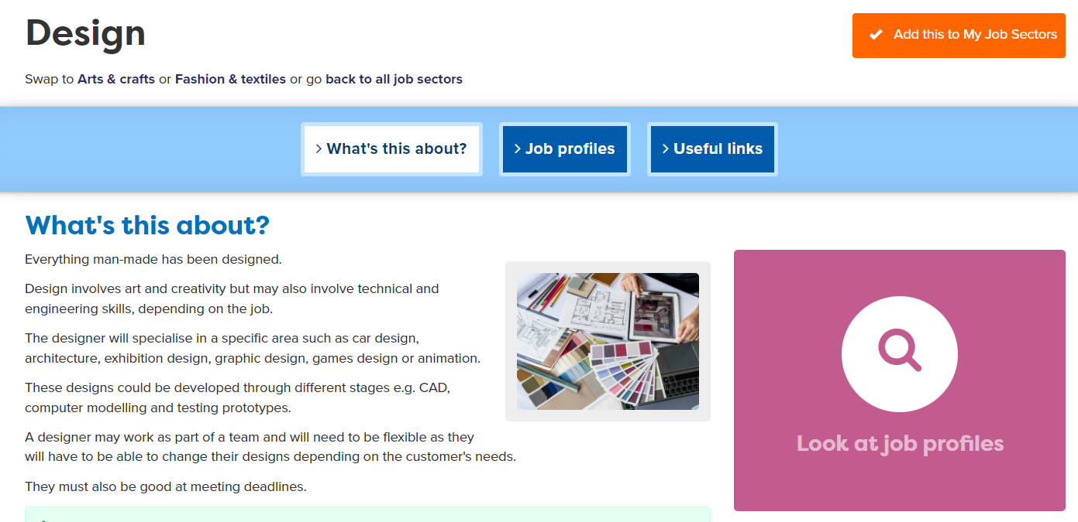
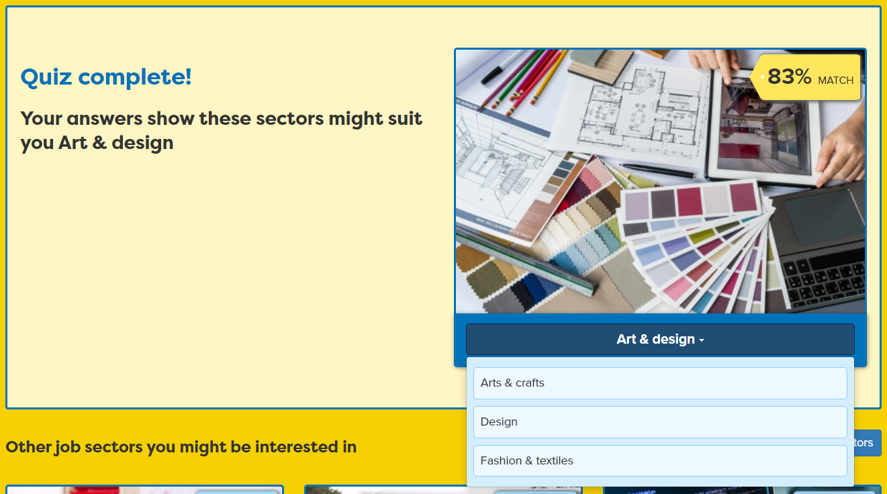
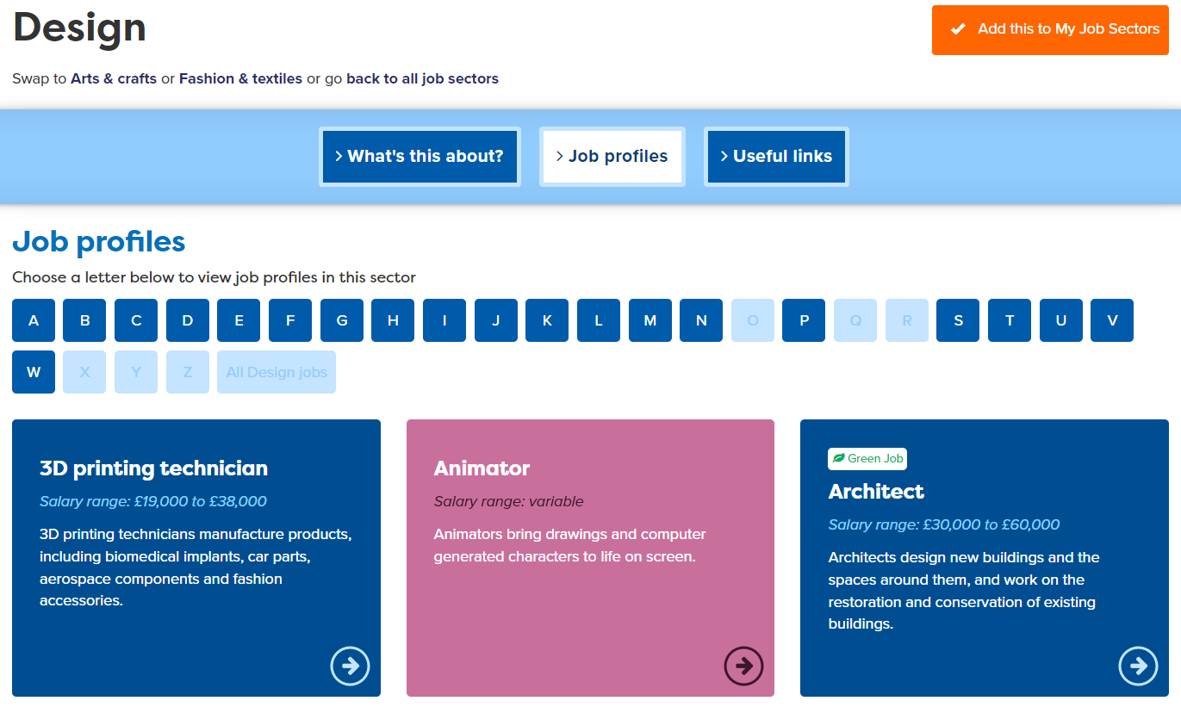
Exploring Jobs

Slide 32
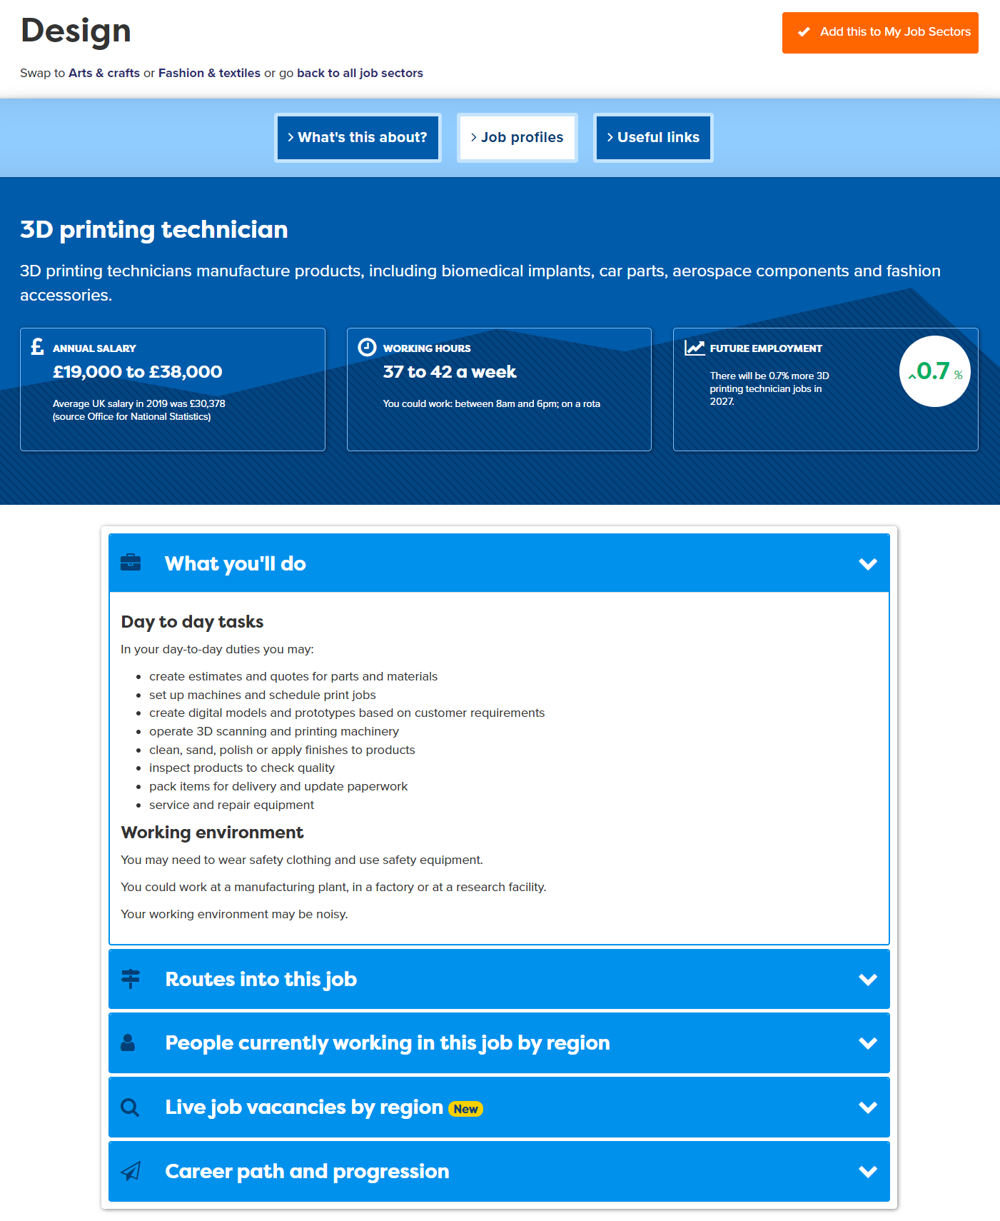
Research the Job
Notes:
When students find jobs of interest, encourage them to tag the job sector to add to their Career Tools.

Slide 33
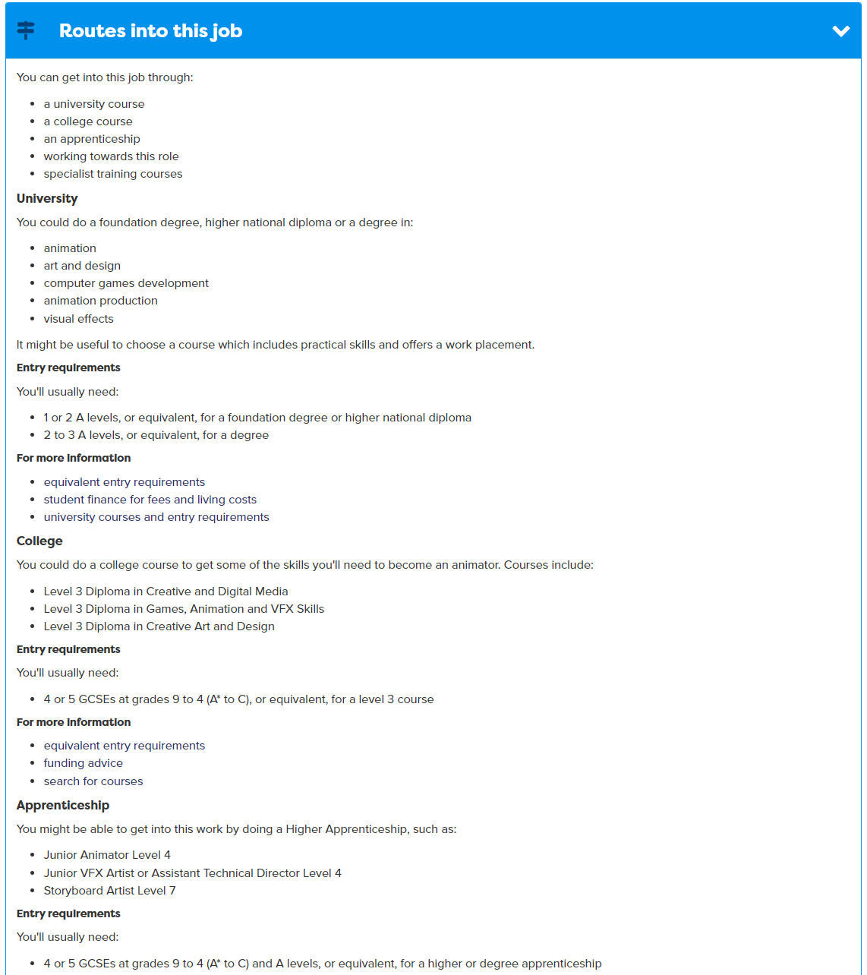
Research the Job
Look at 2 jobs
Notes:
When students find jobs of interest, encourage them to tag the job sector to add to their Career Tools.

Slide 34
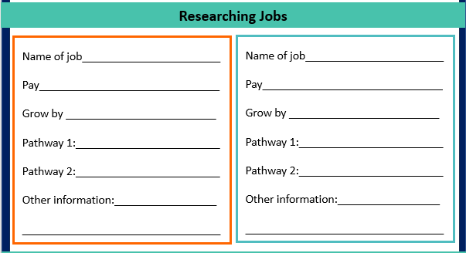
Task:
Explore two jobs
Add details to your workbook
20 mins
Notes:
When students find jobs of interest, encourage them to tag the job sector to add to their Career Tools.

Slide 35
More about pathways – which might suit you?
What pathways can I choose at the end of Y11?
Academic
Vocational/Technical
Apprenticeship
Mostly in a 6th Form or 6th Form College
Mostly in a
local college
Mostly in a workplace
Notes:
Ask them to say what pathways they can do at 16.

Slide 36
What do you know already?
Academic
Vocational/Technical
Apprenticeship
Mostly in a 6th Form or 6th Form College
Mostly in a
local college
Mostly in a workplace
Notes:
As a group see what they already know and then in headline run through next 4 slides

Slide 37


Academic
Getting into the details: 6th Form
A Levels
Other Voc Quals
A levels:
Usually take 3 or 4
Related to a job area
AS levels – in some schools
Small (=1 A Level)
Extended Project Qualification
Large (=2 or 3 A Levels)
L3 Core Maths
Get UCAS points for each, which can get you onto a higher level course
Notes:
Run through each pathway students can choose at the end of Y11

Slide 38


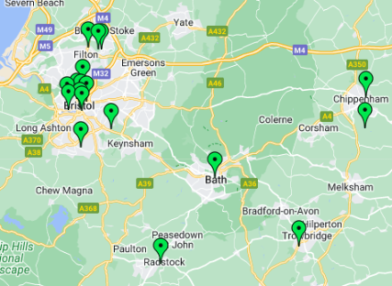



Technical/Vocational
Getting into the details: College
Level 3 –T Levels and other Level 3 qualifications
T Level Foundation (L2)
Level 1 and 2 Voc Quals
Notes:
Explain college has a large range of voc. Some colleges also do A Levels.

Slide 39


T Levels
Agriculture, environment and animal care;
Business and Administration;
Construction;
Creative and Design;
Digital;
Education and Early Years;
Engineering and Manufacturing;
Health and Science;
Legal, finance and accounting;
Sales and Marketing (2025).
Created by business.
Train for a specific job.
2 years - equivalent to three A levels
Building Services Engineering for Construction
Construction: Design, Surveying and Planning
Get UCAS points, which can get you onto a higher level course
Notes:
Remind students they need to check entry as some need 5 GCSEs at 4-9, some want 5 GCSEs at 5-9.

Slide 40






Apprenticeship
Getting into the details: In the workplace
Higher/Degree Apprenticeship
£7.55 per hour – (but some employers pay more)
Higher/Degree Apprenticeship
Higher/Degree Apprenticeship
Learn by doing the job, in the workplace
Advanced Apprenticeship
Need to find one like finding a job
Intermediate Apprenticeship
Get UCAS points if Level 3+, which can get you onto a higher level course
New Foundation level (2025)
Notes:
Explain will be looking at how to find an apprenticeship later in session

Slide 41



What are the pathway choices?
Which pathways would you suggest?
Academic
Vocational/Technical
Apprenticeship
Marina likes to learn through doing things and feels she wants to get into a work situation. She wants to be trained as a nursery practitioner
Sam has always loved biology and wants to do biomedical science in the future. He likes getting into the detail of a subject.
Aisha doesn’t want to go on to 6th Form. She is interested in health science and learns best through practical work.
Notes:
Optional task as a group:
See if students can suggest a pathway. NB: There might be more than one pathway that would be good to explore.
For Marina - There is an education and early years’ T Level as an alternative to an apprenticeship in nursery practitioner.
Sam could do A Levels or a T Level in Science but it depends what he wants to do next as the T Levels lead to:
FOOD MANUFACTURING INSPECTOR
LABORATORY TECHNICIAN
METROLOGIST
Aisha could do a health science T Level or train to be a lab tech through apprenticeships.
Choosing your pathway depends on how you like to learn and what you want to do later.
A Levels help you to stay broad.

Slide 42
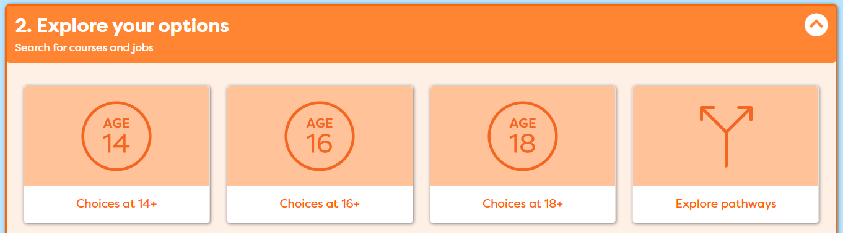
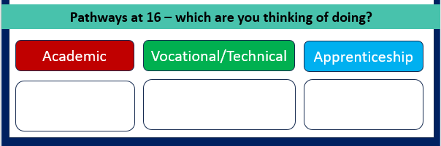
10 mins
Task:
Explore different pathways
Think about which might suit you
Notes:
When students find jobs of interest, encourage them to tag the job sector to add to their Career Tools.

Slide 43

Tell the group
Which three job sectors were suggested by the quiz
Which jobs did you look at?
What did you learn?
Which pathways are you thinking of?
Notes:
Ask students if they know what a career means?
Encourage students to explain what is meant by the word career then reveal the answer.
Ask students to share it they have any idea about what sort of job or work they might like to do one day?

Slide 44
careerpilot.org.uk
See you next time
Digital Postcard:
What we did and what you could do now

Slide 45
What inspires you?
Look at Jobs and pathways
Explore courses and make plans

Slide 46








What you will get from this lesson
Review what we have done
Think about your next steps
Find out how to look for courses
Do a quiz

Slide 47
Sign in to Careerpilot, look at report
1
2
careerpilot.org.uk
Notes:
Show students that if they are new to Careerpilot, they need to register to use the website.
They must click on the ‘Register’ button in the top right corner to open up a short registration form that takes a few minutes to complete.
Remind students to use their school email address to register and to click on your school from the drop down list.
Students that have already registered just need to log in with their email and password.

Slide 48
Reminder about pathways – which might suit you?
What pathways can I choose at the end of Y11?
Academic
Vocational/Technical
Apprenticeship
Mostly in a 6th Form or 6th Form College
Mostly in a
local college
Mostly in a workplace
Notes:
Ask them to say what pathways they can do at 16.

Slide 49
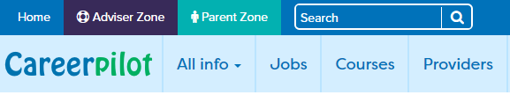
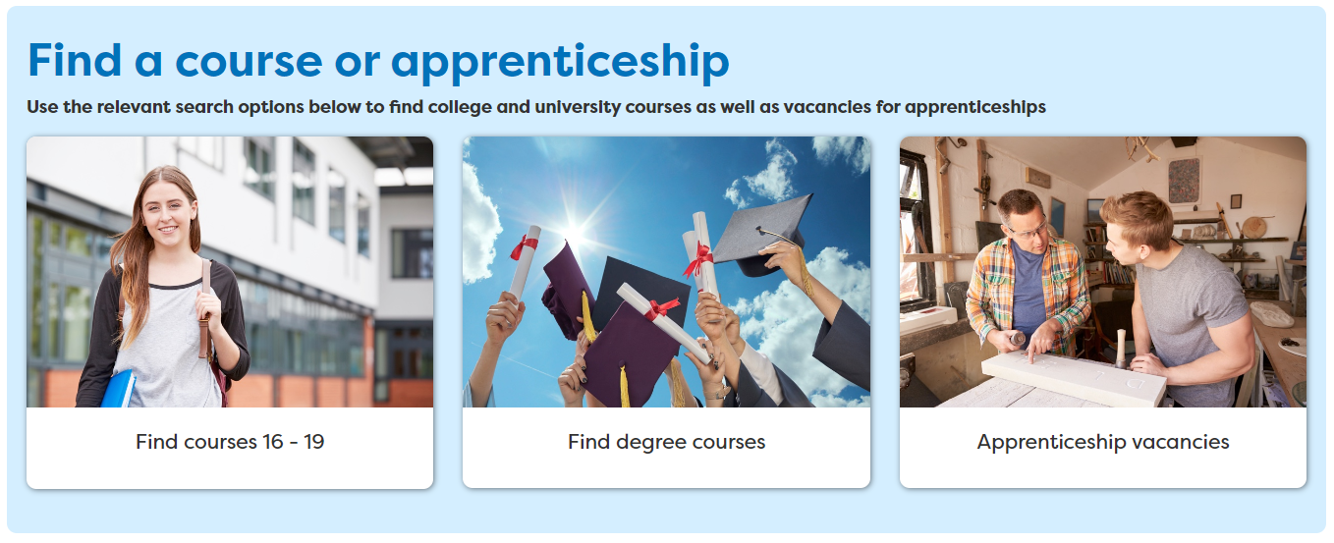
Where could you look for a course?
Or look on your school’s website if they have a 6th Form
Notes:
Explain that there are three pathways but in all pathways there are levels of quals. Level 2 is getting 5 GCSEs grade 4-1.
Show them the other levels and make the point that all pathways can lead to a degree.
The bit of the qualification ladder we are mainly talking about today is their choices after GCSEs

Slide 50
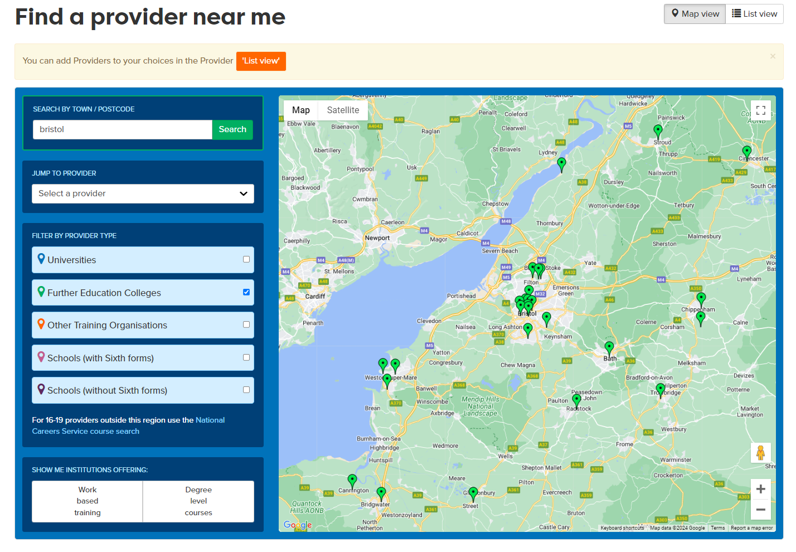
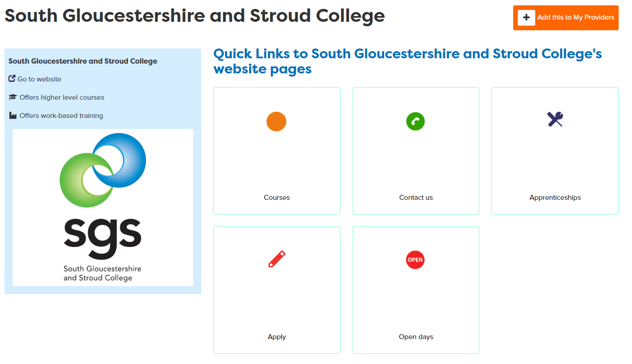
Where could you look?
College open days are a great way to see what they offer
Notes:
Can click through to providers site or click orange circle to see courses. Add + to Career Tools if you like it.

Slide 51
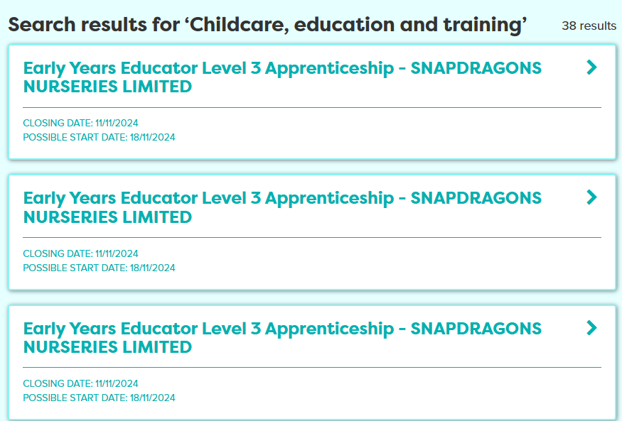
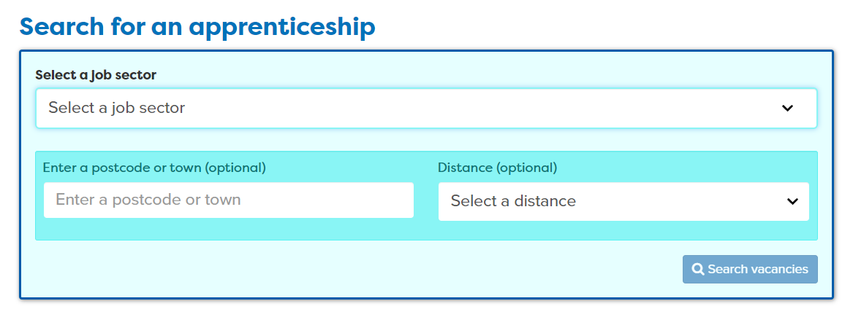
Looking for an apprenticeship
Notes:
Explain how to use apprenticeship search and tag any of interest

Slide 52
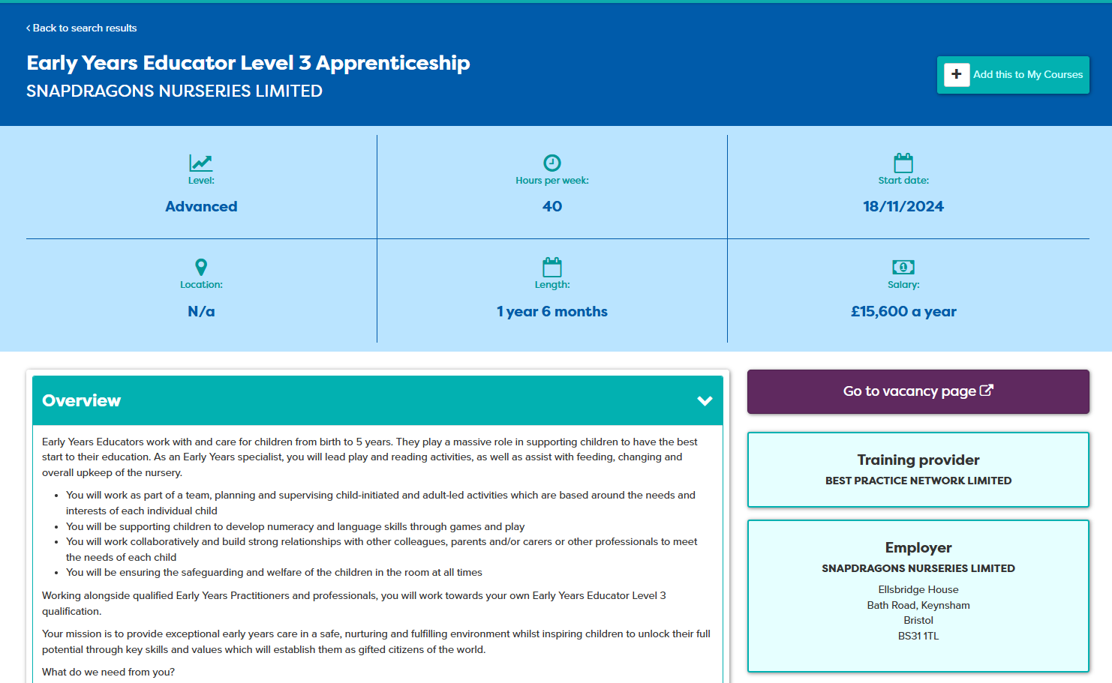
Looking for an apprenticeship
Notes:
Explain how to use apprenticeship search and tag any of interest

Slide 53
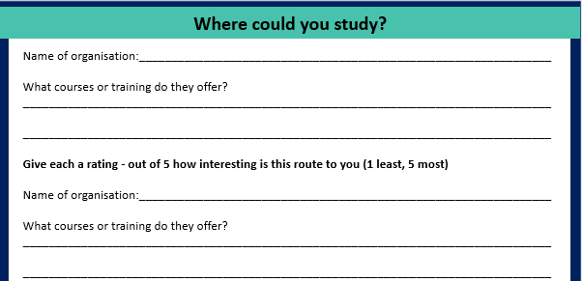
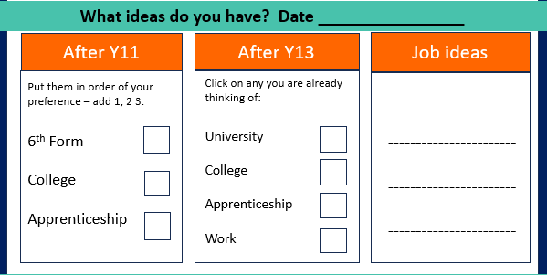
Exploring courses
1. Record what you find out about courses in your workbook
2. Add your ideas about your future plans in your workbook
30 mins
Notes:
Students now have time to look at different courses and record what they have found.
Advisers has time to go round individuals and discuss their plans and suggest actions

Slide 54
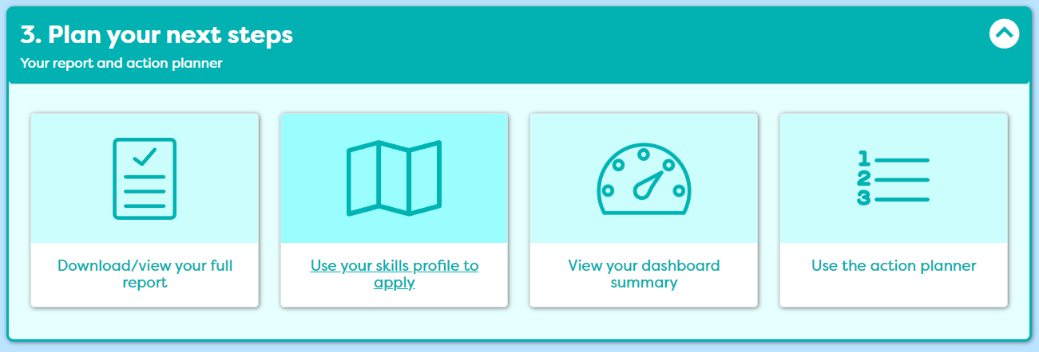

Write two actions you will take to explore your career further
5 mins
Notes:
Students can choose what sort of course/training they look for.

Slide 55
Share with the group
Your most preferred post 16 pathway (at the moment)
One course you found out about
Notes:
Group share of information and choices

Slide 56




Quiz

Slide 57
You have been amazing!
Good luck with your future plans.
We hope you feel…
Notes:
Can leave out of short of time

Slide 58



But what does it take to be a successful learner?

Slide 59

What makes a successful learner?
Can take responsibility for their own learning
Questions everything to make sure they understand
Are driven by what interests them
Where are you now?
Which are your strongest?
Which one will you work on?
Can keep going through challenges
Are determined to succeed
Exercise their minds and their bodies
Know how and when to ask for help
1
Can learn from their mistakes

Slide 60

The bigger picture - Qualification Pathways
Academic
Technical/Vocational
Apprenticeship
Degree Achieved
Degree Year 2
HND
Foundation Degree Y2
Higher Apprenticeship
Degree Year 1
HNC
Foundation Degree Y1
Higher Apprenticeship
A levels
T LEVEL other Level 3 - BTEC/OCR
Advanced Apprenticeship
5 x GCSEs 4 - 9
T Level Foundation and other Level 2
Intermediate Apprenticeship
GCSEs 1 - 3
Notes:
Optional to show

Slide 61


What Skills does the jobs need?
Have you got any skills already that match to the job?

