Slide 1


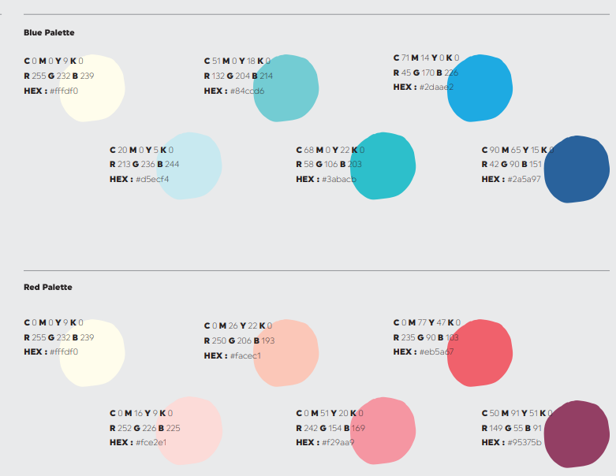
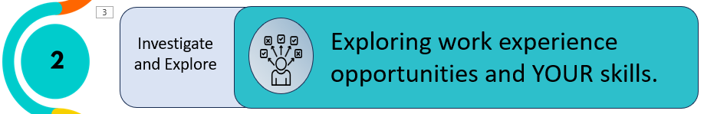


Digital Postcard
Lesson 2
This is what we did
You:
Identified a range of job roles in a specific working context;
Explored local companies that might offer work experience placement opportunities;
Recognised essential workplace skills you have developed/could develop.
Looked at what skills you have that map to a work experience job role.
This is what you can do now
Go to Careerpilot.org.uk, sign in and look at your Career Tools report;
Ask your family and friends for ideas for work experience placements;
Use online methods to find possible work experience placements e.g AI, Google Maps; Remind your self of the ways to look for work experience placements.
This is what we will do next time
How to contact employers;
How to be well prepared for your placement;
Knowing when you are successful.
How to access an easy CV builder.
careerpilot@bath.ac.uk

